Slide 1
Keeping Your Child Engaged- Truancy Prevention and Intervention

Slide 2

Agenda
Brief Overview of Local Rules
Truancy in DC
Reasons for Truancy
Impact of Truancy
Research Based Strategies
Resources
Next Steps
Notes:
Session Overview

Slide 3
Objectives
Participants will:
    Know the Law
    Review the Impact of Truancy
    Identify Strategies to Address Truancy

Slide 4
Objectives
The Law

Slide 5

Compulsory Education Requirements
DC requires children from age 5-17 years old to attend a public school, private school, or to receive home-based instruction (homeschooling) until the student graduates or reaches their 18th birthday.

Slide 6

Select the statement that is true.
It is against the law to allow a child to miss school without an excused absence.
Your LEA must provide you with a list of valid excused absences.
Both statements are true.

Slide 7
Compulsory Education Cont.
Unexcused Absences. The absence of a minor from school without valid excuse is unlawful and may subject to parent/guardian to criminal prosecution.
Excused Absences. An educational institution must publish and make available to parents and students the list of valid excused absences

Slide 8

South Capitol Act
 | School Based Student Support Team
Review and address cause(s) Talk and partner with the student and parents or guardian; and IEP team, as applicable; Act as quickly as possible to address the issue; Recommend solutions and resources; Work with community, faith based and other agencies to address truancy, making referrals as needed and when available; and Develop and follow an action plan in consultation with the student and student’s parent or guardian.

Slide 9

Which of these statements is true?
Children aged 5 to 13 years of age- are reported to Child and Family Services Agency (CFSA) after 10 unexcused absences in a school year.
Children aged 14 and 17 years of age- are reported to the Court Services Division of the Family Court after 15 unexcused absences in a school year.
All children ages 5 through 17 are reported to the Metropolitan Police Department after 10 unexcused absences in a school year.
None of the above.

Slide 10
Post It Board Questions
TRUANCY/ ABSENTEEISM RATES

Slide 11
True or False?
Children who miss a lot of school in kindergarten and first grade, are a lot less likely to be doing well in school by the third grade.
        True
        False
Notes:
Why does it matter? Research shows that poor attendance in early years has a continuing impact on learning.

Slide 12
Impact of Truancy
Children who are truant are more likely to:
  Have lower grades
  Be suspended or expelled
  Drop out
  Be delinquent
  Unemployed after age 18
  Cost the community a lot of resources

Slide 13
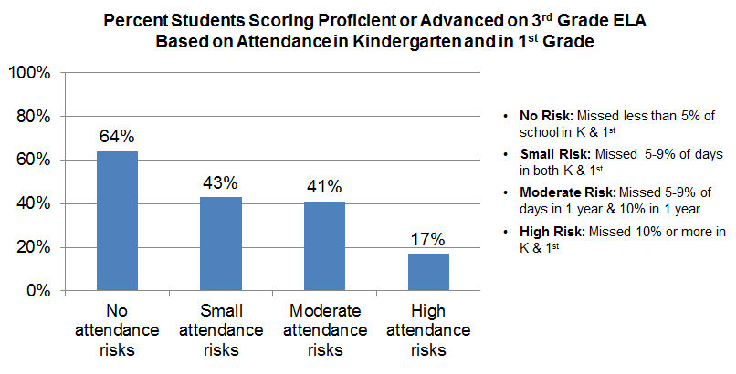
Impact of Truancy on Achievement
Source: Addressing Truancy: Innovative Approaches to Systemically Increasing Attendance and Reducing Chronic Truancy, US Department of Education, Supportive School Discipline, February 2013

Slide 14
What can I do as a parent?

Slide 15
Why is parental involvement important?
Research concludes that family has a major influence on children's achievement in school and through life.
Children spend only 14% of their time with a teacher
When schools, families, and community groups work together supporting learning:
  Children do better in school;
  Stay in school longer; and
  Like school more.

Slide 16
WHAT TO DO AT HOME
Rules and Boundaries
  Clear expectations, rewards, consequences
Set Aside Time
  Talk to your child (school, homework, friends, needs), be supportive
  Build a relationship with the teacher
Build Support Systems
  Peers, School (know school policy, expectations), Children’s friends (make them welcome in your home)
Routine
  Schedule, Homework Spot, Bedtime, Know Critical Calendar Events, Limit Non-Educational Time with Technology
Modeling
Maintain Your Family’s Health
Know your child’s school and education plan
  How does it build on strengths, address weaknesses
  What is your child expected to learn this year?
  What supports are available?

Slide 17
Partner with your Local School
TEACHERS | PARENTS | STUDENTS
Work with Families to Set Goals | Get the Child To School Every Day Ready To Learn | Take Responsibility for Learning
Communicate Progress | Support the School | Come to School Ready to Learn
Set Conditions for Success | Advocate for Child’s Best Interests | Respect the Learning of Others
No Excuses | No Excuses | No Excuses
Lyman Millard, Communications Director, Breakthrough Schools, June 2012

Slide 18
Post It Board Questions
REASONS STUDENTS ARE ABSENT

Slide 19
What can I do as a parent?
Find out why? Talk to your child and to your child’s teacher.
Work with your child and teacher to develop an action plan.
Ask for help in finding the right support (i.e. for academic, peer group, counseling, etc.)
Use available resources to remove any attendance barriers impacting your child.

Slide 20
INTERVENTIONS

Slide 21
Reasons for Truancy
School environment | Family | Personal
Relationships with teacher | Poverty | Low Self Esteem
Inappropriate academic placement | Homelessness | Poor Relationships with Other Students
Poorly applied attendance policies | Transportation issues | Feelings of Academic Incompetence
Fear/Safety | Family Conflict | Gang Involvement
Academic Failure | Parental Practices | Health Issues
Suspension or Expulsion | Substance Abuse | Drug and Alcohol Use
 | Living Situation

Slide 22
Strategies to Ensure Attendance
School environment | Family | Personal
Talk to your child’s teacher about your child’s hobbies, interests, or learning challenges; know when school starts; types of absences that are excused; and share the information with your child. | Talk to the school counselor, or teacher about need for food, clothing, supplies, medical attention or any other need. | Build on strengths, address weaknesses in and out of school via tutoring, arts, music lessons, sports clubs, community or church-related groups, or mentors, afterschool programs, athletics.
Contact the school regularly to check on progress, attendance, and behavior. Look for signs that your child is engaged or disengaged with the school. Learn what your school is doing to address bullying. | Homelessness/doubled up families: see the homeless liaison if transportation support is needed. | Help your child build support systems via community, faith based or mentoring agencies, and welcome your child’s friends if appropriate. Encourage your child to participate in clubs and activities at school.
Make sure the school is able to contact you regarding absences or other school issues. | Find support groups or community counseling for family issues or losses. Form a parent support group. | Ensure that your child is healthy and rested. Seek prompt medical attention when needed and follow ongoing treatments for ailments like asthma or diabetes.
Understand what your child is expected to learn. Ensure that your school plan addresses your child’s strengths and weaknesses. | Prioritize attendance and school- set clear expectations and routines for homework, sleep and waking up. | Reward your child for outstanding attendance and efforts. Reserve a regular time for one on one with your child on a monthly or weekly basis.

Slide 23
Contact Information:
Sheryl Hamilton
Director
Community Learning and School Support (CLASS) Unit
Office of the Elementary and Secondary Education
Office of the State Superintendent of Education (OSSE)
810 1st Street, N.E., 8th Floor
Washington D.C. 20002
202-741-6404 (office)
sheryl.hamilton@dc.gov
www.osse.dc.gov
Notes:
Session Overview

