Slide 1
Smart College Selection: Begin With The End In Mind
Office of the State Superintendent of Education
2012 Second Annual DC Financial Aid Conference
January 19, 2012

Slide 2
Begin With The End In Mind - On Time Graduation!
Goals
Highlight the value of smart college selection to the Double the Numbers goal and to students
Highlight national trends in college access and completion
Demonstrate how College Results Online (CRO) as a tool supports increased persistence
Provide opportunity to use CRO with underprepared college bound students

Slide 3
Double The Numbers Coalition
An initiative of College Success Foundation-DC
Citywide coalition focusing on timely college completion
Goal is to double the number – from 9% to 18%
Theory of action - Increase college-ready high school graduates, improve postsecondary transitions, increase college persistence,
Support and strengthen college access community - Roundtable meetings; Listserv; Collaboration

Slide 4
2006 research - 9% of DC 9th graders graduate from PSE
57% do not graduate
Ultimate outcome
32% of graduates do not enroll in college
69% of enrollees do not graduate college
*
Source: Double the Numbers for College Success: A Call to Action for the District of Columbia. DC State Education Office, October 2006. http://www.doublethenumbersdc.org/images/pdfs/doublingnumber.pdf

Slide 5
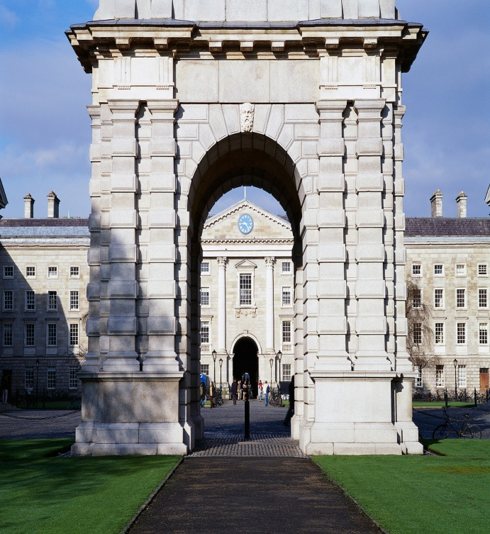
Begin With The End In Mind - On Time Graduation!
What’s your goal?
What’s your goal?
Get into any college
Graduate in 4-6 years

Slide 6
Begin With The End In Mind- On Time Graduation!
On Time Graduation!
The Value Proposition
There is no feeling like this for the student!
Its cost effective.
It’s ethical.
We build a body of evidence that it can be done.
We build a robust college going culture in schools.
We become good stewards of the students’ aspirations.

Slide 7
Begin With The End In Mind - On Time Graduation!
On Time Graduation
Formula for Success
We can make it happen!
Student
+ (Good Graduation Rates + Right Fit)
x (Strong Supports + Sweet Aid Package)
x Hard Work
> /= On Time Graduation

Slide 8
Begin With The End In Mind - On Time Graduation!

Slide 9
THE EDUCATION TRUST
WHO WE ARE
WHAT WE DO
The Education Trust works for the high academic achievement of all students at all levels, pre-kindergarten through college, and forever closing the achievement gaps that separate low-income students and students of color from other youth. Our basic tenet is this — All children will learn at high levels when they are taught to high levels.
Advocacy to help schools, colleges, and communities mount campaigns to close gaps
Research and policy analysis on patterns and practices that both cause and close gaps
Technical assistance to schools, colleges, and community-based organizations to raise student achievement and close gaps

Slide 10
Higher Education at EdTrust

Slide 11
College-going is on the rise for all students…
Note: Data for black, Hispanic, and low-income represent two-year moving average because of small sample sizes.
Source: NCES, Condition of Education (2010) and Condition of Education (2011)

Slide 12
But access isn’t the only issue

Slide 13
What about success?

Slide 14
Black and Latino Freshmen Complete College at Lower Rates Than Other Students
Six -Year Graduation Rates at 4-Year Institutions
Source: IPEDS First Look 2009-10, Table 7. Graduation rates at Title IV institutions, by race/ethnicity, level and control of institution, gender, and degree at the institution where the students started as full-time, first-time students: United States, cohort year 2003.

Slide 15
Graduation Rates at Top 10 DC TAG Colleges
OSSE, DCTAG Institutions Attended, (AY 2009-2010) and College Navigator.
Note: Data represent six-year graduation rates at four-year colleges and three-year graduation rates at two-year colleges.

Slide 16
What contributes to graduation rate gaps?

Slide 17
Low-income students are more likely to undermatch into less selective institutions, with lower graduation rates
Bowen, Chingos, and McPherson, Crossing the Finish Line, 2009.

Slide 18
1/5 of black and Hispanic students begin college at for-profit institutions
Source: EdTrust Analysis of IPEDS 2009

Slide 19
4-year for-profits have much lower graduation rates than non-profits
IPEDS First Look 2009-10, Table 7. Graduation rates at Title IV institutions, by race/ethnicity, level and control of institution, gender, and degree at the institution where the students started as full-time, first-time students: United States, cohort year 2003.

Slide 20
For-profits represent:
13% of enrollments
24% of Pell Grants and federal student loan dollars
48% of federal student loan defaults.
Ed Trust analysis of IPEDS, 12-Month Enrollment Survey, 12-month headcount enrollment, 2009-10; Majority staff calculation of data provided by U.S. Department of Education, 2008-09 in “Emerging Risk?: An Overview of Growth, Spending, Student Debt and Unanswered Questions in For-Profit Higher Education.” Senate HELP Committee. 24 June 2010; and Ed Trust analysis of FY 2009 data in “Institutional Default Rate Comparison of FY 2007, 2008, and 2009 Cohort Default Rates.”

Slide 21
Another two-fifths begin at public community colleges
Source: EdTrust Analysis of IPEDS 2009

Slide 22
Graduation rates at
public community colleges
Overall rate: 22%
Source: IPEDS First Look: Enrollment in Postsecondary Institutions, Fall 2009; Graduation Rates, 2003 and 2006 Cohorts; and Financial Statistics Fiscal Year 2009.

Slide 23
Chance of attaining a bachelor’s degree within six years, among students who begin at community college?

Slide 24
Only 12 percent.
Percent of students who started at a community college in 2003 and earned a BA degree by 2009
Source: Persistence and Attainment of 2003–04 Beginning Postsecondary Students: After 6 Years First Look, December 2010.

Slide 25
Add it all up…
Gaps in college-going
Undermatching
Low success rates at community colleges and for-profits
Graduation rate gaps

Slide 26
Some students are far more likely than others to attain a college degree
2x
3x
Source: NCES, Condition of Education (2010) and U.S. Census Bureau, Educational Attainment in the United States: 2010.

Slide 27
Young adults from high-income families are 10 times more likely to earn bachelor’s degrees by age 24
Tom Mortenson, Bachelor’s Degree Attainment by Age 24 by Family Income Quartiles, 1970 to 2009 (Oskaloosa, IA: Postsecondary Education Opportunity, 2010). http://www.postsecondary.org/default.asp http://www.publicagenda.org/files/pdf/struggling-in-america-topline.pdf

Slide 28
What can YOU do to change these trends?

Slide 29
Graduation gaps are not inevitable.
Source: IPEDS First Look 2009-10, Table 7. Graduation rates at Title IV institutions, by race/ethnicity, level and control of institution, gender, and degree at the institution where the students started as full-time, first-time students: United States, cohort year 2003.

Slide 30
College Results Online www.collegeresults.org

Slide 31
WHY CRO?
Some institutions are doing better overall - and with low-income and underrepresented minority populations.
Why use CRO to help in your College Search?

Slide 32
How to Use CRO
Choose a College
Compare Colleges
Advanced Search

Slide 33
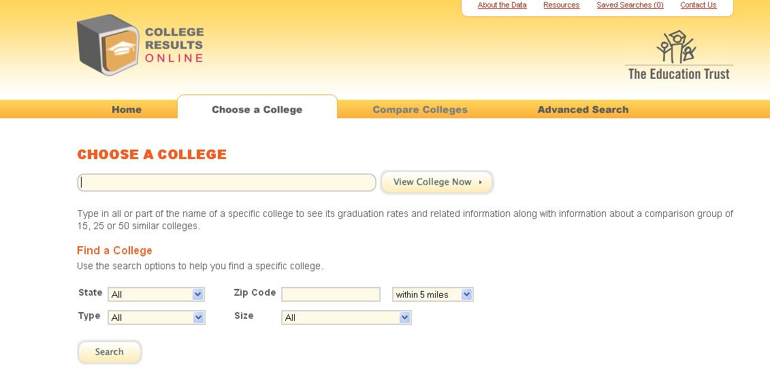

Slide 34
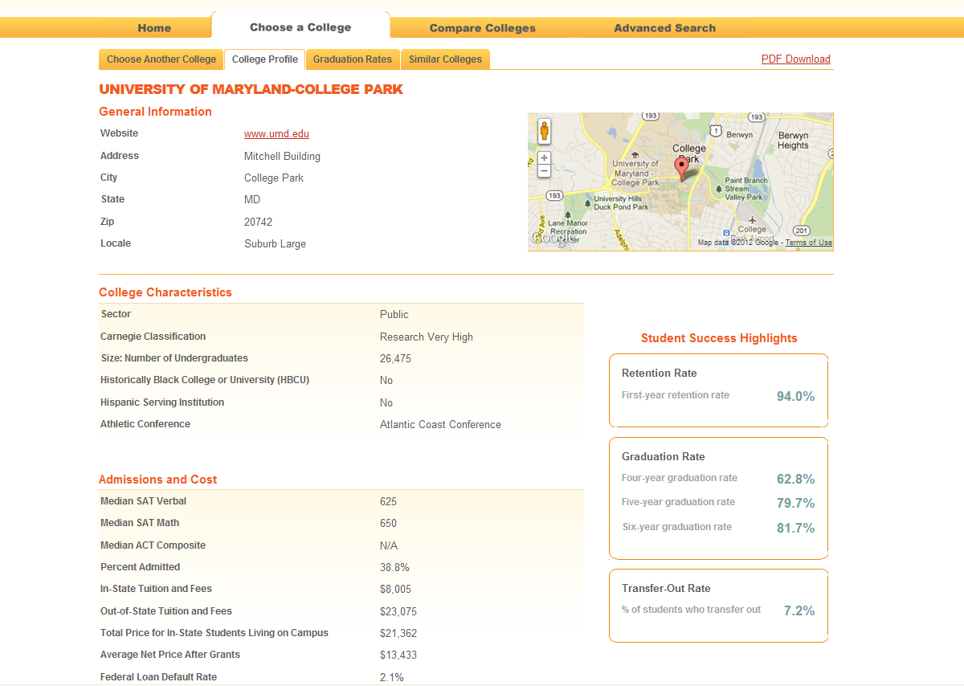

Slide 35
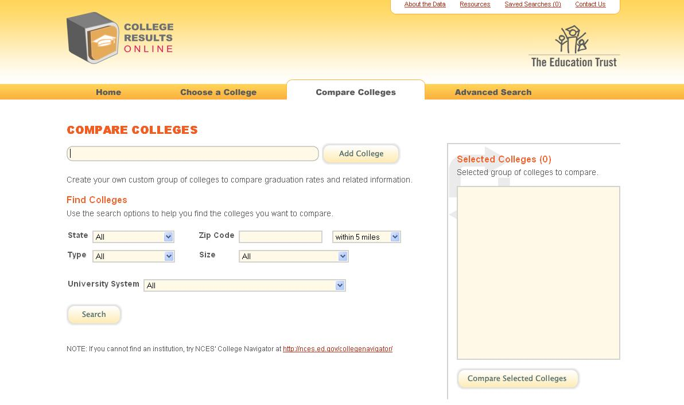

Slide 36
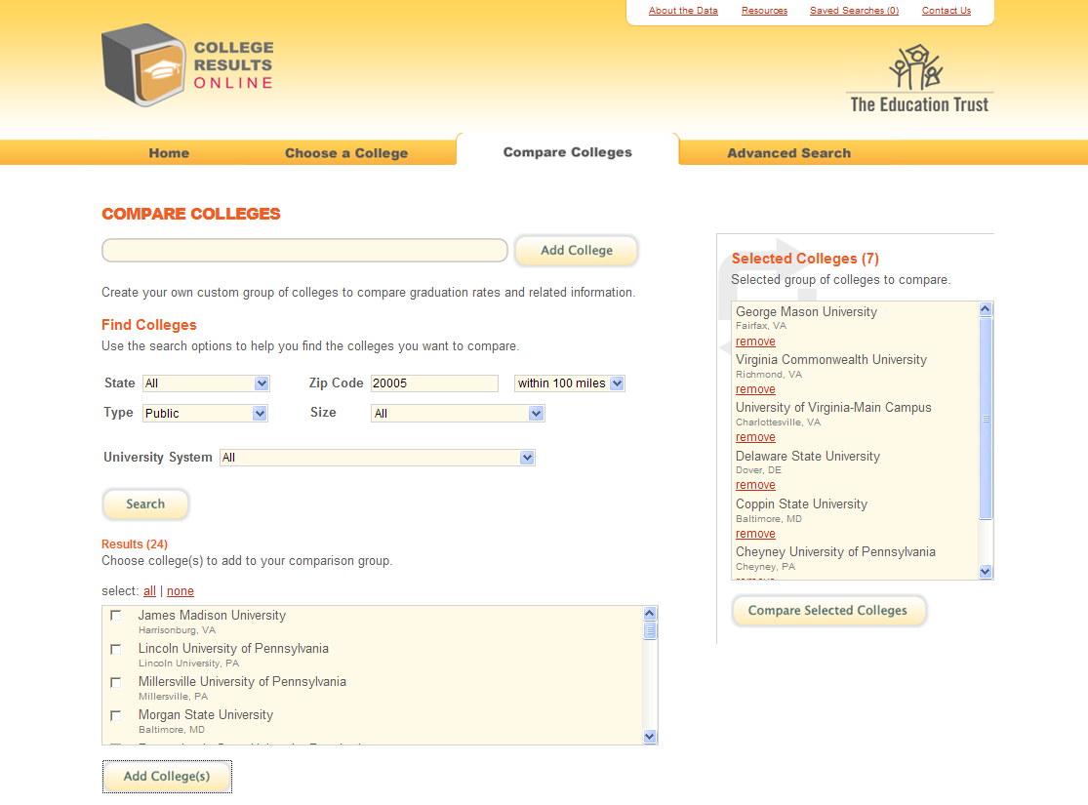

Slide 37
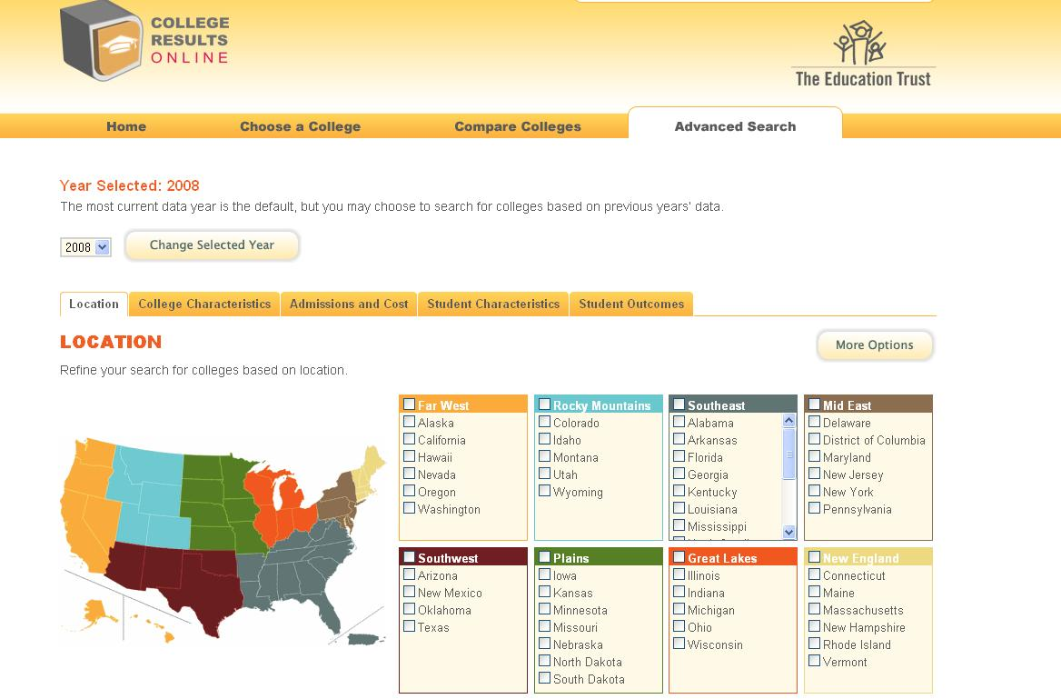

Slide 38
Examples of Advanced Search Options
Zip code
State
Public / Private Nonprofit / For-profit
Graduation rate range
HBCU / HSI
Cost range
SAT score range

Slide 39
Florida Public Four-Year Universities
College Results Online, 2009

Slide 40
A Tale of Two Schools
Florida State University
Median SAT in 2009 was 1185
Classified as Research Very High institution according to Carnegie Classification
Classified as “Very Competitive” by Barron’s
23% of students are URM
18% of students receive Pell
University of South Florida
Median SAT in 2009 was 1140
Classified as Research Very High institution according to Carnegie Classification
Classified as “Competitive” by Barron’s
27% of students are URM
26% of students receive Pell

Slide 41
FSU and USF are peers, with very different grad rates

Slide 42
Student Characteristics

Slide 43
Cost and Financial Aid: Average Grant Size Matters

Slide 44
Retention and Progression Rates

Slide 45
Grad Rates by Race or Gender

Slide 46
Gaps: Some schools do better than others at graduating all students at equal rates

Slide 47
Similar Students, Different Results
Note: URM stands for underrepresented minority students and includes African Americans, Hispanics, and American Indians.
Source: College Results Online 2009 Dataset.

Slide 48
CRO Counseling Exercise: How would you use CRO to advise a student?
Hypothetical example of a DC student
Use CRO data to advise student
There’s no “right” answer!

Slide 49
Top College Destinations for DC TAG recipients
DC TAG Top 50 Rank | Institution | 3-Year Grad Rate (2-year colleges) | 4-Year Grad Rate (4-year colleges) | 6-Year Grad Rate (4-year colleges)
1 | Montgomery College | 14% | - | -
2 | Trinity University | - | 24% | 38%
3 | Virginia State University | - | 25% | 44%
4 | Delaware State University | - | 16% | 37%
5 | PG Community College | 5% | - | -
6 | U. of MD – Eastern Shore | - | 18% | 32%
7 | Bowie State University | - | 15% | 29%
8 | Penn State University | - | 62% | 85%
9 | Temple University | - | 38% | 67%
10 | Norfolk State University | - | 12% | 31%
Source: OSSE, DCTAG Institutions Attended, (AY 2009-2010) and College Navigator.
Note: Data represent six-year graduation rates at four-year colleges and three-year graduation rates at two-year colleges.

Slide 50
CRO Counseling Exercise: How would you use CRO to advise a student?
Consider Michelle:
African American female
Qualifies for free lunch
Slightly below-average academically, but highly motivated
SAT score is 890 (490 math and 400 verbal)
Wants a traditional, residential college experience
Initial inclination: Attend Trinity University - #1 DC TAG four-year college
Willing to travel up to 4 hours (200 miles) away from home

Slide 51
What advice would you give to Michelle?
Use the CRO data to consider:
Graduation rates
Graduation rates by race and gender
Cost – including net price
Other factors important to Michelle

Slide 52
Begin With The End In Mind- On Time Graduation!
On Time Graduation!
The Value Proposition
There is no feeling like this for the student!
Its cost effective.
It’s ethical.
We build a body of evidence that it can be done!
We build a robust college going culture in schools.
We become good stewards of the students’ aspirations.

Slide 53
Contact Us
Mamie Lynch Joseph Yeado
mlynch@edtrust.org jyeado@edtrust.org
Stay connected with The Education Trust online:
www.twitter.com/edtrust www.facebook.com/edtrust
Yvonne Green
Double the Numbers Coalition
ygreen@collegesuccessfoundation.org

