Slide 1
Composition Prompt Training
Tamara Reavis
Director of Standards, Assessment, and Accountability
November 9, 2011
www.osse.dc.gov

Slide 2
Agenda
Welcome and Introductions
Overview of Training
Learning 1 – Examining Previous Composition Prompts
Learning 2 – Examining New Composition Prompts Aligned to Common Core
Learning 3 – Group Sharing
Closure and Evaluation
Notes:
This slide has two purposes:
Highlight the variety of public school options in the district of Columbia

Slide 3
Session Outcome
By the end of the session, participants will:
Review pervious DC CAS composition prompts;
Examine new composition prompts aligned to Common Core;
Share promising practices to bridge depth of knowledge.
Notes:
This slide has two purposes:
Highlight the variety of public school options in the district of Columbia

Slide 4
Depth of Knowledge (Handout)
Level 1: Recall
Level 2: Skill / Concept
Level 3: Strategic Thinking
Level 4: Extended Thinking
Webb, Norman L. and others. “Web Alignment Tool” 24 July 2005. Wisconsin Center of Educational Research. University of Wisconsin-Madison. 2 Feb. 2006. <http://www.wcer.wisc.edu/WAT/index.aspx>.
Notes:
This slide has two purposes:
Highlight the variety of public school options in the district of Columbia

Slide 5
Depth of Knowledge (Handout)
Examine the verbs at each level.
What is the DOK Level of the majority of your classroom activities?
How could this resource be a better tool for your future composition activities?
Webb, Norman L. and others. “Web Alignment Tool” 24 July 2005. Wisconsin Center of Educational Research. University of Wisconsin-Madison. 2 Feb. 2006. <http://www.wcer.wisc.edu/WAT/index.aspx>.
Notes:
This slide has two purposes:
Highlight the variety of public school options in the district of Columbia

Slide 6
Previous Composition Prompt – Grade 4 (2009)
Think about an activity that you enjoy sharing with someone in your family or with your friends. It could be eating or preparing a favorite meal, listening or dancing to music, playing or watching a game or sport, visiting a special place, or doing some other activity.
Write a personal narrative about your favorite time enjoying this activity. In your narrative, include details about when and where the experience happened and who shared the experience with you. Describe what happened during the experience and why you enjoyed the activity. Be sure your narrative has a beginning, a middle, and an end.
Use your Planning and Draft Pages when planning your narrative. Then write your narrative on the lined pages in this Test Booklet. Only what you write in this Test Booklet will be scored.
Notes:
This slide has two purposes:
Highlight the variety of public school options in the district of Columbia

Slide 7
Previous Composition Prompt – Grade 4 (2009)
Standard: 4.W-I.1
Write stories that organize plot events in an order that leads to a climax.
What level of knowledge is reflected in this prompt? What skills must a student have to be successful on this prompt?
Notes:
This slide has two purposes:
Highlight the variety of public school options in the district of Columbia

Slide 8
Previous Composition Prompt – Grade 7 (2009)
Imagine a perfect vacation.
In a well-developed composition, describe what you consider to be a perfect vacation. Be sure to include specific details about the things you would see, hear, and feel while taking this vacation.
Use your Planning and Draft Pages when planning your composition. Then write your composition on the lined pages in this Test Booklet. Only what you write in this Test Booklet will be scored.
Notes:
This slide has two purposes:
Highlight the variety of public school options in the district of Columbia

Slide 9
Previous Composition Prompt – Grade 7 (2009)
Standard: 7.W-E.4
Write persuasive essays that
State a clear position
Provide evidence in support of the position
What level of knowledge is reflected in this prompt? What skills must a student have to be successful on this prompt?
How does the level of knowledge in this prompt compare with the level of knowledge in the Grade 4 prompt?
Notes:
This slide has two purposes:
Highlight the variety of public school options in the district of Columbia

Slide 10
Previous Composition Prompt – Grade 10 (2009)
Directions: Think carefully about the ideas presented in the question below and the assignment that follows.
“If you don’t like something, change it. If you can’t change it, change your attitude.”
-Maya Angelou
Assignment: Who is likely to accomplish more—the person who adjusts to society as it is, or the person who attempts to change it? Plan and write an essay in which you develop your ideas on this theme. Support your position with reasoning and examples taken from your reading, studies, experiences, or observations.
Use your Planning and Draft Pages when planning your essay. Then write your essay on the lined pages in this Test Booklet. Only what you write in this Test Booklet will be scored.
Notes:
This slide has two purposes:
Highlight the variety of public school options in the district of Columbia

Slide 11
Previous Composition Prompt – Grade 10 (2009)
Standard: 10.W-E.3
Write interpretations of literary texts that:
extend beyond summary and literal analysis;
address the author’s techniques;
draw inferences about its effects;
support inferences through references to the text or other works.
What level of knowledge is reflected in this prompt? What skills must a student have to be successful on this prompt?
How does the level of knowledge in this prompt compare with the level of knowledge in the Grade 4 and Grade 7 prompt?
Notes:
This slide has two purposes:
Highlight the variety of public school options in the district of Columbia

Slide 12
Common Core State Standards
New composition prompts are aligned to
Anchor Standard for Writing 9 - Draw evidence from literary or informational texts to support analysis, reflection, and research.
Prompt will also be aligned to a reading standard. Responses will demonstrate degrees of mastery of that reading standard.
Grade 4 – CC.4.R.I.1, CC.4.R.L.2, and CC.4.R.L.4;
Grade 7 – CC.7.R.I.1, CC.7.R.I.8, CC.7.R.L.1, and CC.7.R.L.2;
Grade 10 – CC.9-10.R.I.1, CC.9-10.R.I.2, CC.10.R.I.3, CC.9-10.R.L.2, and CC.9-10.R.L.6.
Notes:
This slide has two purposes:
Highlight the variety of public school options in the district of Columbia

Slide 13
Activity - Examining New Composition Prompts Aligned to Common Core
Select Grade Level Common Core Aligned Prompt.
Read the prompt and answer the item independently.
When prompted, turn to an elbow partner and share.
Review responses by using the Key Details and Exemplary Response.
Return your partner’s response for review.
Answer the Discussion Questions.
Complete the Action Steps Worksheet.
Notes:
This slide has two purposes:
Highlight the variety of public school options in the district of Columbia

Slide 14
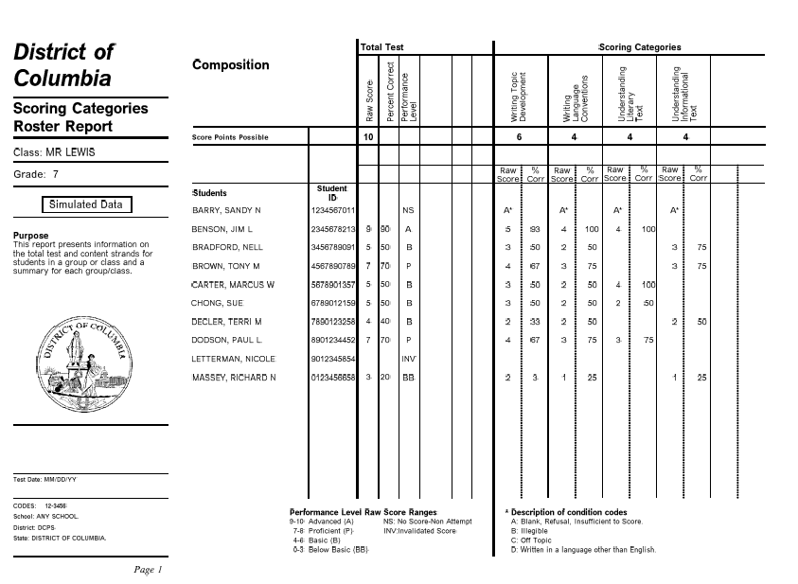

Slide 15
Where to find more information
Common Core State Standards website
http://www.corestandards.org/
2012 DC CAS Resource Guide
http://osse.dc.gov/publication/dc-cas2012-resource-guide
Notes:
This slide has two purposes:
Highlight the variety of public school options in the district of Columbia

