Slide 1
Helping Make Schools Healthy Places to Learn
Division of Wellness and Nutrition
Nichelle Johnson
Healthy and Wellness Specialist
NichelleL.Johnson@dc.gov
Sam Ullery
School Garden Specialist
Sam.Ullery@dc.gov

Slide 2
Social Media
Join the DC Parent and Family Engagement Summit conversation on Twitter!
#DCParents
Follow OSSE on Twitter @OSSEDC

Slide 3
What is the Health Schools Act?

Slide 4
Eat Healthy
All schools are serving free, nutritious breakfasts
Meals are tastier with more fruits, veggies, whole grains, and local foods
Parent Tip:
Look at the school’s monthly menus to see the different types of fruits and veggies that will be served. Encourage your son/daughter to try a different fruit or veggie.

Slide 5
Stay Active
Schools are increasing amounts of time for physical activity and physical education each year
Schools are promoting ways for students to be active throughout the week
Parent Tip:
Encourage your child to be active at home and participate in fun physical activities together (i.e. jump rope, walks to the park, etc.)

Slide 6
Learn Healthy Habits
Students are learning the skills and knowledge to live safe and healthy lives
Schools are tobacco-free on school property and at off-campus school-sponsored events
Parent Tip:
Involve your child in daily chores that affect their health such as: creating a grocery list, reading the energy and water bills, and cooking.

Slide 7
Care for the Environment
Gardens are blossoming across the District schools
Recycling programs are helping conserve our natural resources
Parent Tip:
Start recycling and gardening at home
Volunteer to do small maintenance tasks at a school garden
Read the DDOE Environmental Literacy Plan here:

Slide 8
Create Healthy School Communities
School wellness teams are key to promoting the Healthy Schools Act
Schools are adopting healthy vending and fundraising
Parent Tip:
Become familiar with the school’s local wellness policy
Participate in or establish a school wellness committee
Help schools with healthy fundraisers (i.e. candle sales, 5K)

Slide 9
Healthy Schools Act Quiz
Eat Healthy: All schools are a serving this meal free to all student.
Breakfast
Stay Active: Some schools are committed to recess everyday in an effort to increase this:
Physical Activity
Learn Healthy Habits: What test measures student knowledge in health- related categories?
DC CAS Health and Physical Education Test
Care for the Environment: How many school gardens are in DC?
93
Create Healthy School Communities: This group is essential to promoting the Healthy Schools Act.
School Wellness Team
What are 3 items that can be found on a school’s local wellness policy?
Nutrition Standards, PE Goals, Recycling Goals etc…

Slide 10
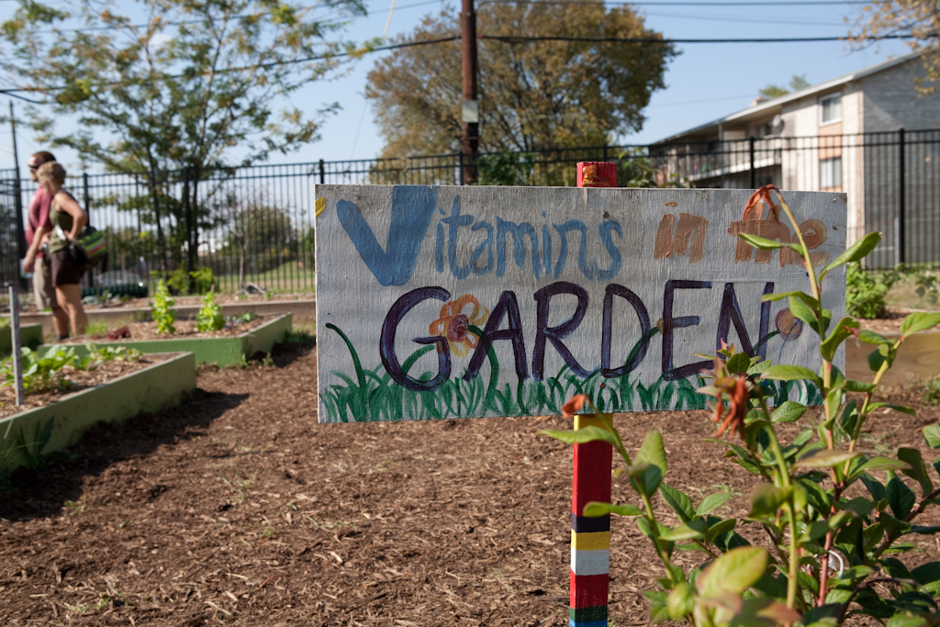
Thank You
Question?

