Slide 1
Hands on with LearnDC
Athena Hernandez Director of Communications, Office of the State Superintendent of Education
Jeffrey Noel Director of Data Management, Office of the State Superintendent of Education

Slide 2
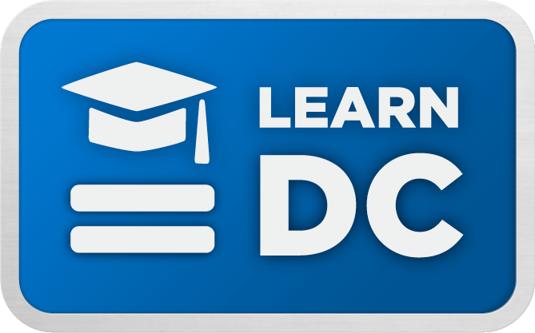
Notes:
LearnDC is a one-stop source for resources and information about education that create opportunities for DC kids in college, careers and life.
We are working hard to improve DC public schools, and LearnDC empowers families with the school information they need, but may not have been able to access in the past.
All information is available online and can be accessed by personal computer, tablet, or at any DC public library.

Slide 3
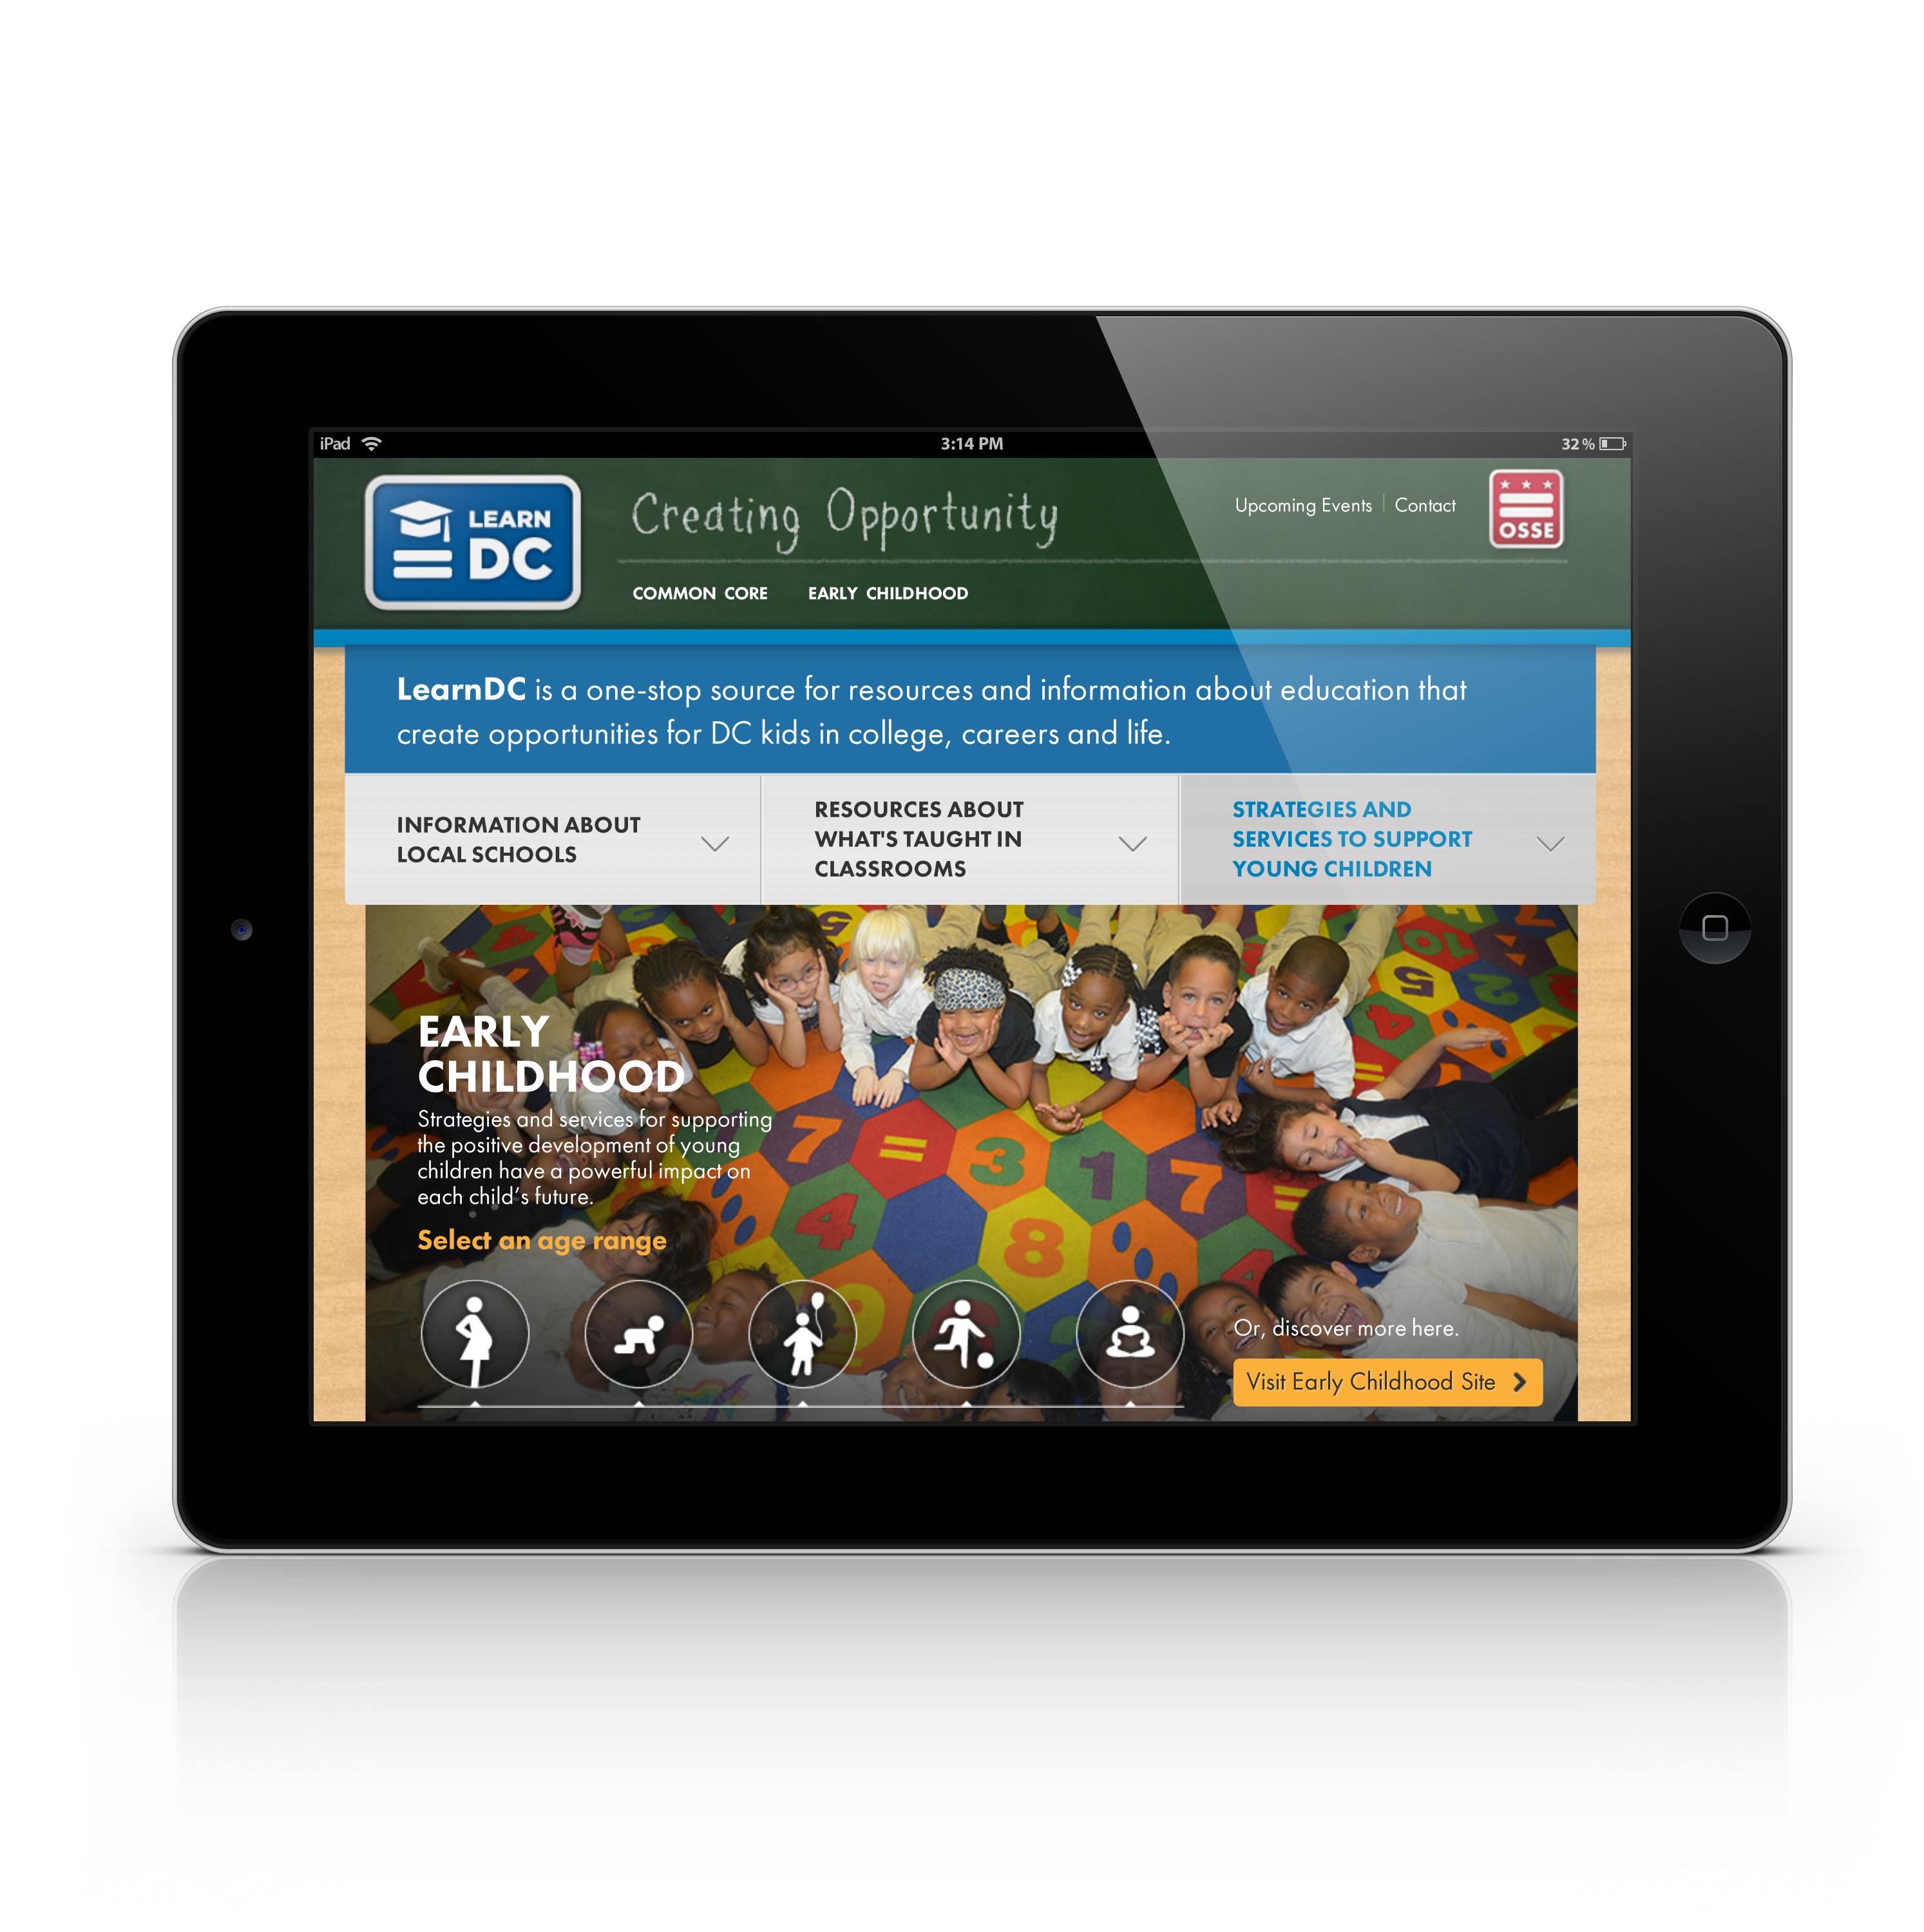
About LearnDC.org
What’s taught in classrooms
Support for young children
Profiles of local schools
Notes:
LearnDC is a growing site that empowers all parents.
LearnDC offers valuable resources on early childhood education, classroom instruction, and accountability.
For the first time, LearnDC will now be providing individual school report cards, allowing you to see how each school in the District is performing.

Slide 4
We Need You
Engage with LearnDC by:
Contact us on LearnDC.org
Complete a comment card
Take our online survey: bit.ly/learndcfeedback
Notes:
LearnDC is a collaborative initiative led by the Office of the State Superintendent of Education (OSSE) in partnership with other agencies and organizations that support young people in DC.
Your feedback is critical. Consider the school profiles and let us know what you think and what else you’d like to see:
Comment directly via Contact Us on the site
Complete a comment card
Take our online survey

