Slide 1
FY22 CACFP Annual Training Town Hall
July 2021

Slide 2
Child & Adult Care Food Program
Physical Distancing in CACFP through June 2022

Slide 3
Physically Distanced Meals Through June 2022
  Why did USDA extend the waivers as we return to regular operations?
  While students return to in-person learning:
  some arrangements may be needed within facilities and school buildings to continue to support social distancing during meal times
  provide options for children and families on days when children are participating in school remotely.
  non-congregate feeding flexibilities provide schools and child care operators the opportunity to provide meal pick-up option for students learning virtually, and also facilitate grab-and-go meals for students attending in person.

Slide 4
Physically Distanced Meals Through June 2022
Available waivers
#87 Non congregate meal service (ends June 2022)
Continues the flexibility allowing institutions to serve meals in a non-congregate setting and utilize a grab-and-go method.
#88 Meal time flexibility (ends June 2022)
#89 Parent/Guardian Pick up (ends June 2022)
Continues the flexibility allowing parents/guardians to pick-up meals on behalf of their enrolled child(ren).
#91 Meal Pattern flexibilities (Grains & Milk) (ends June 2022)
FNS is waiving the following CACFP requirements:
  That at least one serving per day, across all eating occasions, must be whole grain-rich, at &CFR 226.20(a)(4)(i)(A) and 226.2( c)
  That the crediting of grain by ounce equivalents must be fully implemented by October 1, 2021, at 7 CFR 226.20 ( c); and,
  That low-fat milk (1 percent) must be unflavored at 7 CFR 226.20(a)(1)(iii) and 226.20( c). –Not applicable to CACFP At-Risk.
    All other meal pattern requirements remain in effect.
#93 Area-eligibility exemption for at-risk and fdch (ends June 2022)
Allows all CACFP At-risk afterschool programs to operate and receive reimbursement regardless of location.
Allows all family day care homes to serve meals to enrolled children at the Tier 1 rate regardless of location.
#96 Sponsor monitoring (ends 30 days after the end of the public health emergency)
Allows sponsoring institutions to continue implementing desk audits in place of onsite monitoring.
Notes:
We shared this same information with you in April. This just serves as a reminder and an opportunity to highlight waivers that are new for FY 22
GO OVER THESE ITEMS QUICKLY.
We will talk about these in more detail in the next two slides.

Slide 5
Physically Distanced Meals Through June 2022
What’s different for fiscal year 2022?
#91 Meal Pattern flexibilities (Grains & Milk) (ends June 2022)
FNS is waiving the following CACFP requirements:
  That at least one serving per day, across all eating occasions, must be whole grain-rich, at &CFR 226.20(a)(4)(i)(A) and 226.2( c)
  That the crediting of grain by ounce equivalents must be fully implemented by October 1, 2021, at 7 CFR 226.20 ( c); and,
  That low-fat milk (1 percent) must be unflavored at 7 CFR 226.20(a)(1)(iii) and 226.20( c). –Not applicable to CACFP At-Risk.
    All other meal pattern requirements remain in effect.
#93 Area-eligibility exemption for at-risk and FDCH (ends June 2022)
Allows all CACFP At-risk afterschool programs to operate and receive reimbursement regardless of location.
Allows all family day care homes to serve meals to enrolled children at the Teir 1 rate regardless of location.
All CACFP operations flexibilities must be approved by the State agency before implementation, including extensions for FY 21.
Notes:
Two waivers have been greatly changed for fiscal year 2022.
Waiver #91 Meal Pattern Flexibilities
At one point, USDA allowed CACFP sponsors to waive and not serve any component of the meal pattern. You had to offer a good reason of course.
This has changed.
There are three specific meal pattern requirements that you can request to waive.
1) Offering the whole-grain rich item at least once a day.
2) Measuring whole-grains in ounces, and
3) When serving low-fat milk it must be unflavored.
Waiver #93 Area-eligibility Waiver
Any afterschool program or family day care home can participate regardless of its location.
This is an opportunity to ramp up recruitment.
- How can we work on this together?
- How can the State agency support your outreach efforts? Please drop ideas in the chat.

Slide 6
Physically Distanced Meals Through June 2022
What’s the same for fiscal year 2022?
#87 Non congregate meal service (ends June 2022)
Continues the flexibility allowing institutions to serve meals in a non-congregate setting and utilize a grab-and-go method.
#88 Meal time flexibility (ends June 2022)
#89 Parent/Guardian Pick up (ends June 2022)
Continues the flexibility allowing parents/guardians to pick-up meals on behalf of their enrolled child(ren).
    All other meal pattern requirements remain in effect.
#96 Sponsor monitoring (ends 30 days after the end of the public health emergency)
Allows sponsoring institutions to continue implementing desk audits in place of onsite monitoring.
All CACFP operations flexibilities must be approved by the State agency before implementation, including extensions for FY 21.
Notes:
-- PUT THIS IN THE CHAT: Who is interested in serving non-congregate meals this year? Yes or No? Why?

Slide 7
ECE health & safety guidance and CACFP meals
On site Meals - Infants
While feeding infants or very young children, staff should:
  Pull long hair off neck, as in a pony-tail;
  Wear a large, button-down, long-sleeved shirt;
Remove and wash their clothing and/or the child’s clothing if touched by any secretions; and
Wash their hands or body if touched by secretions or after handling soiled clothes.

Slide 8
ECE health & safety guidance and CACFP meals
On site Meals - Children
Child care facilities must follow all applicable federal and local food safety requirements. Additionally, child care providers should follow the below recommendations.
All child care providers should serve meals following the physical (social) distancing and hygiene guidance.
Meals should be eaten outdoors as much as possible. Indoor meals should take place in well ventilated spaces.
Meals should be served individually. If meals are typically served family style or via self-service stations (such as hot bars and salad bars), child care facilities should discontinue this practice and, instead, individually plate each child’s meal so that utensils are not shared.
Children must wash hands before and after eating, drinking, or handling food.
Child care facilities should use disposable foodservice items (e.g., utensils, dishes). If disposable items are not feasible or desirable, child care facilities must implement procedures for all non-disposable foodservice items to be either manually washed, rinsed, and sanitized in a three-compartment sink or in a dishwasher.

Slide 9
ECE health & safety guidance and CACFP meals
On site Meals – Children
If disposable foodservice items are not used, children must be provided with individual clean and sanitary eating and drinking utensils that must be washed and sanitized after each use. Children should not share utensils, cups, or plates during meals.
Staff must wash hands before and after handling food or helping children to eat.
Staff should follow all PPE best practices in Appendix B;
Tables and chairs should be cleaned and sanitized before and after the meal.
If handling individual lunch boxes, staff should wash their hands between the handling of each lunch box. Food items should be removed from the lunch box and placed with the child, or plated separately, and then the lunch box should be returned to the child’s cubby.
Staff should routinely clean, disinfect, and sanitize surfaces and objects that are frequently touched such as kitchen countertops, cafeteria and service tables, door handles, carts, and trays (if applicable).
Child care facilities should avoid sharing of utensils and other personal items.
Note: Children may open and handle their own lunch boxes if developmentally appropriate.

Slide 10
Emergency Shelter Participant Age Waiver
Flexibility offered
Participants through the age of 24 years old may be served meals and claimed for reimbursement.
  The waiver increases the maximum age of eligible participants from 18 to 24 years old.
When does the waiver expire?
30 days after the end of the federal declaration of the public health emergency.
How to implement
Apply current practices to the new age group.
Notes:
Use the meal pattern for CACFP 6 – 18 and increase portion sizes.

Slide 11

USDA CACFP Waivers
All of the following can be found on USDA’s FNS Policy Website:
https://www.fns.usda.gov/cacfp/policy
AND
in the monthly OSSE’s Division Newsletter “Beyond the Tray”

Slide 12
Waiver Registration and Reporting
Waiver Registration
  Continue to complete and update the waiver registration spreadsheet.
  Submit as part of your FY 22 application submission.
Waiver Reporting
Complete and submit the Claim Waiver Addendum along with your monthly claim for
reimbursement.
  Only complete this form if you have registered for and are implementing a meal service waiver.
  The meals listed on this form must also be included on the claim for reimbursement.

Slide 13
Important USDA Updates
Pandemic Cost Reimbursement Payments
  DC will issue checks before September 30, 2021.
  Eligible institutions = Institutions that submit claims between September 2020 and the first 90 days after the end of the federal COVID-19 pandemic.
  Organizations that have not submitted a claim by August 2021 must submit a statement certifying that they will submit a claim before the end of the eligibility period in order to receive funding.
Civil Rights Data Collection Change
  Visual racial and ethnicity determination must cease.
  Alternative determination methods: written self-identification on forms such as enrollment, IES, etc.
    If information is not available via these documents, then the participant’s racial/ethnicity identification must be marked as “unknown” in Orchard and on the Master Enrollment List.
    For the purposes of the federal child nutrition programs, do not ask a participant to identify their race or ethnicity during a compliance review or meal observation.
    If this section of the a CNP form is left blank, you can ask a participant if they would like to complete this section.

Slide 14
Procurement Practices
Food, Supplies & Services

Slide 15
Federal Child Nutrition Program Procurement Practices
Which purchases must use federal procurement practices?
All purchases that will be paid with federal meal reimbursement funds:
  Food purchases
    Vended meals or whole foods for self-preparation
  Supplies
    Cleaning supplies, office supplies, etc.
  Services
    Contractors that complete CACFP related duties

Slide 16
Federal Child Nutrition Program Procurement Practices
Procurement Categories
Micro-purchasing (up to $10,000)
Small purchases ($10,001 - $249,999)
Large purchases ($250,000 +)
There are specific procurement practices for each procurement category.
Documenting the implementation of practices is required for each category.

Slide 17
Federal Child Nutrition Program Procurement Practices
Annual Requirements
Requirements vary by procurement category and type of procurement.
There is a requirement to update and/or acknowledge the continuation of procurement contracts every year.
  A contract must be renewed with signatures.
  A new procurement must be executed.
  The market scan (comparative shopping) must be refreshed.
    This applies to small purchases food/non-food supply shopping.

Slide 18
Federal Child Nutrition Program Procurement Practices
Sponsored facilities procurement practices
Sponsored facilities are required to adhere to federal procurement standards.
    This means sponsoring organizations must provide sponsored sites training on this topic and monitor the activity.
Sponsored facilities (affiliated or unaffiliated) are considered non-federal entities in the category of subrecipients.
  2 CFR 200.69: A non-Federal entity is a state, local government, Indian tribe, institution of higher education, or nonprofit organization that carries out a Federal award as a recipient or subrecipient.
  2 CFR 200.93: A subrecipient is a non-Federal entity that receives a subaward from a pass-through entity (State agency or sponsoring organization) to carry out part of a Federal program.
2 CFR 200.318(a): Non-federal entities’ procurement responsibilities include that it can use its own documented procurement procedures which reflect applicable State, local, and tribal laws and regulations, provided that the procurements conform to applicable Federal law and the standards identified 2 CFR 200 .

Slide 19
Announcements

Slide 20
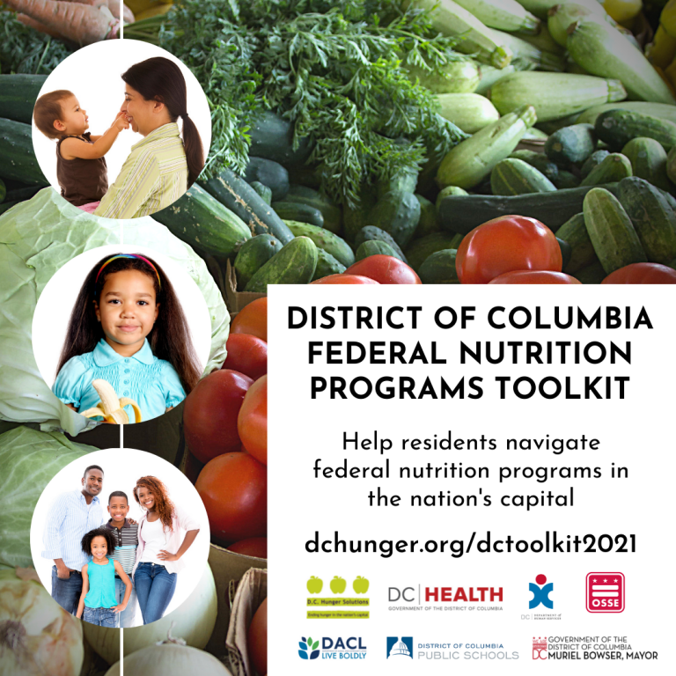
DC Federal Food Programs Toolkit
Interagency initiative
Facility and resident tested
Eligible programs by age
Up-to-date information
Housed by DC Hunger Solutions
Online and printable
Online version in seven languages

Slide 21
Announcements
FY22 Letter to Households & IES Forms
CACFP Program Management Forms
*Reminder: IES forms are valid for 12 months*
FY22 Training Modules (to also be posted soon on the website)
FY 22 CACFP Civil Rights - Overview
FY22 CACFP Performance Standards & Institution Responsibilities
FY22 Financial Management (to come)
FY22 Procurement (to come)

Slide 22
Announcements
Orchard Application Training Release: July 20, 2021
Virtual Orchard Office Hours: August 2021 – September 2021
  Contact your assigned specialist who will determine the best virtual method for providing technical assistance.

Slide 23
Orchard Application Process

Slide 24
Orchard Application Submission
All institutions have been emailed with their application submission deadline.
Please note: If an institution is non-responsive to repeated State agency request for application submission/correction within specific timelines and after 30 days, the State agency will initiate a termination or application denial depending on the round of your application review process.
An institution can receive payment for a fiscal year’s claims once that fiscal year’s application is approved. *
(7 CFR § 226.15(b))
*The State agency must adhere to federal payment timelines.
*The State agency is not allowed to pay claims passed the 60th day after the last day of the claim month.
*The State agency cannot pay claims before the fiscal application is approved.
*Institutions that do not have approved applications in the system prior to claiming for that fiscal year and within the 60-day deadline of claim submission, will only have the option to elect the 36-month exemption for a claim if eligible.

Slide 25
Orchard Application Submission
Common reasons for returning the application:
(1) Submission credentials:
The Authorized Representative (owner, executive director) must use their unique credentials to submit the application. Only after the first version of the application submitted by the Authorized Rep has been approved, the official designee may edit the application with updates.
(2) Training modules:
Application review includes ensuring that all Responsible Principals/Individuals (Authorized Representative, Official Designee(s), Primary Contact(s)) have taken the required annual training modules for this Fiscal Year.
(3) Certifications:
These must be signed by the appropriate parties designated on the form.
(4) Budget/Supporting Documentation:
Ensure that all supporting documentation is submitted for the specialist to review.
(5) SAM Registration:
Check to make sure your SAM registration does not lapse during application review. If so, it may mean delays as this is one check for making sure you have valid vendor approval to receive payment from the District.

Slide 26
Reminders

Slide 27
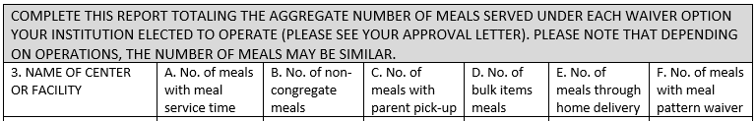
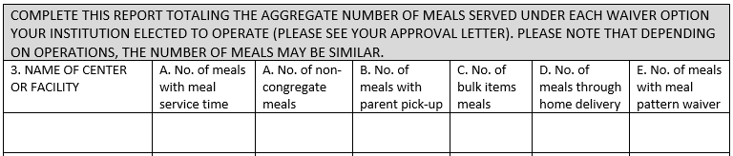
Claim & Waiver Addendum
FY22 Claim Workbook
*includes Title XX addendum and Waiver Addendum*
Claim for Reimbursement: Report all eligible meals served on your claim for reimbursement and maintain supporting documentation.
Waiver Addendum: Use to inform the SA how many meals on your claim for reimbursement fall into each category (your institution must be approved for each).

Slide 28
Updated Documents in Orchard Library
Independent Centers:
  Financial Management Certification: IC renewal applications
  Annual Budget: IC new applicants: Cash-in-Lieu has not been released yet by USDA
    The budget template will be sent and budget revisions will be requested once that's available
  Letter to Households
Sponsoring Organizations:
  Agreements with facilities: (Needs to be uploaded in site level documents)
  Annual budget: Cash-in-Lieu has not been released yet by USDA
    The budget template will be sent and budget revisions will be requested once that's available
  Letter to Households

Slide 29
https://osse.dc.gov/cacfp
Program Specialists:
Monica Clark: Monica.Tclark@dc.gov
Crishna Hill: Crishna.Hill@dc.gov
Erica Nelson: Erica.Nelson@dc.gov
Managers:
Katrina Florek: Katrina.Florek@dc.gov
Suzanne Henley: Suzanne.Henley@dc.gov

