Slide 1
DC School Report Card
[School Name] | [Date]

Slide 2
DC School Report Card
The DC School Report Card is a dynamic website that gives parents and families a look into all public schools in the District of Columbia.
Notes:
Today/this evening, we are going to share information with you about the new DC School Report Card, an interactive website that provides accessible information about ALL public schools in the District of Columbia, both DCPS and charter.
We will also talk about some uses for the new website tool, and hear your questions.
The DC School Report Card was released for the first time in December

Slide 3
What is a School Report Card?
A school report card provides important information about how a school is educating all of it’s students.
Parent-friendly report cards are a federal requirement under the Every Student Succeeds Act (ESSA), which replaced No Child Left Behind.
In DC, the report card was built by the Office of the State Superintendent of Education (OSSE), with input from thousands of parents, educators, and community members.
Notes:
While we are here talking about “report cards,” this isn’t the same report card that you receive at home from your child’s school. This is a report card for the school itself.
In 2015, then-President Obama signed a new federal education law called the Every Student Succeeds Act, or ESSA. This law replaced what was previously known as No Child Left Behind.
One of the major changes of ESSA was that it offers more flexibility to states to come up with an education plan that fit their unique context, which is especially important in a place like DC. While there are still many things we are required to do by the US Dept of Education, we were able to make other decisions based on community feedback and the particulars of our system here.
It also requires all states to create parent-friendly “report cards” and to release them publicly by December 2018.
Here you can see a picture of one of the pages of our report card, which is still in development. In addition to the school-level report cards, we will also have LEA-level and state-level report cards.
We will get a more in depth sneak preview in just a few moments.

Slide 4
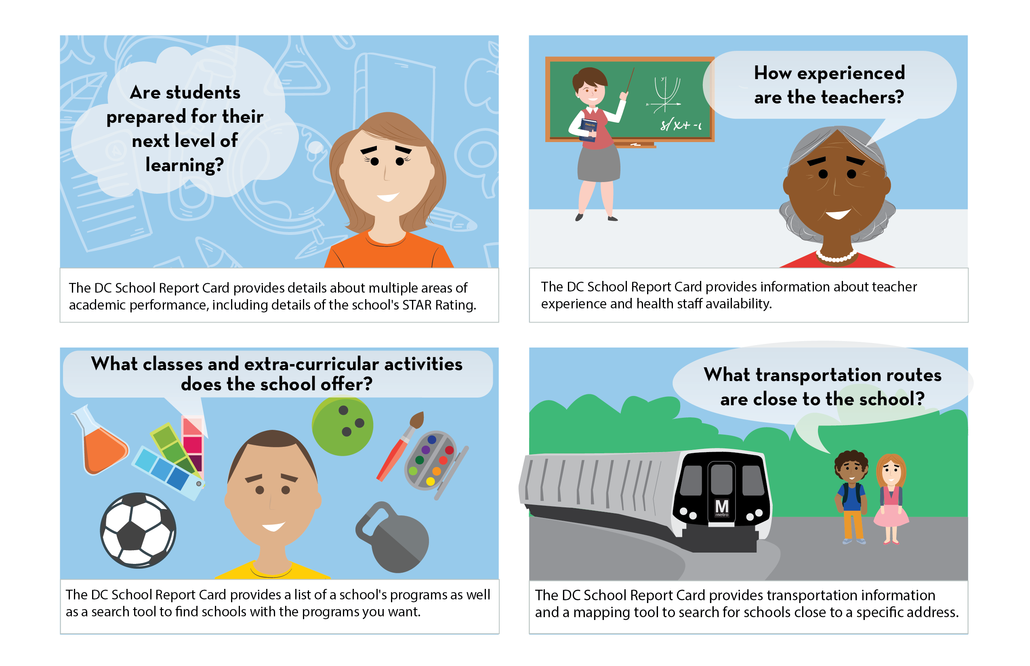
Helping Families with Student-Centered Decisions
The DC School Report Card will help parents and families answer important questions about schools, such as how well students are being prepared for the next level of learning, what activities are available, how experienced the teachers are, and more.
Notes:
- The DC School Report Card will provide a wealth of information that will help parents/families answer some of the most important questions about their child’s school, including location and transportation options, school programs, teacher experience, and how the school is preparing students for the next level of learning.

Slide 5
Exploring the DC School Report Card

Slide 6
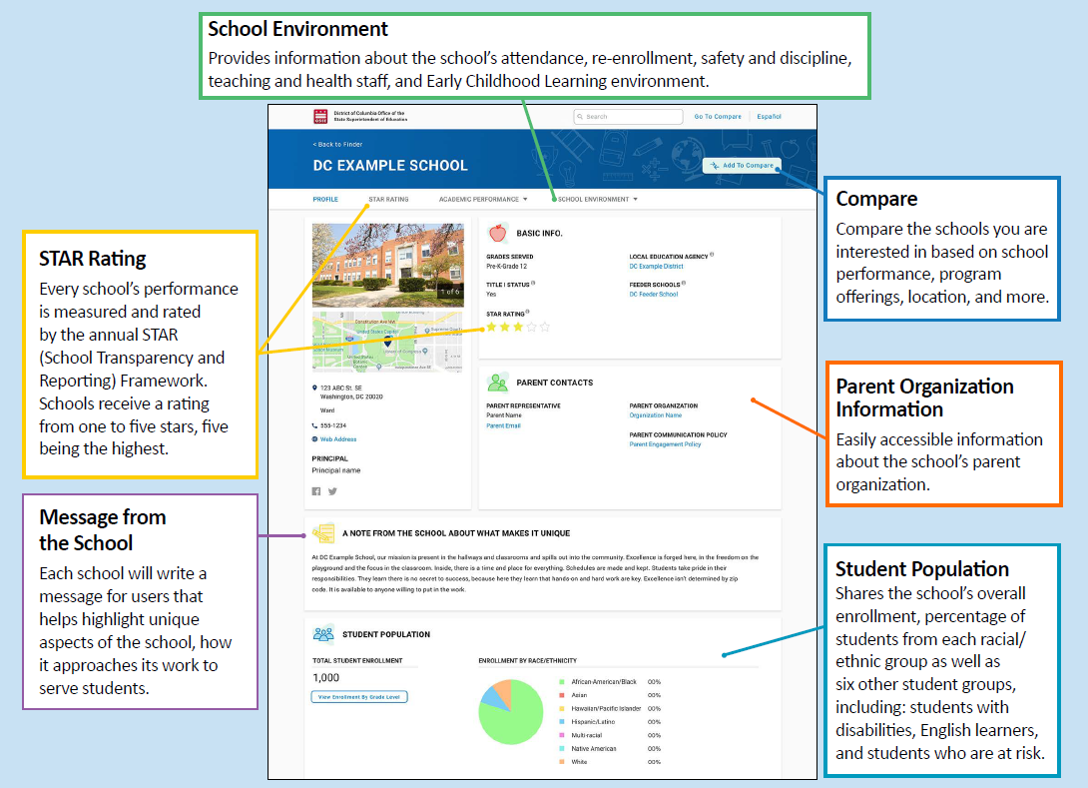
DC School Report Card – School Profile
Notes:
Helpful and important data that OSSE published in the past was not easily accessible or organized in a manner readily shared with or designed for parents and non education content experts.
Mention the Report Card At-A-Glance handout for more details

Slide 7
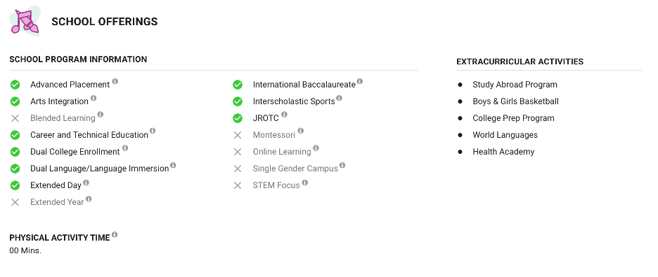
More from the School Profile
Notes:
The new DC school report card includes over 150 data elements including the STAR rating AND many other important and frequently requested information about schools from parents and the community
Here, you can see the listing of school program information and extracurricular activities at the example school

Slide 8
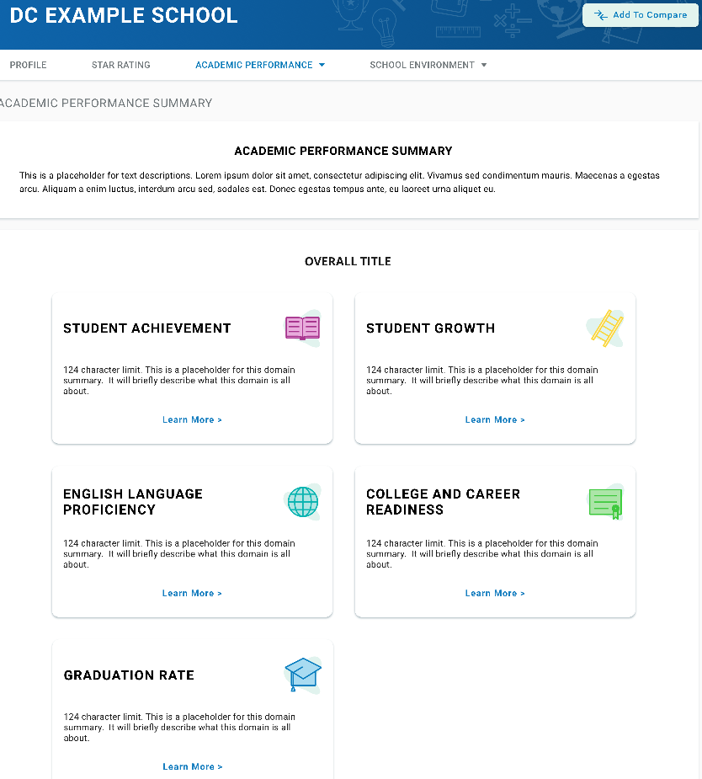
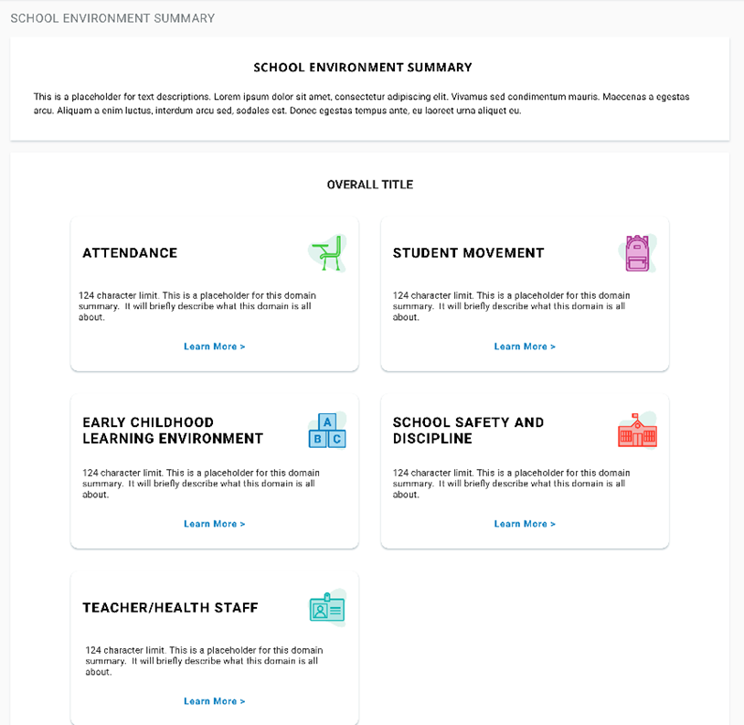
School Report Card Overview Pages
Each section of the website provides an overview of the information included.
Notes:
This is an overview of two of the introductory pages of the Academic Performance Summary and School Environment sections.
From these pages, you can click on any of these boxes to get more details about that section

Slide 9
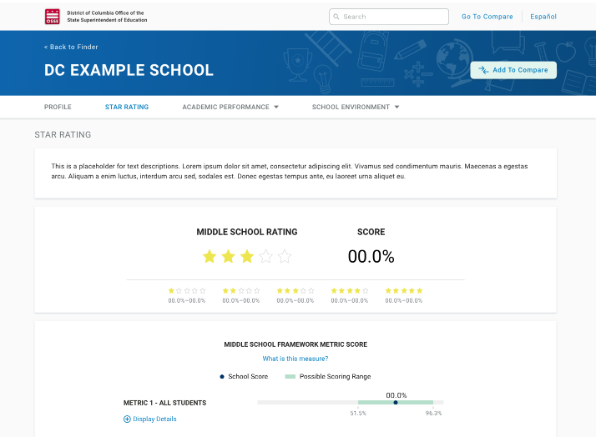
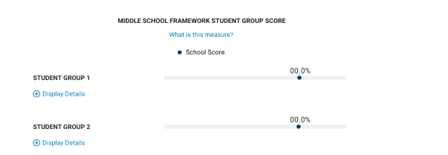
School Transparency and Reporting Framework Page
Explore school performance by looking at outcomes for different groups of students, and for all students in the school by metric.
Notes:
The final section of the report card that I’ll cover this evening is the STAR Framework.
Here, you can see a view of what the STAR Framework section looks like for a middle school.
You’ll be able to see how the school is doing overall by STAR Score and STAR Rating.
You’ll also be able to see how the school is doing on each data point (for example, daily attendance for students), and how the school is doing with each group of students in the school. This was a specific request of parents we talked to about designing the STAR Framework page.

Slide 10
What’s Next?

Slide 11
The DC School Report Card and [School Name]
[School name] received a [1-5] star rating this year, based on our student outcomes for the 2017-18 school year.
We are especially proud of our school’s performance on a few areas of the DC School Report Card:
[Highlight area #1]
[Highlight area #2]
[Highlight area #3]
[Highlight area #4]

Slide 12
The DC School Report Card and [School Name] (Cont.)
There are a few areas where we will continue to focus on our growth:
[Area #1]
[Area #2]
[Area #3]
[Area #4]

Slide 13
How You Can Support Our School
[Insert information about how parents can help to support the school, including opportunities to get involved]

Slide 14
How You Can Get More Information
Explore the DC School Report Card at DCSchoolReportCard.org
Visit OSSE’s website at osse.dc.gov/dcschoolreportcard to find more information about the DC School Report Card and STAR Framework
Sign up for updates from OSSE by emailing DCSchoolReportCard@dc.gov, including opportunities for community engagement
Questions? Email OSSE at DCSchoolReportCard@dc.gov

