Slide 1
DC-CAS Health Online
Spring 2013 Pilot
Test Administration System (TAS) Training
Webinar Etiquette
This call will be operator assisted.
Please submit questions through the chat window throughout the presentation or via the operator during the Q&A portion of the meeting.
2/28/2013
Notes:
Welcome to Test Administration Training

Slide 2
Agenda
Welcome and Session Goals
Milestone Update and Checkpoint Review
Support, Resources, Next Steps, Q&A
Online Program Overview & Changes for Spring 2013
Roles/Responsibilities
Demo/Training Test Administration System (TAS)
Slide 2
Notes:
Welcome to the Spring 2013 Site Readiness Training event. **Participation is only required for one of these sessions as all sessions are identical.
We have a lot to cover today – so let’s jump right in. My name is ______. I am an Online Implementation Manager at CTB and am responsible to ensure that we do the best job we can in making the both the student’s experience as well as the staff’s experience with Washington DC online testing as pleasant, painless and engaging as possible. Today’s meeting has been scheduled for two hours and includes information on the following topics - an quick look at some of the upcoming Milestones and Key Events, a review of common terminology, along with an overview of the Online Program. We will then dive in to the Site Readiness instructions and installing the test delivery client and content. We will wrap up with details on support resources available to you, next steps and a Question and Answer session.

Slide 3
Welcome to CTB
Welcome to CTB
Office of State Superintendent Office
Dr. Margaret Barco
Erin Watts
CTB/McGraw-Hill Education
Director of Assessment
Health Education Specialist
Glenn Gage, Program Associate
Amy Dement-Dorey, Sr. Program Manager
Rob Mann, Online Implementation Manager
Slide 3
Notes:
Bullet Points
Introduce SDE and CTB. Mention CTB customer support also on phone.
Script
I want to spend a moment to introduce key team members for the DC-CAS testing program. We have team members from the OSSE (Office of State Superintendent Office) on the call (WHO) with us along with CTB program and customer support team members.. From CTB, we have program team members as well as a customer support.

Slide 4
Session Goals
Preview key functionality of DC Health Online
Provide Test Coordinator tools to train Test Examiners
Prepare Test and Technology Coordinators for online test administration
Slide 4

Slide 5
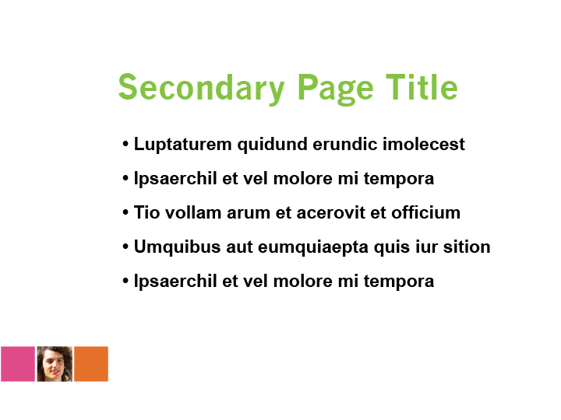
Milestones (Important Dates)
Milestones | Dates
Technology Site Readiness Training | March 18 & 21
Test Administration System Training | March 25 & 26
Demo Web Site Access Test Delivery Client (TDC) download/install | March 25
Online Test Administration System (TAS) Test Content available for download / install | April 4
Sessions created and Test Tickets Printed (Schools with CTB Support) | April 8 - 19
Health Online Pilot: Practice Testing Operational Test window | April 8 - 19 April 22 - May 2, 2013
Slide 5
Notes:
Bullet Points (Script is same for this page)
Review the Milestones and dates.
Script
Review the Milestones and dates.

Slide 6
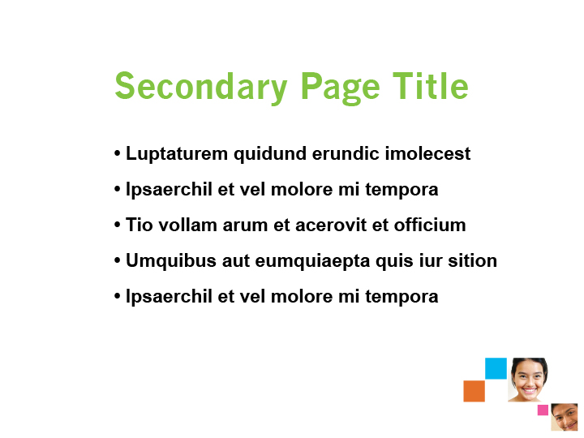
Checkpoints Review
Checkpoint Review
Checkpoint 1
Site Readiness Data Collection
Test Administration System Training and Access
Final Workstation Check
Technology Readiness
Checkpoint 2
Initial Site Readiness Report
Final Content Installation
Test Pre-Assignments
Test Delivery Client Installation
Site Support and Troubleshooting
Checkpoint 3
Slide 6

Slide 7
Roles and Responsibilities
School Technology Coordinator (STC)
Before Test
During Test
After Test
Conduct final workstation check.
Download and install Test Delivery Client (TDC)
Support schools during testing.
Follow up with Test Chariperson regarding online testing experience.
Download and install final content.
Work with TC to develop a phone tree.
March 25
April 4
Slide 7

Slide 8
Roles and Responsibilities
Test Chairperson (TC)
Before Test
During Test
After Test
Contact OSSE concerning invalidations.
Train Proctors.
Distribute TAM (from CTB).
Ensure IT staff completed site readiness tasks.
Manage student data.
Review/update test assignments.
Schedule additional tests, if needed.
Print test tickets and provide to the school. (TC or STC).
Check status on testing completions.
Ensure test tickets and access codes have been securely destroyed.
Supervise tasks performed by STC.
Attend OSSE and CTB trainings.
Review local assessment schedule.
Work with STC to develop a phone tree.
Slide 8
Notes:
SAY: The following slides cover many details of the DTC, BTC, Test Admin and Proctor roles and responsibilities.
These are covered in detail in the Test Administration Manual, which you receive from CTB prior to testing.
Please refer to your powerpoint slide notes as I review these roles/responsibilities.
The key points that we will cover in today’s training are highlighted.
[ Only read the highlighted bubbles ]

Slide 9
Roles and Responsibilities
Test Chairperson (TC)
Before Test
Review documents including TAM, quick start guide, etc.
During Test
Supervise administration of online testing.
After Test
Contact the TC to report instances where Invalidation may be required.
Attend OSSE and District-directed trainings.
Confirm site readiness with local IT staff.
Manage student data/ accommodations.
Review/manage test assignments.
Print and securely store test tickets (TC may also print).
Design local assessment schedule.
Return all test tickets and access codes to your TC for secure destruction.
Check status on testing completions.
Work with TC to develop a phone tree.
Provide all test irregularity reports to TC.
Destroy all scratch/grid paper turned in from TA from testing sessions.
Slide 9

Slide 10
Roles and Responsibilities
Test Administrator (TA)
Before Test
During Test
Direct students to the DC Health Online log-in screen or have it open on the desktop.
After Test
After each test session collect all the test tickets and access codes and store in a secure location until you can return to the BTC.
Distribute individual test tickets to students
Provide the Test Access Code (one session at a time) *Do not provide all Test Access codes at the same time.
Read the test directions aloud from the TAM.
Walk around the classroom.
Verify all students have exited the test properly.
Assist students with technology issues during testing.
Provide all test irregularity reports to TC.
Determine materials (“outside” of the online testing system) that you will need for each testing session.
Log testing irregularities.
Complete a thorough review of the TAM. Bookmark the start of each session.
Confirm and document online assessment dates, times, and locations
Report (to TC) instances where an invalidation may be required – this may also occur during the test.
Prepare a log/chart for testing irregularities.
Collect all scratch paper and turn in to the TC to destroy.
Provide Scratch paper.
Create a seating chart of where students are sitting in the room.
Slide 10

Slide 11
Roles and Responsibilities
Test Proctor (TP)
Before Test
During Test
Help to direct students to the DC Health Online log-in screen or have it opened on the desktop.
After Test
May help collect all the test tickets to be returned to the TC.
Make sure access codes do not leave the room. Confirm that only one access code is provided for the test session.
Listen and verify that the test directions are read aloud correctly from the TAM.
Verify all students have exited the test properly or are continuing to work on the test.
Prepare a log/chart for collecting testing irregularities.
Log testing irregularities.
Report (to TC or TA) instances where a testing irregularity has occurred.
Confirm and document online assessment dates, times, and locations.
Create a seating chart of where students are sitting in the room.
Observe students as they are testing.
Slide 11

Slide 12
DC Health Online Program Overview
DC Health Online Program Overview
Accommodations and Student Testing Tools
Online Practice Tests
CTB DC CAS Web Portal ctb.com/dc-cas
Documentation and Training Materials
Access the Test Administration System
Download Test Delivery Client
Available Options for Students
Other Testing Considerations
Test Administration System (TAS) Practice Tests
DEMO site (sandbox) separate from live site.
Slide 12

Slide 13
Documentation and Training Available
Documentation/ Materials
Online Quick Start Guide
DC CAS Online Test Administration Manual
Test Coordinator Training
DC CAS Online Checklist
Quick Troubleshooting Tips
Training Materials/Tools
Pre-recorded Test Coordinator Training Sessions (webinar)
DC CAS TAS Training 2013 Presentation
www.ctb.com/dc-cas
Slide 13

Slide 14
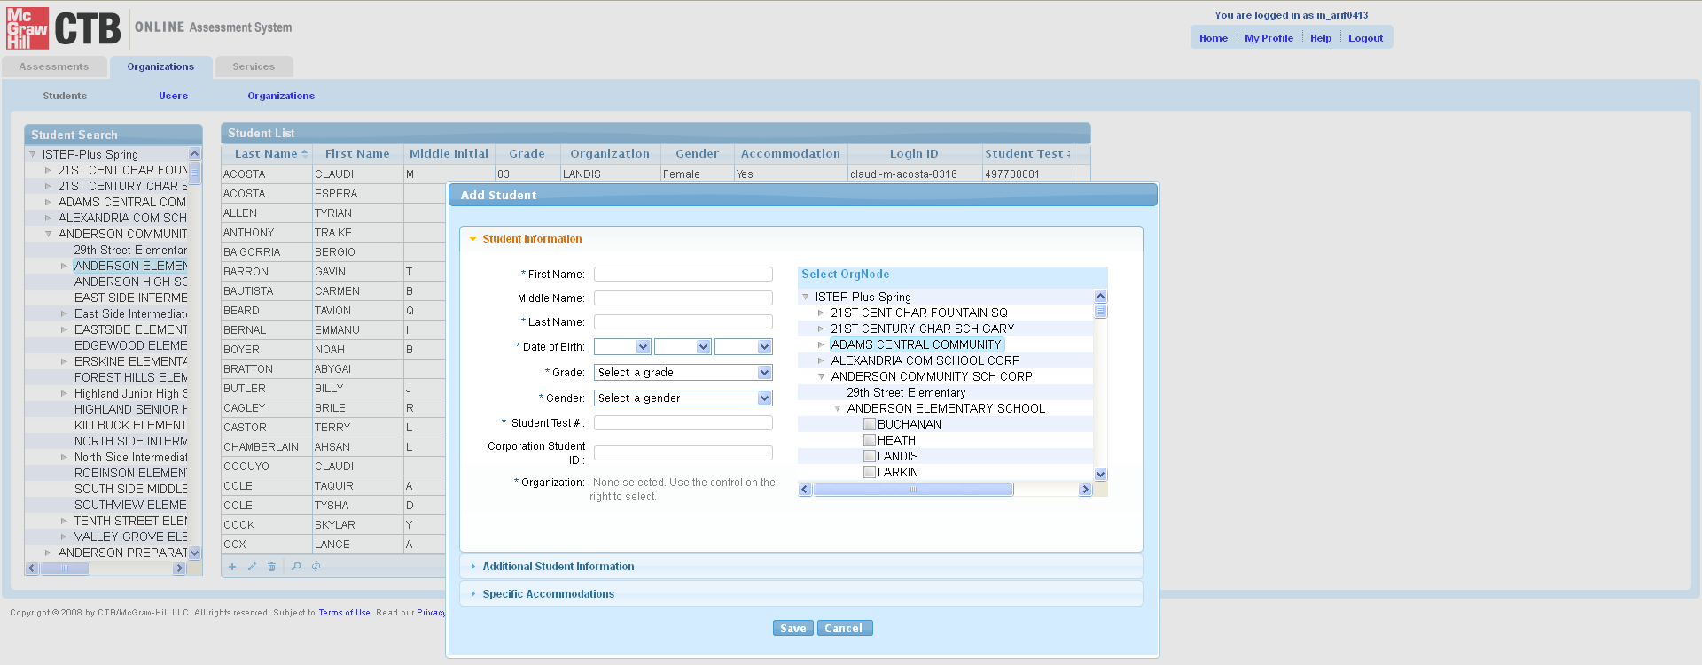
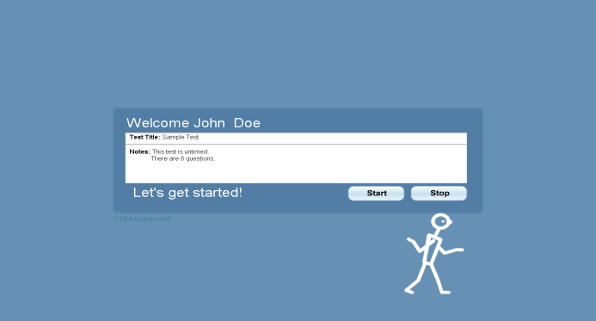
Looking Ahead
Online Program Overview
Test Administration System (OAS)
Student data management
Test assignments
Testing status
Test Delivery Client (TDC)
Student testing software (TDC)
Lock down browser
Slide 14
Notes:
The CTB Online Assessment System consists of 2 applications, the Test Delivery Client and the Test Administration System. The focus of today’s presentation is on the Test Delivery Client.
Today’s training will focus on getting your site ready with the Test Delivery Client software and the ancillary components.
For initial site readiness, the Test Delivery Client software can be downloaded directly without having to login to the Test Admin web site.
Links to the Test Delivery Client (TDC) are being sent in a memo to District Test Coordinators.

Slide 15
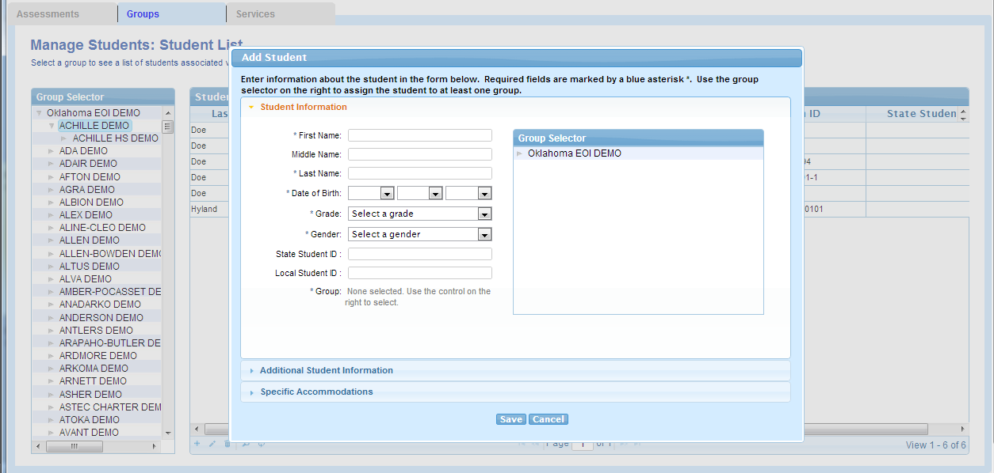
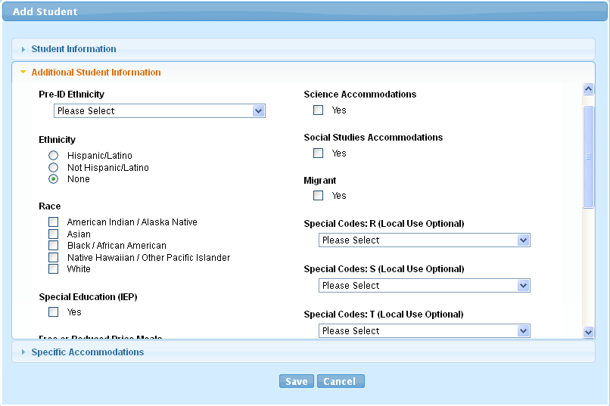
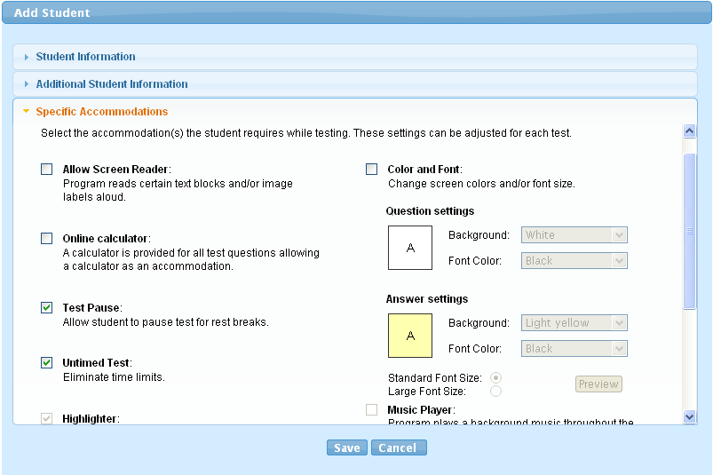
Test Administration System
Test Administration System
Test Administration System (TAS) Enhancements
Improved Student and Class management
  Locked hierarchy
  Student Profile fields grouped for convenience
  Prevent student edits after export to reporting
  Export Student List
  Assign specific test form
Slide 15
Notes:
Bullet Points:
Changes for Spring to help with student and class management
Hierarchy frozen for District, School and Subject levels. Makes adding/editing a Class easier.
Student demographic fields/profile organized for easier data editing
No biographic edits after test window – make sure your edits are not lost once the data moves on to the reporting system
Ability to assign a student to a specific form
Enabled Export or student and user information.
Script
The Test Administration System has undergone changes since the 2012 Winter administration.

Slide 16
Specifics for Spring 2013
Check opt-out in the student profile
Survey Questions after Session 3
Break/access code between Sessions
Set ELL and accommodations in Online Profile
Notes:
[ XXX Add notes ]

Slide 17


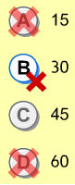


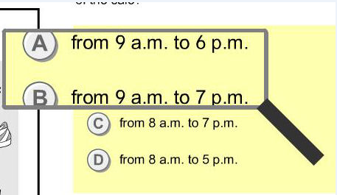

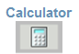


Student Testing Tools
Option (Answer Choice) eliminator
Highlighter
Eraser
Magnifying Glass
Pause Test – 20 minute timer
Mark for Later Review
Slide 17
Notes:
Main Points:
Additional tools are available to students and administrators:
Scheduling subtests – allows for break between tests.
Un-timed setting – Examiner tracks time, not software.
Stop/Pause – Students can click a button to stop/pause the test.
Highlighter – Used to highlight portions of the screen.
Eraser – Erases highlighting or option eliminator marks.
Mark for Later Review – Marks the question number in yellow at the bottom of the testing screen so a student can return to it later.
Option Eliminator – Allows students to place a red “X” over incorrect answer choices to help them pick the correct answer.
Manipulatives – On-screen tools (protractor, ruler, and calculator) that can help the student work through a problem.
Reference Card – Contains mathematical formulas that students can reference during certain questions. This is available only for certain grades.
Test Coordinators can also sit with students prior to testing to let them preview several accommodations settings.
Say: Additional testing tools available include:
Un-timed: the un-timed test
Highlighter/Mark for Later Review allows the student to highlight an item, skip the question, and return later.
Eraser allows the student to erase an undesired answer.
Option Eliminator allows the students to eliminate answer choices they feel are incorrect.
Manipulatives such as a protractor, ruler, calculator
Reference card - available only for certain grades. STUDENTS ARE PERMITTED TO USE A HARD COPY OF THE MATHEMATICS REFERENCE SHEET, AS WELL, IN APPROPRIATE GRADE LEVELS.
Advanced settings of student preferences:
If you prefer, Test Coordinators can sit with students to set their preferences outside of the lockdown browser and in advance of the testing window, allowing students to see how the changes will affect their test experience before they actually take the test.

Slide 18
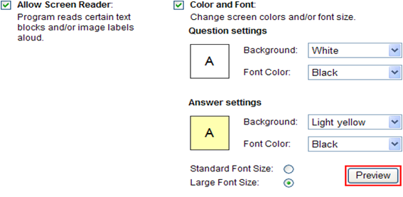
Test Accommodations
Accommodations available for students on an IEP, 504 Plan, or ELL students
Screen Reader Text-to-speech
Font Size
Background and Font Color
Slide 18
Notes:
Main Points:
Students with an IEP, Section 504 Plan, or ILP can have specific accommodations set in the testing software.
Passages will not be read for reading comprehension items.
Say: The Online System provides flexibility to implement and configure support for a wide range of accommodations based on individual need.
Students with an IEP, Section 504 Plan, or ILP can have specific accommodations set in the testing software. Some available accommodations include:
Screen Reader / Text-to-Speech
This is available for students who require an audio version of the assessment. The screen reader will be provided as part of the test client.
Note that passages and test questions will not be read for reading comprehension items.
Alternative Text for Graphics = Everything on the screen and every standard action can be read aloud. When the student clicks an image, students will hear text describing the image they clicked.
Variable Font Size / Color / Screen Background Color, Variable Image Size.

Slide 19
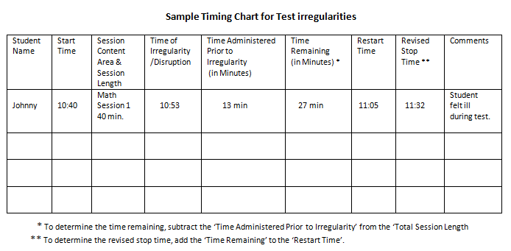
Other Test Administration Considerations
Local test schedule calendar
Transition time between test sessions
Outside of system accommodations
Accommodation-based student groups
Test Coordinator / Tech Coordinator /Special Education Director planning team
Slide 19
Notes:
Main Points:
Many DC CAS Online administrative activities take place within the Test Administration System, this slide covers things that occur outside of the system:
Test and Tech Coordinators should work as a team to select testing times to avoid other network intensive processes (e.g., payroll, video streaming, etc.), and also room availability.
Discuss possible scenarios with Tech Coordinator and decide on plan of action.
Check with Tech Coordinators to ensure that test content is available on all machines.
Verify that technical support (at school level) will be available during testing in case there are any issues.
Allow at least 15 minutes between sessions for transition time and to give makeup time for students with technical difficulties.
Certain accommodations require the Test Examiners to do things, such as account for extended time or assure that headphones are provided to students with the Text Reader accommodation.
Think about testing location for groups of students needing certain accommodations outside of the system.
Say: Many DC CAS Online administrative activities take place within the Test Administration System. This slide covers things that occur outside of the system such as:
The Test Coordinator and Tech Coordinator’ working as a team to:
Decide and confirm the best times when the test can be conducted and ensure there are no other processes (such as payroll, video streaming, etc.) occurring at those times that could impact the student testing experience.
A local test schedule should be developed (outside of the DC CAS Online system) to confirm the rooms used for testing and times/grades for testing.
The Test Coordinator and Tech Coordinator also need to ensure the site is ready for successful testing.
The Tech Coordinator needs to ensure the test content is available on all machines. The test cannot proceed if the content is not pre-positioned. Instructions are provided separately to the Tech Coordinator regarding these tasks.
The Test Coordinator and Tech Coordinator need to verify the availability of technical assistance during the test.
The Test Coordinator should ensure the Tech Coordinator is available during testing to assist in resolving any glitches that may occur. Having more than one technical advisor available to assist may be helpful.
The Test Coordinator and Tech Coordinator will also identify any possible situations that may cause problems during testing and decide on a plan of action.
Allowing time between sessions is a MUST to accommodate students moving between classrooms and/or challenges during testing such as technology issues. 15-20 minutes between sessions is recommended.
The test will not be timed by the online application. Each student will appear in the system with an Untimed Test accommodation.
To take advantage of the text reader accommodation, the system cannot be muted. Students should be provided with headsets and the volume adjusted once the student is seated.

Slide 20
Practice Test Options for Students
TAS Practice Test
Create Test Session in TAS
Print Test Tickets and Access Code
Requires use of Workstation Installed Test Delivery Client
Requires Practice Test Content to be Installed
Must be taken at School
Assign Students in TAS
Slide 20
Notes:
There are two methods to familiarize students with the online testing application; the Experience Online Testing website and through a Practice Test administered at the school. Differences between the two systems are noted on this slide. The most important take away from this slide is that the Experience Online Testing website does not take the place of a Required Practice Test. The Experience Online Testing website is an internet simulation of the test client meant for teachers, parents and student to use to familiarize themselves with online testing. Actual practice tests are conducted at the school and require the use of the installed test delivery client as well as test sessions and test tickets for students.

Slide 21
Demonstration / Training TAS Website
Pre-loaded with DC Schools appended with _DEMO
Where can I obtain login credentials for the Demo website?
What is the Demo TAS website?
Replica of the live Online Testing Test Administration System Website
What is available on the Demo TAS website?
2 school level; create additional as needed
Visit oas.ctb.com
Separate login from other CTB accounts
How do I access the Demo TAS website?
Why would I use the Demo TAS website?
Practice tests in system for scheduling
Content download package includes all tests
Will the Demo TAS website provide reports or data?
No - Data created on the Demo TAS website is not extracted for reports or monitored for completion of practice tests.
Use this site to create fake student accounts and test sessions to confirm workstation readiness. Do not use for actual student practice testing.
What content will work with fake test sessions on the Demo TAS website?
Some fake student data. Create additional as needed.
Slide 21
Notes:
Say:
In addition to the live Online Test Administration System, CTB has prepare and made available a Training DEMO TAS website. This Sandbox site should be used for training school staff. The data currently present in the site contains fake student data. The site can also be used for validating the software installs on the student testing workstations. Fake student accounts should only be added to the Sandbox TAS website and never in the live TAS site.
Please note that the data present in the Sandbox TAS:
is identical in format and volume to the real system, except that the student data has been scrambled.
this website is not accessible via SSO. The Sandbox TAS will be accessed through a different url.
If you create additional school level accounts in this environment, please name the account so that it is clear that it is to be used only for the Sandbox.
Do not administer real student practice tests from this site as no data is exported or scored.
Operational tests are not available in this website.

Slide 22
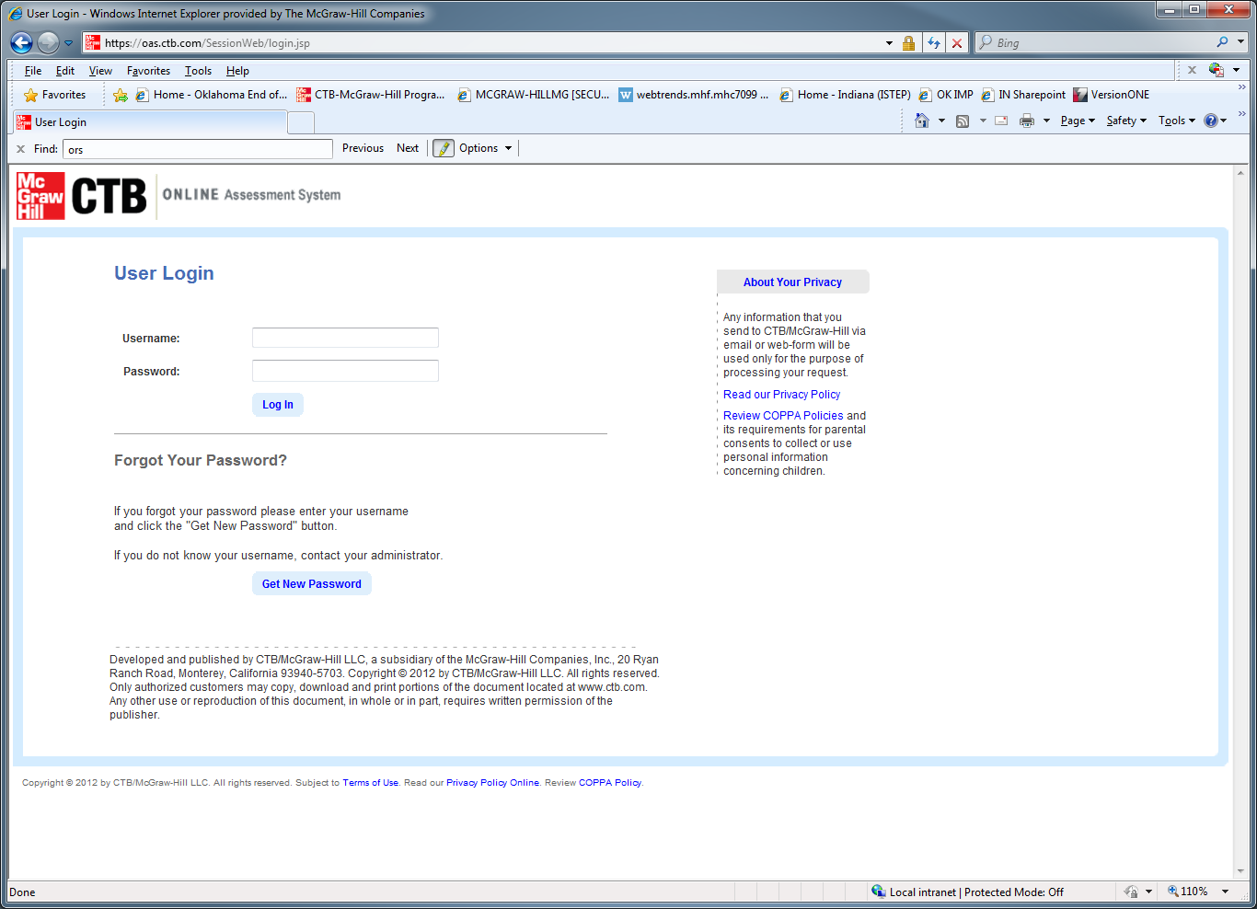
Demo/Training Test Administration System (TAS)
Use Demo account login credentials to access the Training TAS Web site.
URL: https://oas.ctb.com
Copyright © 2012 by CTB/McGraw-Hill LLC. All rights reserved.
Slide 22

Slide 23
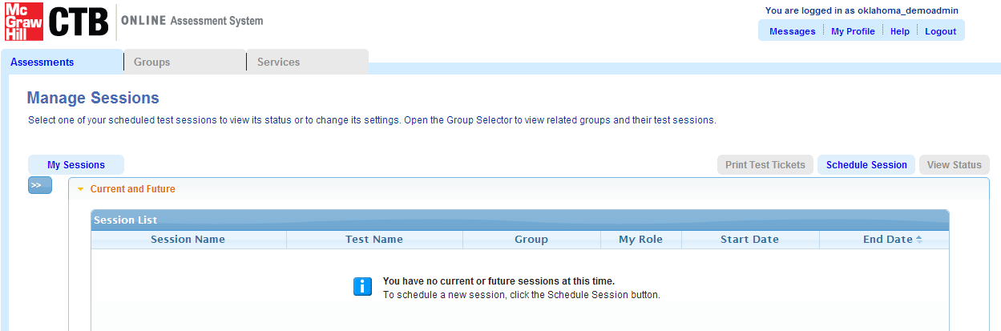

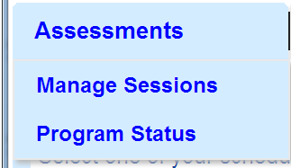
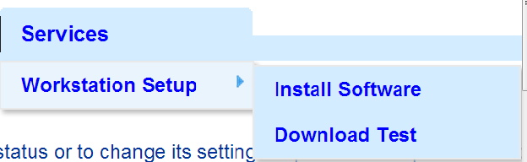
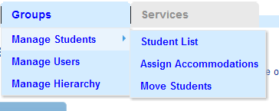






General Navigation: Tabs and Tools
Copyright © 2012 by CTB/McGraw-Hill LLC. All rights reserved.
Slide 23

Slide 24
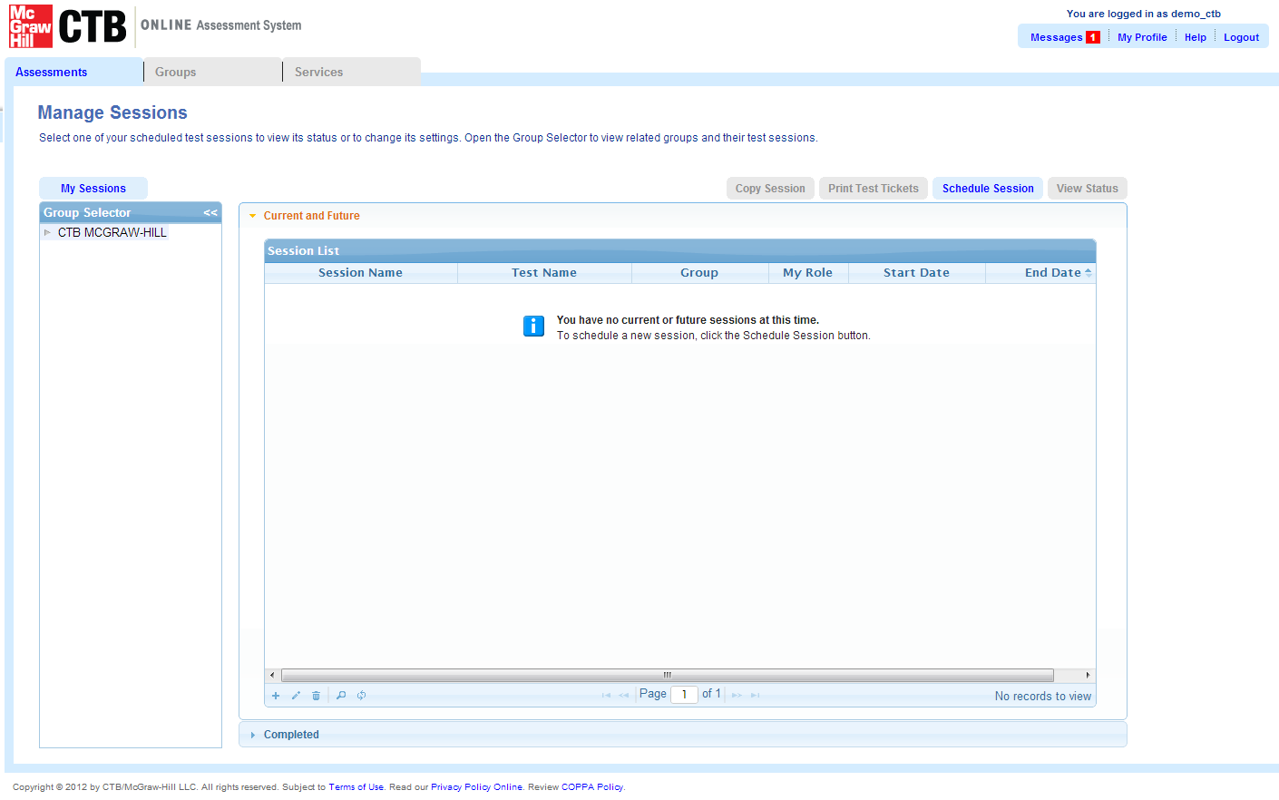

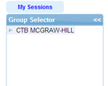

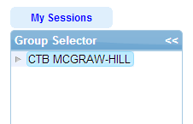
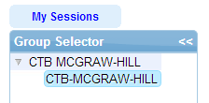
IDOE Online Testing Program Overview
General Navigation: Group Selector Feature
Group Selector feature:
The “Group Selector” feature is present on most TAS pages.
Clicking the Gray Arrow (left of name) to turn and point at the heading name collapses/hides the options under that heading.
Clicking the Gray Arrow (left of name) to the down position expands options under that heading.
Highlighting a name will filter and display data about that entity level – corporation, school or class/teacher.
Slide 24
Notes:
The Group Selector feature is used throughout the TAS website. The operation of this feature is two part. First, clicking the Gray arrow to a down position will expand the current level to view levels under that heading. Clicking the gray arrow back to the original position will collapse the view back to the original heading. Second, clicking directly on a heading name will activate that heading – and the resulting contents present in the panel on the right will be a filtered list based on that heading name only. You can always tell which heading name is active because you will notice a blue bar surrounding the heading.

Slide 25
TAS Feature Review – Test Sessions
Test Session
Demo 1: Create a test session and assign students.
Demo 3: View session status and invalidation option.
Demo 4: View program status.
Demo 2: Find a test session and print test tickets.
Other Considerations (Access Codes, Equivalent Forms)
Slide 25
Notes:
Now we will review features based on the main Tabs available in the Online Test Administration System. Beginning with the Assessment Tab, we will review the features related to Test Sessions. These include: How to Create a Test Session and Assign Students; How to Find and Print Test Tickets for a Test Session, How to View Test Session Status, and finally, How to View Test Session Program Status.
Each feature will be presented by first outlining the steps required to use the feature. We will then follow by reviewing animated slides to demonstrate how to locate and use the feature within the application.

Slide 26
TAS Feature Review – Test Sessions
Demo 1: Create a Test Session. Assign Students
D. Select a Test Group from the dropdown list and click to select a Test under Tests Section.
E. Allow breaks will be automatically set. This sets access codes.
A. Click “Manage Sessions” from the Assessments menu tab.
B. Expand School Panel
F. Click on Test Details bar to assign name, dates, and time to test.
G. Click on the Add Student bar to add students to the test. Click OK.
H. Click Save to create the test and exit.
C. Click the Schedule Session button.
Slide 26

Slide 27
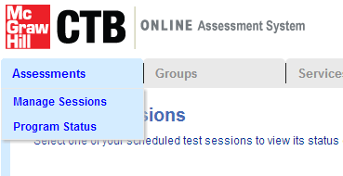
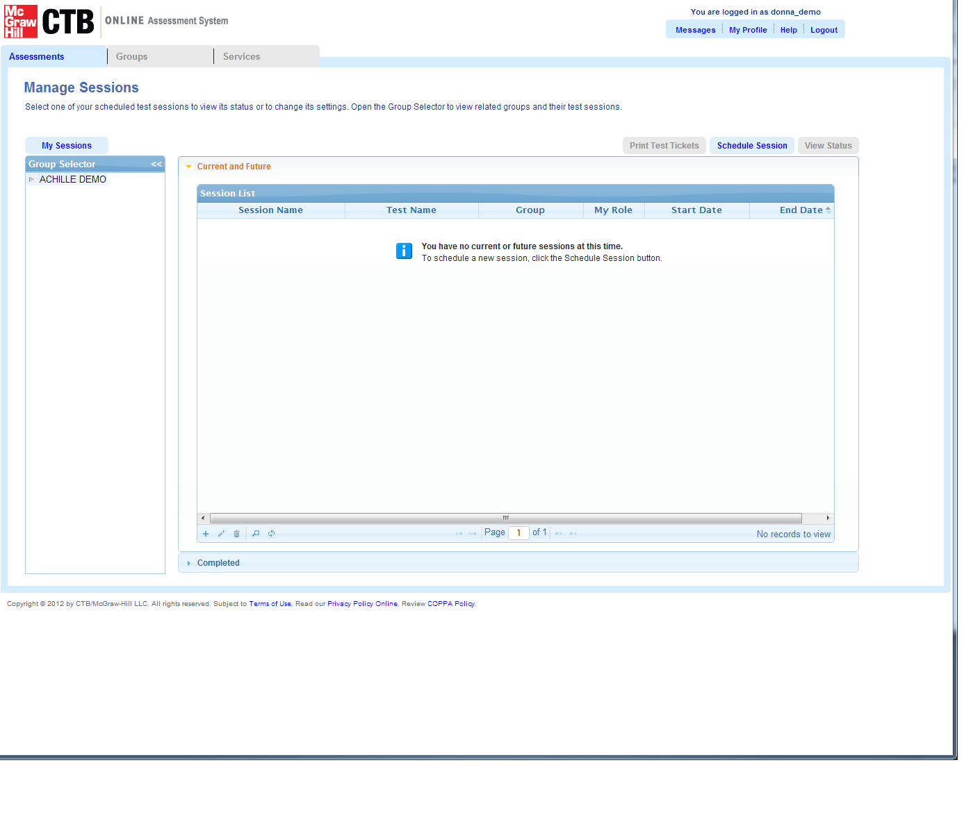
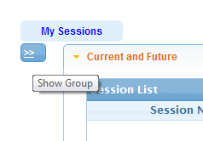
TAS Feature Review – Test Sessions
Demo 1: Create a Test Session. Assign Students
A. Click Assessments Tab, Choose Program Status
B. Click to Expand District/School list
C. Click on Schedule Session button
Slide 27

Slide 28
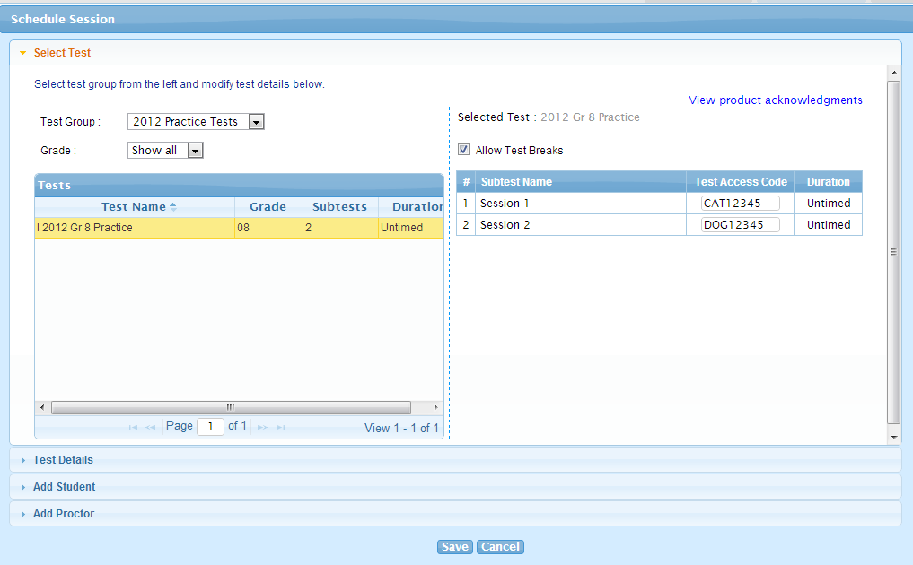
TAS Feature Review – Test Sessions
Demo 1: Create a Test Session. Assign Students
D. Select Test Group and Test from list.
E. Allow Test Breaks (automatically checked).
Slide 28

Slide 29
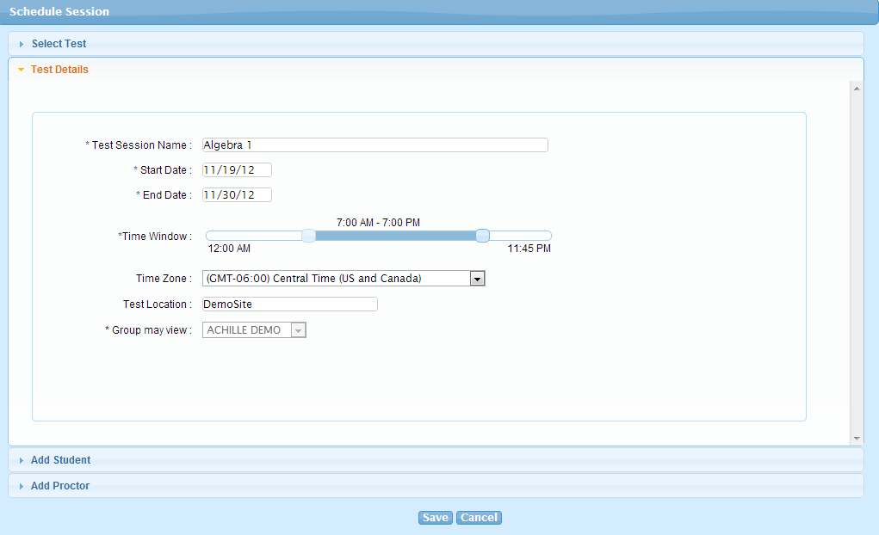
TAS Feature Review – Test Sessions
Demo 1: Create a Test Session. Assign Students
F. Add Test Details - Name the Test and set the date, window and other details
Slide 29

Slide 30
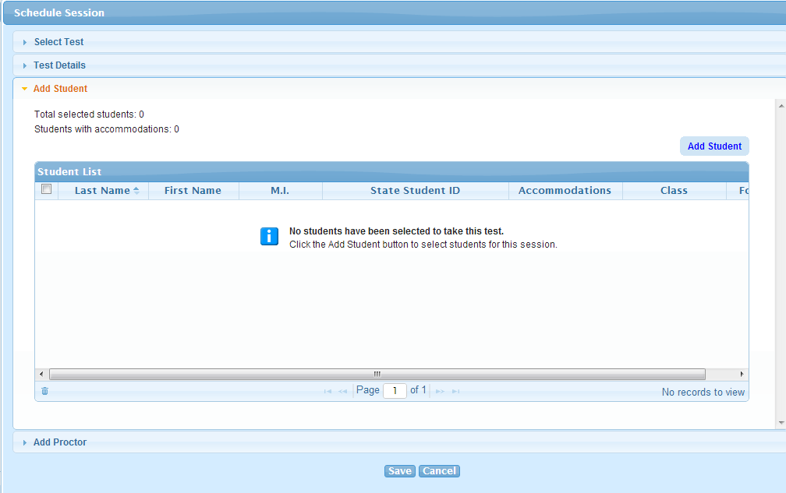
TAS Feature Review – Test Sessions
Demo 1: Create a Test Session. Assign Students
G. Add Students by clicking the Add Student button
Slide 30

Slide 31
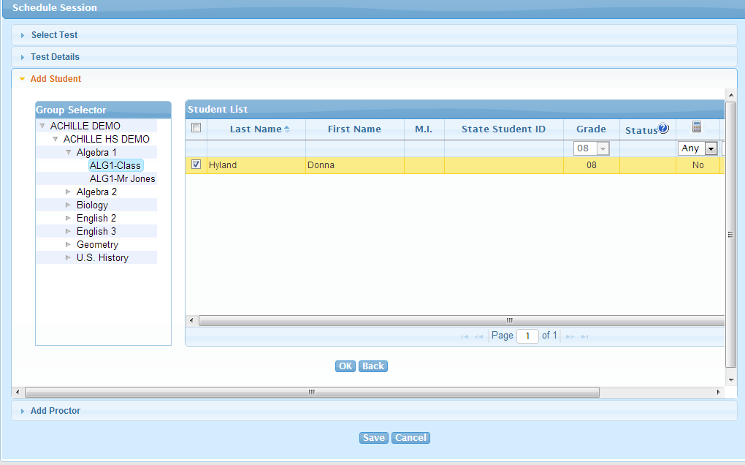
TAS Feature Review – Test Sessions
Demo 1: Create a Test Session. Assign Students
G. Navigate to the Class in the Group Selector panel.
G. Click the check box next to the student name
G. Click OK
H. Click Save
Slide 31

Slide 32
TAS Feature Review – Test Sessions
Demo 2: Find a Test Session and Print Test Tickets
D. Click on Print Test Tickets to View and Print Test Tickets (individual, multiple or summary).
E. Open the Adobe print options by clicking File, then Print. Change the Page Scaling dropdown to Multiple pages per sheet to see how a printout would look with 4 tickets per page. Click Cancel to cancel the print.
F. Return to the Home screen.
B. Expand School Panel
A. Click “Manage Sessions” from the Assessments menu tab.
C. Click on a Test Session from the Session list.
Slide 32

Slide 33
Test Administration System Feature Review
Demo 2: Find a Test Session and Print Test Tickets
A. Click Assessments Tab, Choose Program Status
B. Click to Expand District/School list
Slide 33

Slide 34
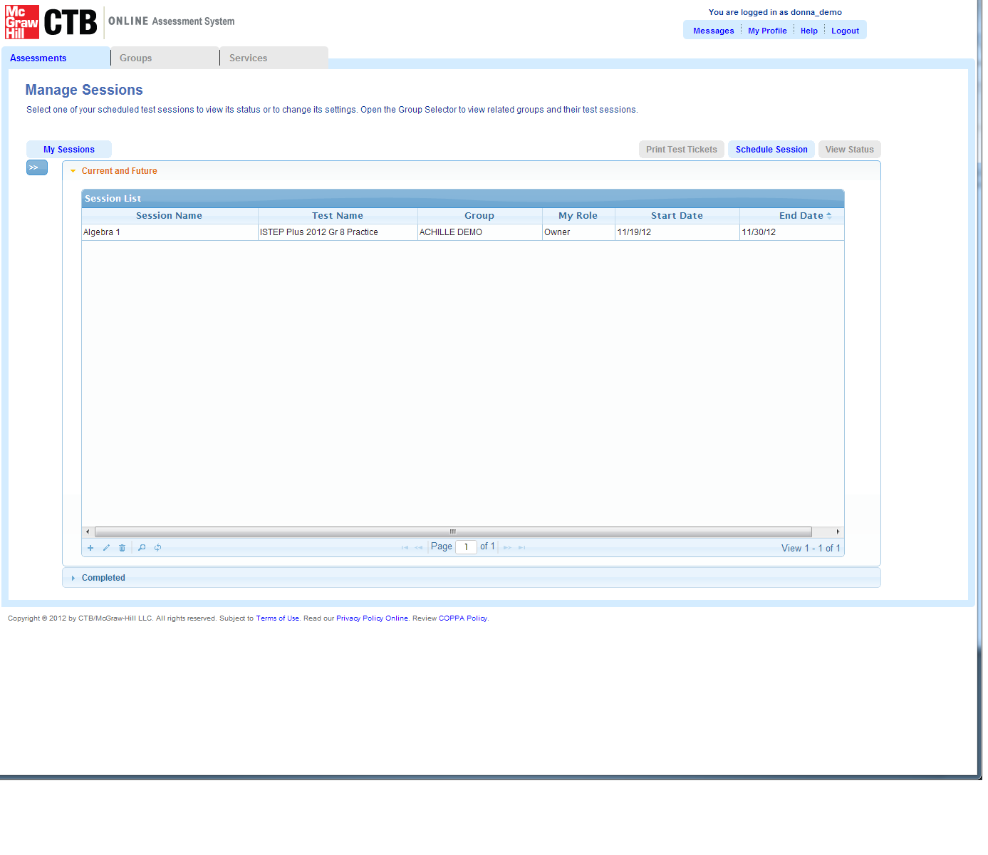
Test Administration System Feature Review
Demo 2: Find a Test Session and Print Test Tickets
D. Click Print Test Tickets
C. Click to Test Session
Slide 34

Slide 35
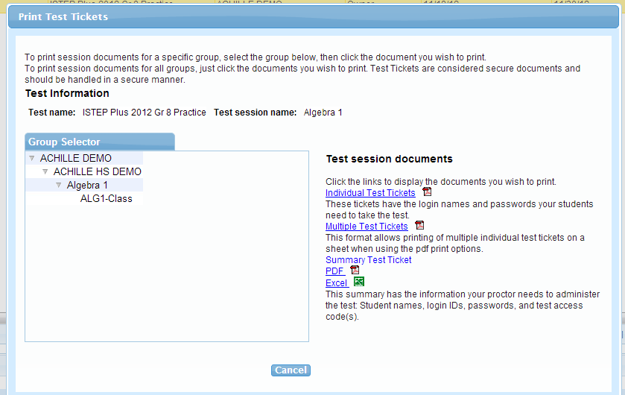
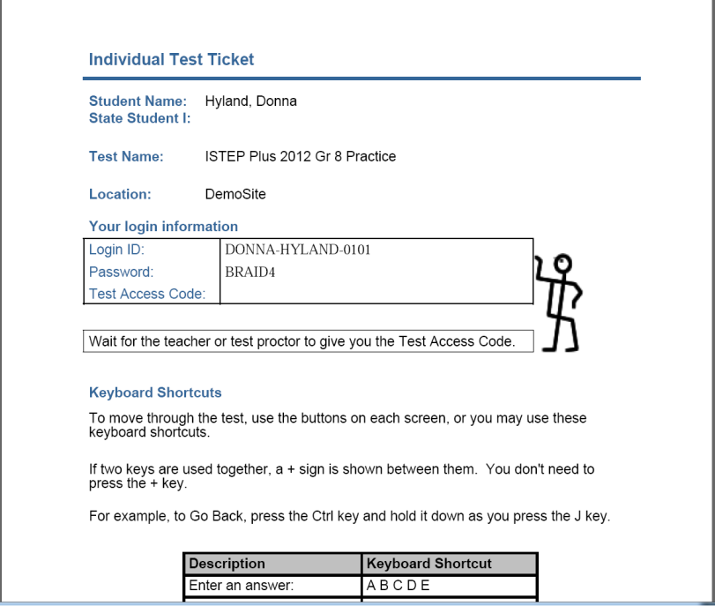
Test Administration System Feature Review
Demo 2: Find a Test Session and Print Test Tickets
E. Choose a test ticket option
Slide 35

Slide 36
TAS Feature Review – Test Sessions
Demo 3: View Session Status
A. Click “Manage Sessions” from the Assessments menu tab.
C. Click on a Test Session from the Session list to highlight.
D. Click on the View Status button to view the status of this session.
E. Refer to the Online Test Status column to see the current test status for the student(s).
B. Expand School Panel
F. Refer to the Validation Status column. Do not change the status of students to invalid.
G. Review student subtest details.
Slide 36

Slide 37
TAS Feature Review – Test Sessions
Demo 3: View Session Status and Invalidations
A. Click Assessments Tab, Choose Program Status
B. Click to Expand District/School list
Slide 37

Slide 38
TAS Feature Review – Test Sessions
Demo 3: View Session Status and Invalidations
D. Click View Status
C. Click to Test Session
Slide 38

Slide 39
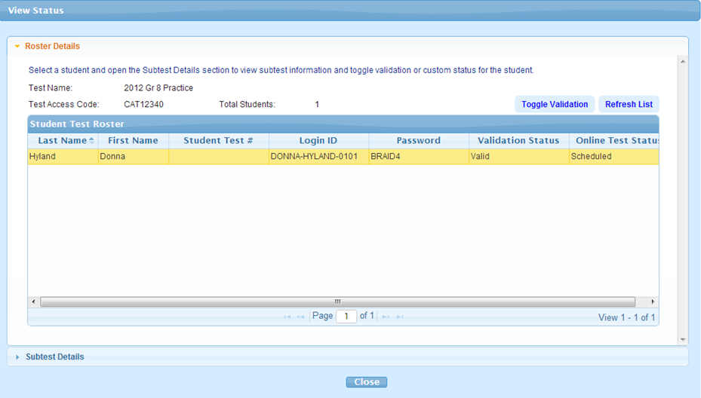
TAS Feature Review – Test Sessions
Demo 3: View Session Status and Invalidations
F. Test Validation – Ignore. Do not use.
E. Current Testing Status for the Student
G. Click to open Student Subtest Details.
Slide 39

Slide 40
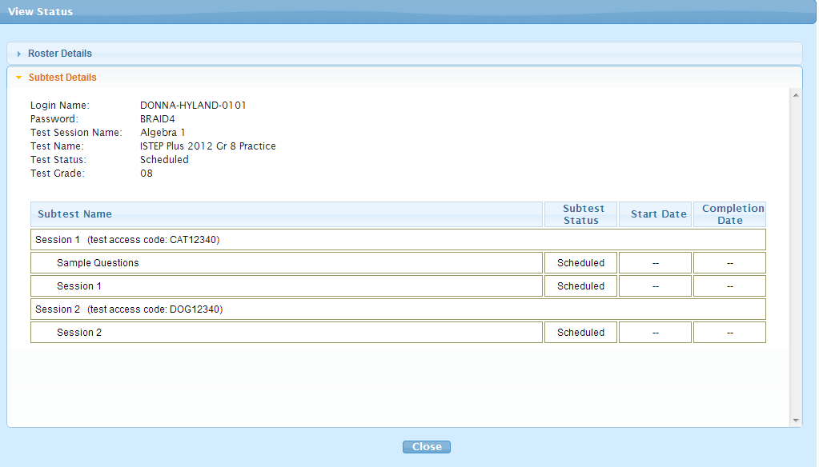
TAS Feature Review – Test Sessions
Demo 3: View Session Status and Invalidations
G. Student Subtest Details.
Slide 40

Slide 41
TAS Feature Review – Test Sessions
Demo 4: View Program Status
A. Click “Program Status” from the Assessments menu tab.
B. Choose the School from the Group dropdown selection.
C. Select an Assessment and Review Program Status.
Slide 41

Slide 42
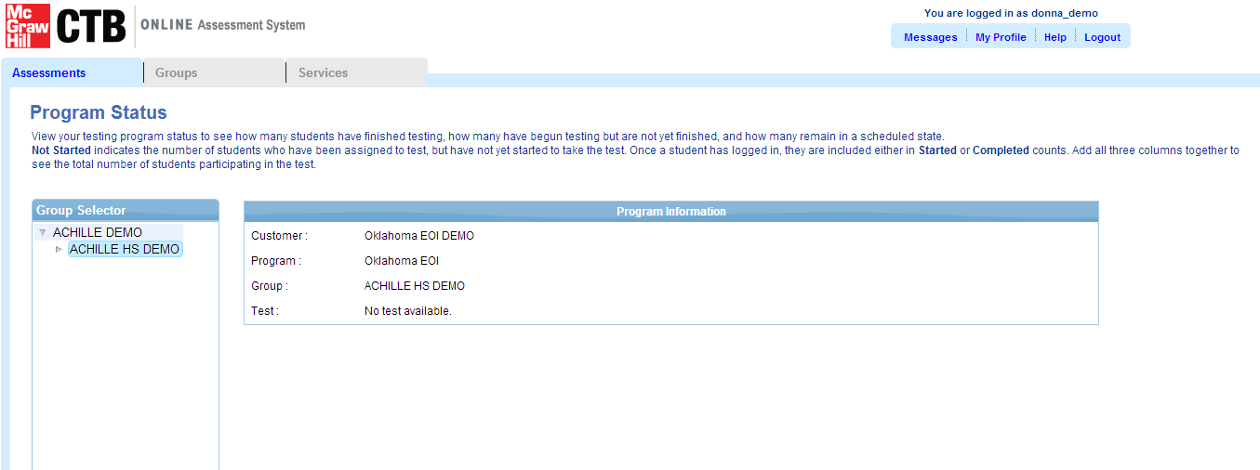
TAS Feature Review – Test Sessions
A. Click Assessments Tab, Choose Program Status
Demo 4: View Program
Status
B. Choose School from Dropdown list
C. Select Assessment and View Program Status.
Slide 42

Slide 43
TAS Feature Review – Test Sessions
Other Testing Considerations
Invalidation Process
Test Access Codes
Lost Access Codes Prior to Operational Test Window
Slide 43

Slide 44
TAS Feature Review – Manage Users
Manage Users
Demo 1: Find and Edit a User
Demo 2: Add a New User
Slide 44

Slide 45
TAS Feature Review – Manage Users
Demo 1: Find and Edit a User
A. Click “Manage Users” from the Groups menu tab.
B. Navigate to the School to display current users.
C. Open the user account by double clicking on the user row.
D. Edit the information details for the user such as updating an email address.
E. Click Save and exit out of the user profile.
Slide 45

Slide 46
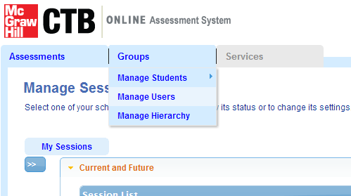
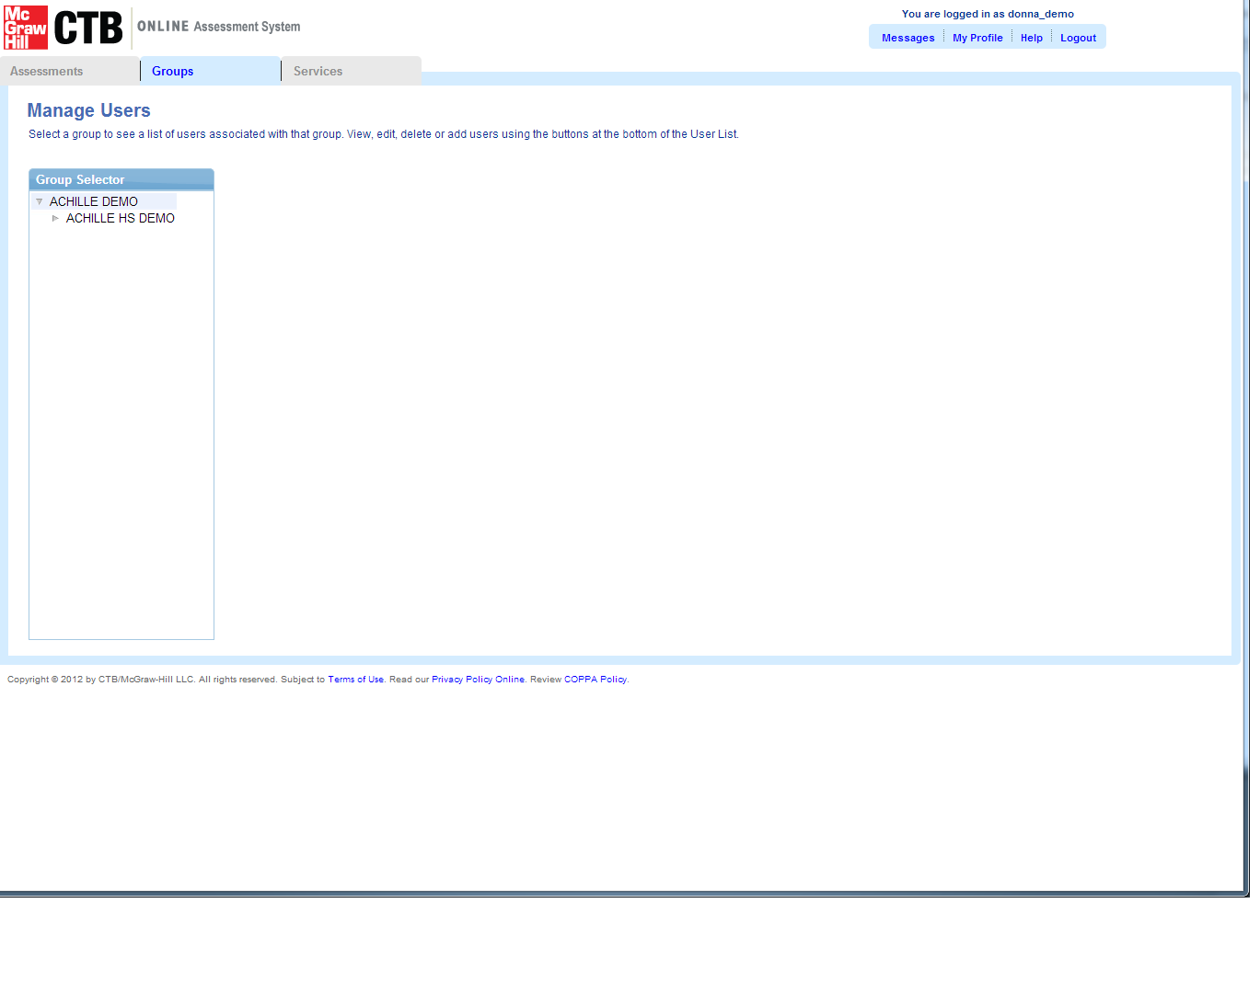
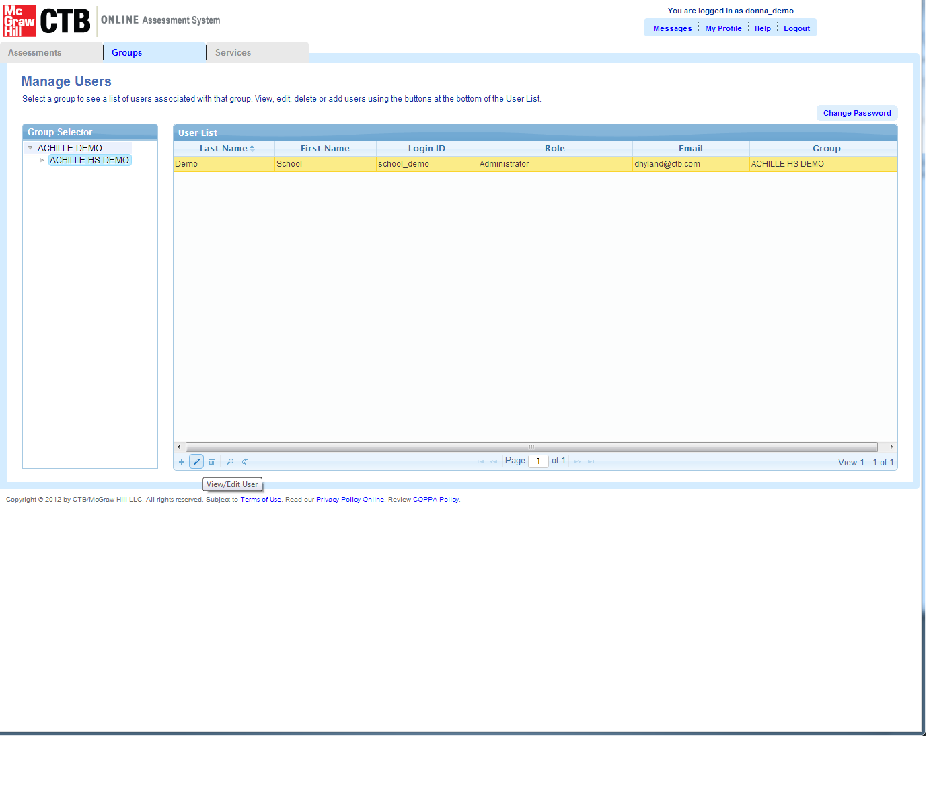
TAS Feature Review – Manage Users
A. Click Groups Tab, Choose Manage Users
Demo 1: Find and Edit a User
B. Navigate to school to view current users
C. Click Pencil Image to Edit User or Double Click User Row
Slide 46

Slide 47
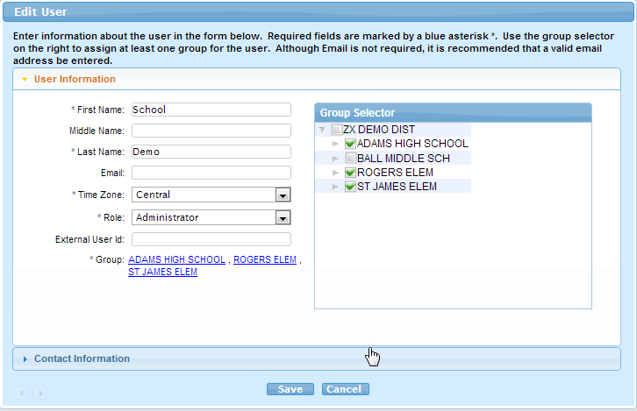
TAS Feature Review – Manage Users
Demo 1: Find and Edit a User
D. Edit User Information Fields
E. Select schools the User can access
F. Save
Slide 47

Slide 48
TAS Feature Review – Manage Users
Demo 2: Add a New User
A. Click “Manage Users” from the Groups menu tab.
B. Navigate to the school to display available users for that school.
C. Click the + (plus) symbol to open the “Add User” window.
D. Add user information. Ensure that email address is correct. TAS will use the email address to contact the new user with account details.
E. Click Save and exit out class screen.
Slide 48

Slide 49
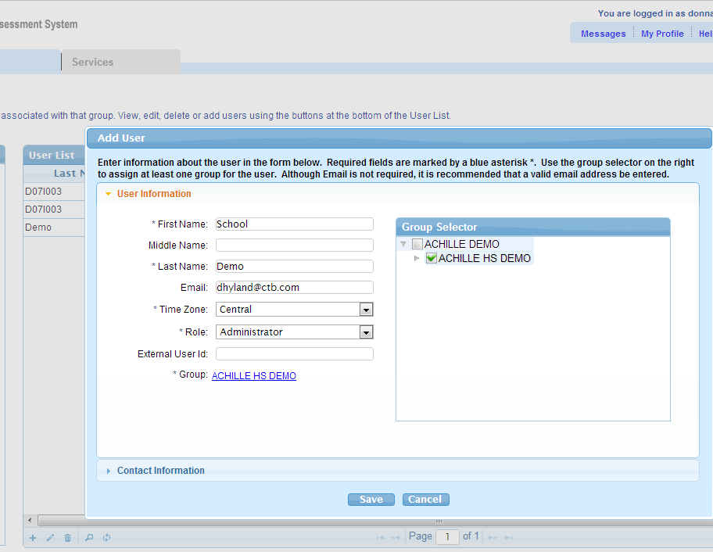
TAS Feature Review – Manage Users
A. Click Groups Tab, Choose Manage Users
Demo 2: Add a New User
D. Enter User Profile Data
B. Navigate to school to view current users
D. Select School
E. Save
C. Click + to add User
Slide 49

Slide 50
TAS Feature Review – Manage Users
Other Considerations
Tech Coordinator may need access to multiple schools. Can be assigned by District-level Test Coordinator.
Slide 50

Slide 51
TAS Feature Review – Student Management
Student Management
Demo 2: Add a New Student
Demo 3: Mark Student Not Testing
Other Considerations – Student Delete
Demo 1: Find and Edit a Student
Slide 51

Slide 52
TAS Feature Review – Student Management
Demo 1: Find and Edit a Student
A. Click “Manage Students” and then “Student List” from the Groups menu tab.
B. Navigate to the School to display students.
C. Click the Magnifying Glass option to open the search window.
D. Enter the first few letters of the student’s last name and click Search.
E. Choose the correct student from the displayed list by double clicking on student.
F. Edit profile details and/or accommodations/ Add Text to Speech.
G. Click Save and exit out of the student profile.
Slide 52

Slide 53
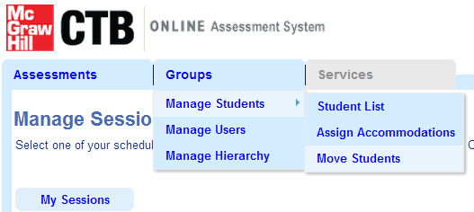
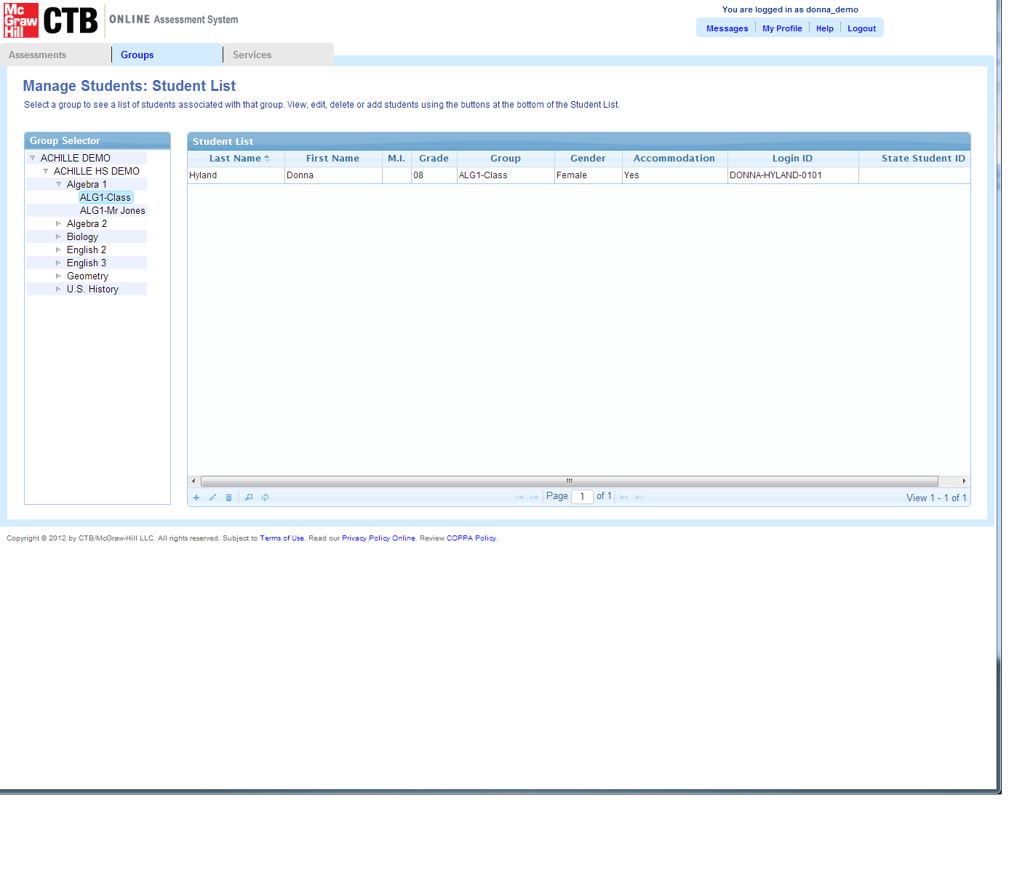
TAS Feature Review – Student Management
A. Click Groups Tab, Choose Manage Students and Student List
Demo 1: Find and Edit
a Student
B. Navigate to school and Subject and Class to view students.
Slide 53

Slide 54
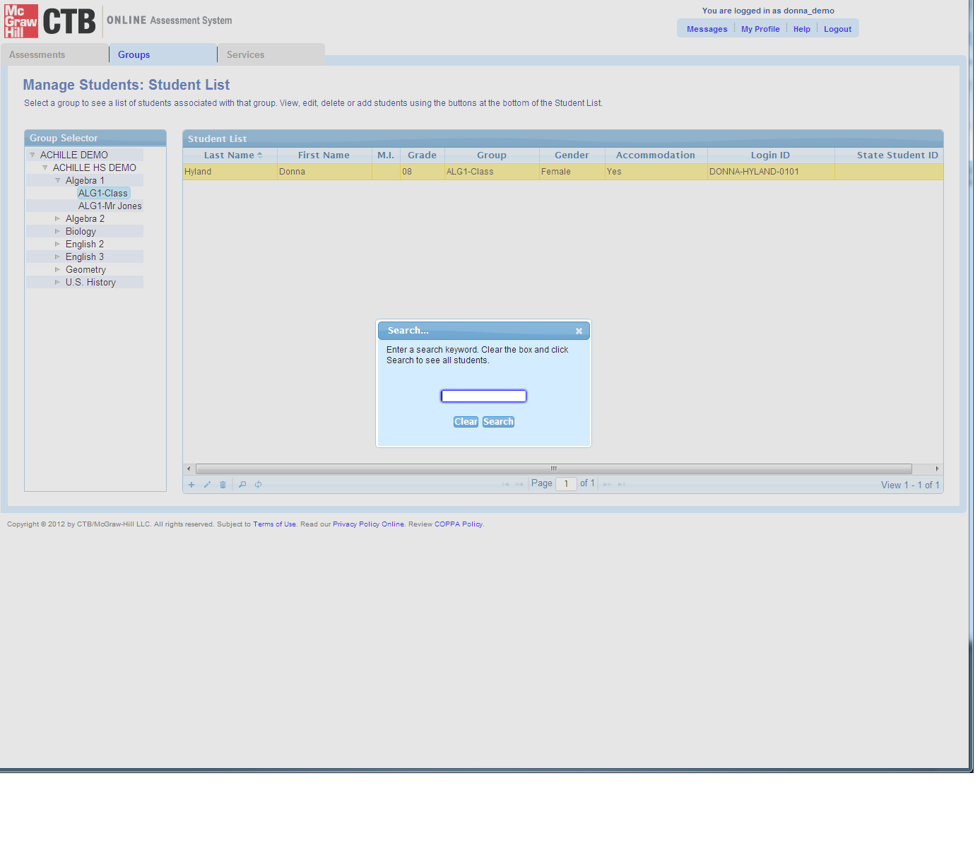
TAS Feature Review – Student Management
Demo 1: Find and Edit a Student
E. Choose student from list by double clicking
D. Enter the first few letters of the student first or last name
C. OR Click magnifying glass to open search window
Slide 54

Slide 55
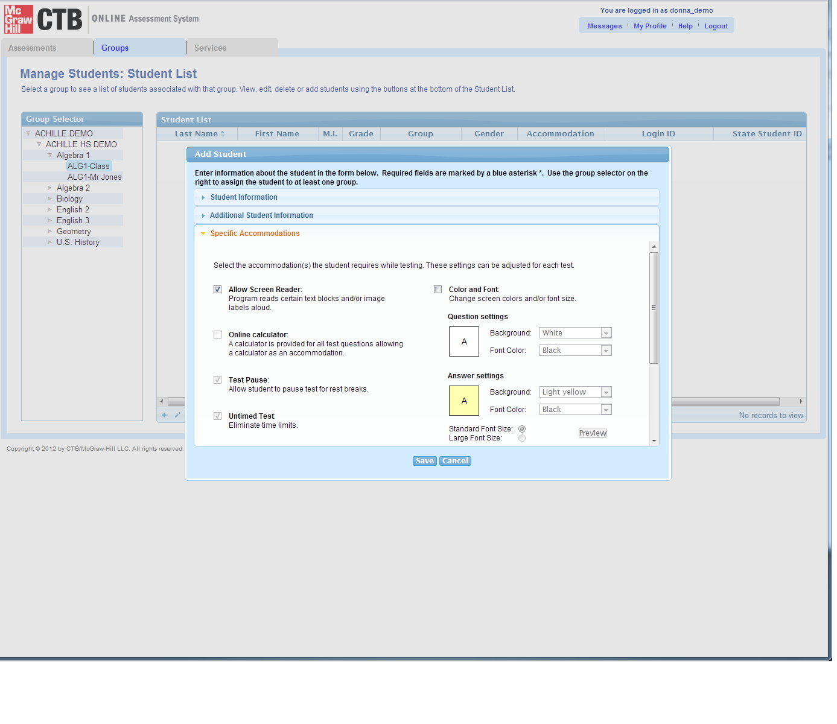
TAS Feature Review – Student Management
Demo 1: Find and Edit a Student
F. Edit student profile – Add Text to Speech Accommodation
G. Click Save
Slide 55

Slide 56
TAS Feature Review – Student Management
Demo 2: Add a New Student
A. Click “Manage Students” and then “Student List” from the Groups menu tab.
B. Navigate to the School to display students.
C. Click the + (plus) symbol to open the Add Student window.
D. Add student to a Subject/Class.
E. Enter profile details and accommodations.
F. Click Save and exit out of the student profile.
Slide 56

Slide 57
TAS Feature Review – Student Management
A. Click Groups Tab, Choose Manage Students and Student List
Demo 2: Add a New Student
B. Navigate to school and Subject and Class to view students.
Slide 57

Slide 58
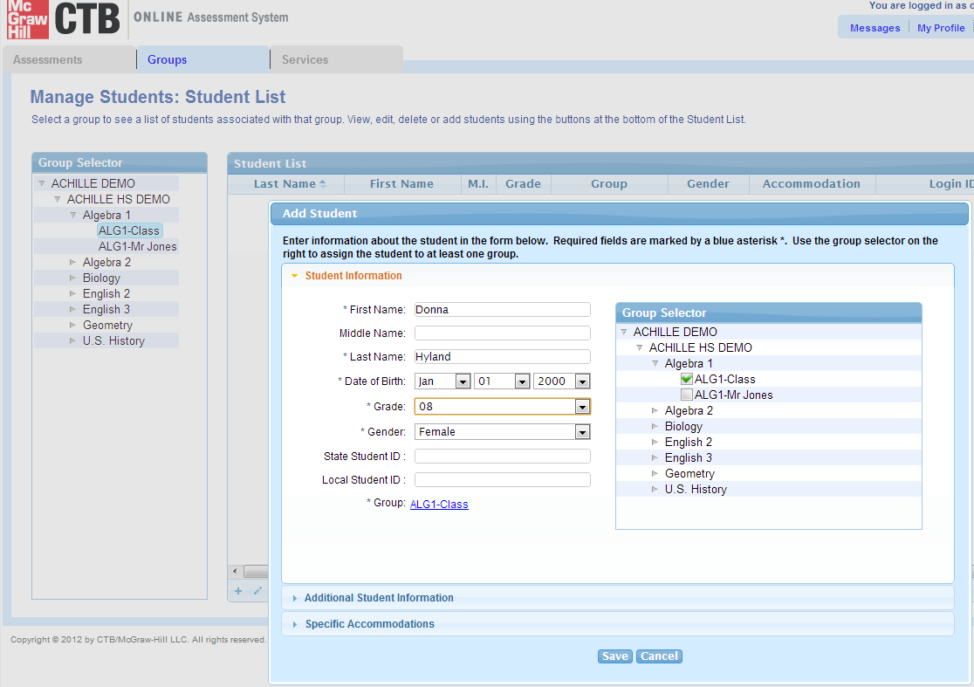
TAS Feature Review – Student Management
Demo 2: Add a New Student
D. Enter Student Profile Data
D. Add Student to subject/class
E. Enter Additional student info
F. Save
C. Click + Symbol to open Add Student Window
Slide 58

Slide 59
TAS Feature Review – Student Management
Demo 3: Mark Student Opt-Out for Health Sex Ed questions
A. Click “Manage Students” and then “Student List” from the Groups menu tab.
B. Navigate to the School to display students.
C. Click the Magnifying Glass option to open the search window (if needed).
D. Enter the first few letters of the student’s last name and click Search.
E. Choose the correct student from the displayed list by double clicking on student.
F. Open the Additional Student Information Panel.
H. Click Save to exit out of the student profile.
G. Check the 4 boxes for Special Use
Slide 59

Slide 60
TAS Feature Review – Student Management
A. Click Groups Tab, Choose Manage Students and Student List
Demo 3: Mark Student Opt-Out
B. Navigate to school and Subject and Class to view students.
Slide 60

Slide 61
TAS Feature Review – Student Management
Demo 3: Mark Student Opt-Out
E. Choose student from list by double clicking
D. Enter the first few letters of the student first or last name
C. OR Click magnifying glass to open search window
Slide 61

Slide 62
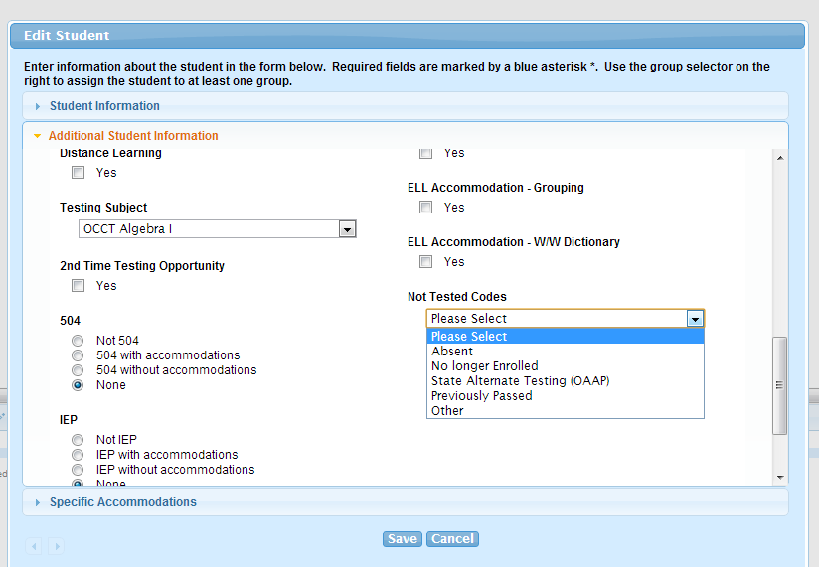
TAS Feature Review – Student Management
Demo 3: Mark Student Not Testing - EOI
Replace screenshot with mockup
F. Open the Student’s Additional Student Information Panel
G. Select reason for not testing
H. Save
Slide 62

Slide 63
TAS Feature Review – Student Management
Other Testing Considerations
Student Delete
Slide 63

Slide 64
Demo – Manage Classes and Students
Manage Classes and Students
Demo 2: Find and Edit a Class
Demo 1: Add a New Class
Slide 64

Slide 65
Demo – Manage Classes and Students
Demo 1: Add a New Class (Teacher)
A. Click “Manage Hierarchy” from the Groups menu tab.
C. Click the + (plus) symbol to open the Add Class window.
D. Add class (teacher) Data.
E. Add class to School and Subject.
F. Click Save and exit out class screen.
B. Navigate to the School and Subject to display classes.
Slide 65
Notes:
Note: For grades 6-8, it is important to Add Classes with teacher names and then add students to those classes, IF you want students reported by teacher. Otherwise, the default teacher name is “NO NAME”
Also – because of the locked hierarchy, you can only add classes under a Subject. This helps keep the class assignments organized for testing and reporting.

Slide 66
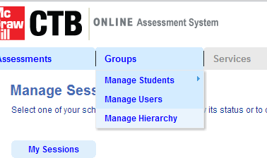
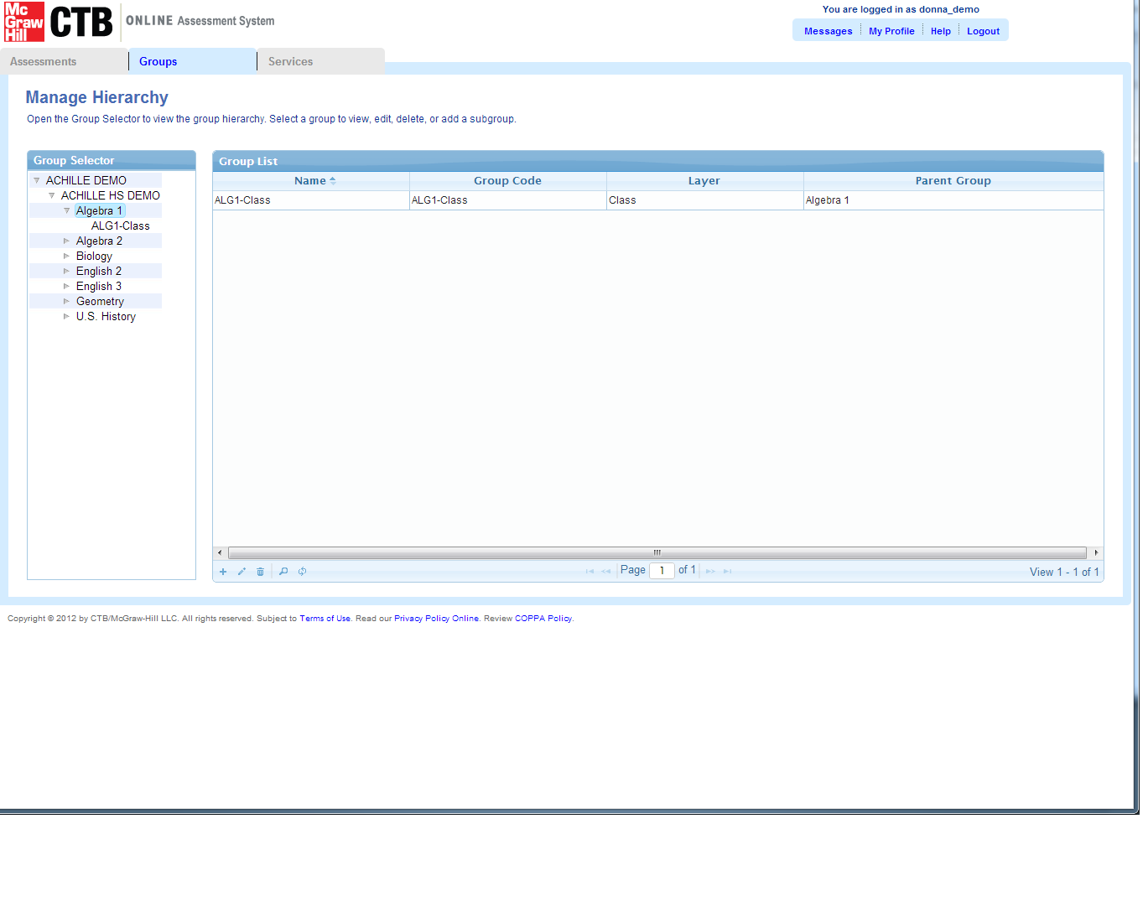
Demo – Manage Classes and Students
Demo 1: Add a New Class (Teacher)
A. Click Groups Tab, Choose Manage Hierarchy
B. Navigate to school and subject to view current classes
Slide 66

Slide 67
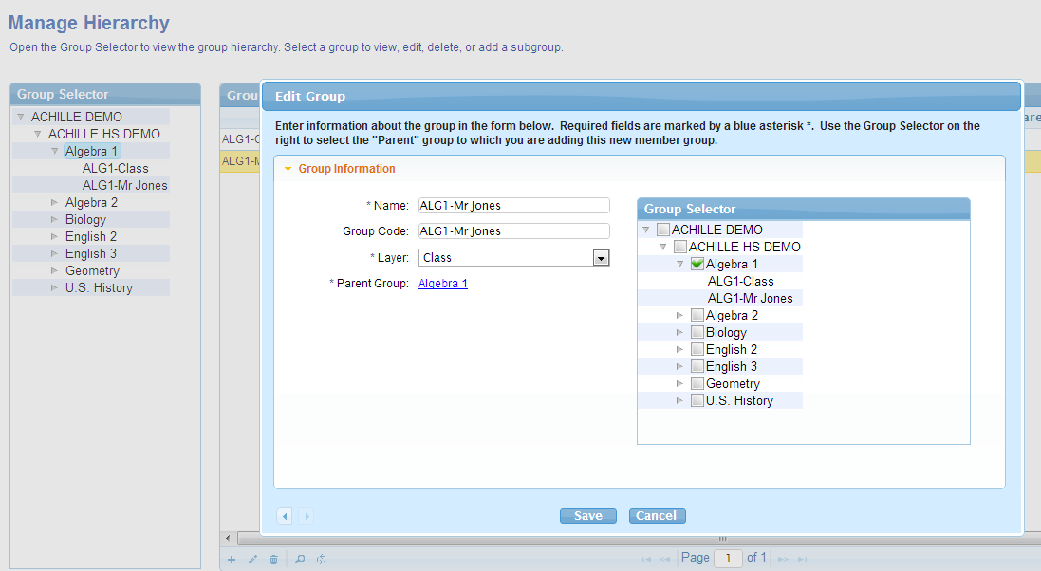
Demo – Manage Classes and Students
Demo 1: Add a New Class (Teacher)
D. Enter New Class Data
E. Select School and Subject as Parent Group
C. Click + to add Class
F. Save
Slide 67

Slide 68
Demo – Manage Classes and Students
Demo 2: Find and Edit a Class (Teacher)
A. Click “Manage Hierarchy” from the Groups menu tab.
B. Navigate to the School and Subject to display classes.
C. Choose the correct class (teacher) from the displayed list by double clicking on record.
D. Edit the information details for the class.
E. Click Save and exit out of the class profile.
Slide 68
Notes:
NOTE: It is important to note that the “Hierarchy” is locked for District, School and Subject.
These should only be edited by CTB Technical Support.
DC Health users can create and edit the class-level to add teachers, and assign students to classes.

Slide 69
Demo – Manage Classes and Students
Demo 2: Find and Edit a Class (Teacher)
A. Click Groups Tab, Choose Manage Hierarchy
B. Navigate to school and Subject to view current classes
Slide 69

Slide 70
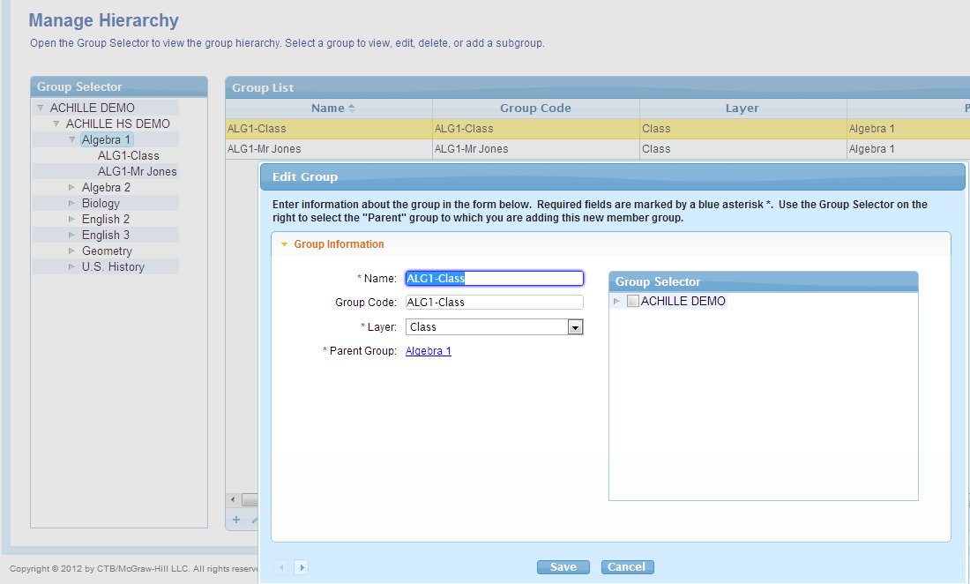
Demo – Manage Classes and Students
Demo 2: Find and Edit a Class (Teacher)
D. Edit Class Details
E. Save
C. Click Pencil Image to Edit Class or Double Click User Row
Slide 70

Slide 71
Need Help
Support Resources
Need Help?
Support Options and Resources
Slide 71
Notes:
Bullet Points:
Covered a lot of information
Resources are available if you need them.
Script
We have covered a lot of information today. If you find you need help, there are several resources available to you.

Slide 72
Support Resources
Support Resources
Administration Policies and Procedures Assistance
DC Office of State Superintendent Office
Office of Accountability and Assessments
http://www.osse.dc.gov
DC CAS Customer Support (CTB)
CTB DC CAS Help Desk
DC-CAS_helpdesk@ctb.com
http://www.ctb.com/dc-cas
Phone: 800-994-8579, Fax: 866-282-2251
Hours of Operation: 8:30 a.m. – 5:00 p.m. Eastern Time
Slide 72
Notes:
Bullet Points:
Refer policy questions to the State Superintendent Office (OSSE)
Refer technology related question to the CTB support team.
Script
For policy related questions, please contact the . For technical support needs, please contact the CTB DC CAS Help Desk either via email or phone.

Slide 73
Resolution Approach
Test Administration
Acts
of Nature
OSSE Case-by-Case Decision
CTB Customer Support
Local Site Troubleshooting
LAN / WAN / ISP
Bandwidth intensive applications
General TAS and TDC functionality questions and support needs
Technological
Resolution Approach
Slide 73
Notes:
Main Points:
Support for local issues can be categorized as illustrated here.
CTB support will be available for Test Administration questions/issues.
Technological issues will be handled collaboratively by local technical support and CTB.
Acts of Nature will be handled on a case-by-case basis with OSSE . Please contact both CTB and OSSE with details of your situation.
Say:
From a local perspective, there a several categories of issues to be aware of and possible approaches to their resolution.
During the Test Administration, and while the students are testing, our CTB support team will be there to assist with normal functionality questions or issues.
At the next level, Technological issues and troubleshooting will be done in collaboration with CTB and other resources.
Note: Your local technical support team is your primary point of contact for technical support issues. They have resources and documentation on how to handle common issues and errors.
For issues out of your control - for example severe weather conditions or the cable being cut, which actually happened last year, one possible resolution is a test window extension. All such issues would be decided by the OSSE on a case-by-case basis.

Slide 74
Next Steps/Takeaways
Next Steps/ Takeaways
Train your Tech Coordinator or have him/her attend a training session.
Print test tickets and prepare schedules for testing sessions.
Conduct practice tests with students
Schedule Practice Tests and Operational Test Sessions
New DEMO Site & TDC available March 25
April 4: Practice / Operational content available for download
Slide 74

Slide 75
Training Toolkit
Training Toolkit
Test Administration Manual
Troubleshooting Guide
Online Quick Start Guide
Online Test Preparation and Administration and Checklist
Test Administration Training Power point Presentation
Slide 75

Slide 76
QA
Q & A
Answers
Questions?
Slide 76
Notes:
Bullet Points:
Questions and Answer period
Taking questions from chat first, then operator can open the line.
Script
Now let’s turn our attention to answering your questions. We will take questions from the chat pane first; then the operator will open the phone lines for questions. We have representatives from OSSE on the call with us, as well as a member of the CTB support team to assist in responding to your questions.

Slide 77
QA
Appendix – Additional TAS Features
Additional Features
Demo : Bulk Assign Accommodations
Demo : Export Student Lists
Slide 77

Slide 78
Additional TAS Features
Demo : Bulk Assign Accommodations
A. Click “Manage Students” and then “Assign Accommodations” from the Groups menu tab.
B. Navigate to the School and Subject to display students.
D. Click the box next to the student names that need accommodations such as Text to Speech.
E. Click the Edit Accommodations button
F. Select the accommodations from the panel that displays.
C. Select up to three filters to select student group.
G. Click Submit.
Slide 78

Slide 79
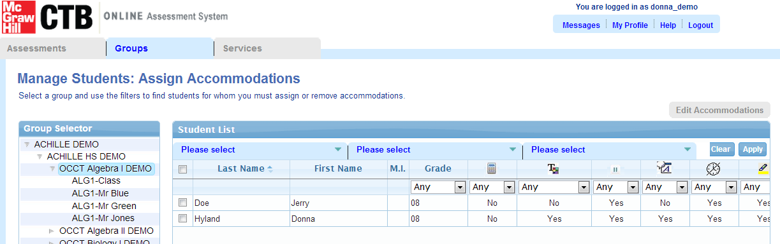
Additional TAS Features – Bulk Assign Accommodations
Demo : Bulk Assign Accommodations
A. Click Groups Tab, Choose Manage Students and Assign Accommodations
B. Navigate to school and Subject and Class to view students.
C. Select up to three filters to narrow the student list.
Slide 79

Slide 80

Additional TAS Features – Bulk Assign Accommodations
Demo : Bulk Assign Accommodations
E. Click Edit Accommodations
D. Click the box next to student name to select.
F. Choose Accommodation
G. Click Submit
Slide 80

Slide 81
Additional TAS Features
Demo : Export Student Lists
A. Choose “User/Student Load” and then Export from the Services menu tab.
B. Click on Student Data and click Export.
Slide 81

Slide 82


Additional TAS Features – Import Students
A. Click Groups Tab, Choose Manage Students and Student List
Demo 3: Export Records
B. Highlight Student Data and Click Export to Download the file.
Slide 82

