Slide 1
DC-CAS Health Online
Spring 2013 Pilot
Site Readiness Training
Webinar Etiquette
This call will be operator assisted.
Please submit questions through the chat window throughout the presentation or via the operator during the Q&A portion of the meeting.
Feb 2013
Slide 1
Notes:
Welcome to Registration and Site Readiness Training

Slide 2
Agenda
Welcome and Session Goals
Milestones (Important Events)
Health Online Program Overview
Support
Test Delivery Client (TDC)
Common Terminology
Slide 2
Notes:
Welcome to the Spring 2013 Site Readiness Training event. **Participation is only required for one of these sessions as all sessions are identical.
We have a lot to cover today – so let’s jump right in. My name is ______. I am an Online Implementation Manager at CTB and am responsible to ensure that we do the best job we can in making the both the student’s experience as well as the educator’s experience with online testing as pleasant, painless and engaging as possible. Today’s meeting has been scheduled for two hours and includes information on the following topics - an quick look at some of the upcoming Milestones and Key Events, a review of common terminology, along with an overview of the Online Program. We will then dive in to the Site Readiness instructions and installing the test delivery client and content. We will wrap up with details on support resources available to you, next steps and a Question and Answer session.
Before we begin – I wanted to mention, due to the volume of attendees, today’s call will be operator assisted. The phone lines will be opened at the end of the training for another question and answer session. In addition to questions over the phone, feel free to ask questions via the chat window. ** If we are unable to answer all your questions during the time allotted today, please do not hesitate to contact the customer support team for further assistance. In addition, if the question was submitted via chat, I will pull those and post those FAQs to the CTB web portal. With that, let’s get started.

Slide 3
Welcome to CTB
Welcome to CTB
Office of State Superintendent Office
Dr. Margaret Barco
Erin Watts
CTB/McGraw-Hill Education
Director of Assessment
Health Education Specialist
Glenn Gage, Program Associate
Amy Dement-Dorey, Sr. Program Manager
Rob Mann, Online Implementation Manager
Slide 3
Notes:
Bullet Points
Introduce SDE and CTB. Mention CTB customer support also on phone.
Script
I want to spend a moment to introduce key team members for the DC-CAS testing program. We have team members from the OSSE (Office of State Superintendent Office) on the call (WHO) with us along with CTB program and customer support team members.. From CTB, we have program team members as well as a customer support.

Slide 4

Benefits of Online Testing
Key Benefits
Ease of test administration
Security
Delivery of Accommodations
Prep for future of testing
Notes:
DOE will present this slide.
Notes on Test Administration, Test Security

Slide 5
Online Test Administration
Easier to administer
Students view one item at a time
Items are shown larger than on paper/pencil version
Research shows comparability between online and paper/pencil testing
Students motivated by online format
Notes:
Easier to administer: no inconvenience and labor intensive demands of paper documents
One item at a time displayed – background for test question and answer choices are different
Items shown larger than test booklet
Students motivated
Research also indicates there is no marked difference in test results for online testing versus paper/pencil – there is an Appendix at the end of this presentation that references Research articles regarding online testing.

Slide 6


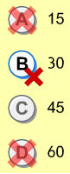




Student Testing Tools
Option eliminator
Highlighter
Eraser
Pause Test
Mark for Later Review
Slide 6
Notes:
Main Points:
Additional tools are available to students and administrators:
Stop/Pause – Students can click a button to stop/pause the test.
Highlighter – Used to highlight portions of the screen.
Eraser – Erases highlighting or option eliminator marks.
Mark for Later Review – Marks the question number in yellow at the bottom of the testing screen so a student can return to it later.
Option Eliminator – Allows students to place a red “X” over incorrect answer choices to help them pick the correct answer.
Say: Additional testing tools available include:
Un-timed: the un-timed test
Highlighter/Mark for Later Review allows the student to highlight an item, skip the question, and return later.
Eraser allows the student to erase an undesired answer.
Option Eliminator allows the students to eliminate answer choices they feel are incorrect.
Advanced settings of student preferences: If you prefer, Test Coordinators can sit with students to set their preferences outside of the lockdown browser and in advance of the testing window, allowing students to see how the changes will affect their test experience before they actually take the test.

Slide 7
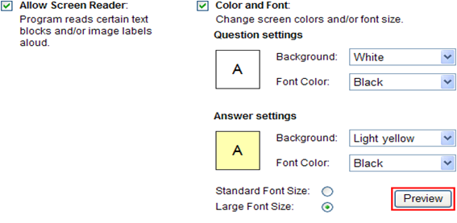
Test Accommodations
Accommodations available for students on an IEP, 504 Plan, or ELL students
Screen Reader Text-to-speech
Font Size
Background and Font Color
Screen Reader speed and volume control
Slide 7
Notes:
Read Aloud features; Multiple students with Accommodations can be assigned as a group and actually tested with student without accommodations provided headphones available.

Slide 8
Agenda
Roles and Responsibilities
Network and Workstations Requirements
Site Preparation Considerations
Support Resources
Important Dates
Q&A
Scope
System Overview
Site Readiness Steps
3/14/2013
8
Notes:
CTB will continue with the slides from here
The slides will be also posted at www.ctb.com/gacrct

Slide 9
DC CAS Health Online Scope
Tests
Online Practice and Health Online Pilot
Administration Dates
Practice: April 8 to April 19, 2013
Subjects
Health: Grades 5, 8, High School
Student Data
Loaded by CTB from school pre-code files
DC CAS: April 22 to May 2, 2013
3/14/2013
9
Notes:
(Speed thru this slide)
Two types of tests. Students must be provided the chance to take the practice test to become familiar with the testing system
Student data pre-loaded in the system is one of the online testing benefits especially for smaller systems that do not mind having all the non-retest students loaded as well
Improvement on the reporting turnaround for schools testing entirely online

Slide 10
Roles Overview
Roles Overview
District Test Coordinator
Assessment policies, procedures and possible test scheduling
School Test Coordinator
Test scheduling, student management, test administration, and invalidations
School Technology Coordinator
Setting up hardware and installing software for each school computer
District Technology Coordinator
Equipment and ISP, proxy servers, firewalls and WAN connections at each school
Notes:
The roles listed are typical to an online test, nevertheless, depending on the size of the system it’s possible that some people may have dual roles.

Slide 11
Roles and Responsibilities
Tech Coordinator
Before Test
Receive Login and Password Emails
Complete Site Readiness Activities
Review Site Readiness and Installation Instructions
Verify network and workstation configuration
Run Network Utility software
Install test software
Download test content
Complete practice test
Submit site certification form
During Test
Assist Test Examiners with technical issues
After Test
Use the Uninstall Utility to remove test software from workstations
Notes:
These are the typical activities the Technology Coordinators are required to perform. Depending on your site, there may be more/ other activities that your Test Coordinator may require assistance with.

Slide 12

Milestones (Important Dates)
Milestones | Dates
Technology Site Readiness Training | March 18 & 21
Test Administration System Training | March 25 & 26
Demo Web Site Access Test Delivery Client (TDC) download/install | March 25
Online Test Administration System (TAS) Test Content available for download / install | April 4
Sessions created and Test Tickets Printed (Schools with CTB Support) | April 8 - 19
Health Online Pilot Practice Testing Operational Test window | April 8 - 19 April 22 - May 2, 2013
Slide 12
Notes:
Bullet Points (Script is same for this page)
Review the Milestones and dates.
Script
Review the Milestones and dates.

Slide 13
Key Session Goals
Health Test Online
Review Test Delivery Client Installation (TDC)
Review Online Program
Slide 13
Notes:
The key session goals for today’s training event include:
An overview of the Online program and the readiness process for both technology and test coordinators We will also review the Test Delivery Client and content installation. We will not cover the Test Administration Site application during today’s session except as it relates to retrieving the test delivery client and content. The Test Administration System application will be covered in sessions that begin in March.

Slide 14
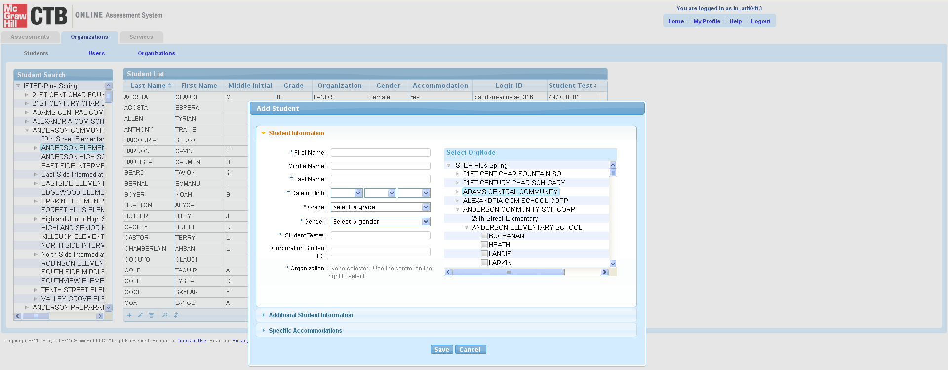
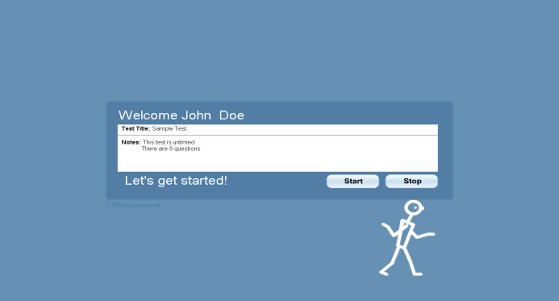
Looking Ahead
Online Program Overview
Test Administration System (OAS)
Student data management
Test assignments
Testing status
Test Delivery Client (TDC)
Student testing software (TDC)
Lock down browser
Slide 14
Notes:
The CTB Online Assessment System consists of 2 applications, the Test Delivery Client and the Test Administration System. The focus of today’s presentation is on the Test Delivery Client.
Today’s training will focus on getting your site ready with the Test Delivery Client software and the ancillary components.
For initial site readiness, the Test Delivery Client software can be downloaded directly without having to login to the Test Admin web site.
Links to the Test Delivery Client (TDC) are being sent in a memo to District Test Coordinators.

Slide 15
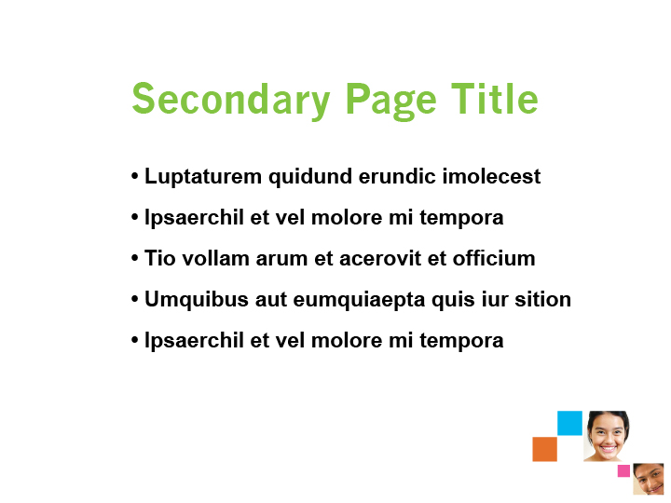
Checkpoints Review
Checkpoints
Checkpoint 1
Test Administration Training (TAS)
Final Workstation Check
Checkpoint 2
Initial Site Readiness Report
Final Content Installation
Test Assignments
Site Readiness Data Collection
Test Delivery Client Installation
Site Support/ Troubleshooting
Checkpoint 3
Technology Readiness
Slide 15
Notes:
Script
The checkpoint process is meant to assist districts and schools with guidance as we prepare and conduct end of instruction test administrations. Checkpoint 1 focuses on site readiness.
We have collected data about DC-CAS workstations and network capacity using the Technology Survey spreadsheet that received and have filled out. CTB is analyzing this data and will communicate with districts and schools that may need support in preparing their sites for online testing.
Checkpoint 2: goals are installing the testing client and content, which is our focus today.
Checkpoint 3 focuses on finalizing preparation for testing. You will hear checkpoints references throughout the training.

Slide 16
Test Delivery Client and Content Tasks
Access the TDC Software and Content
Test Delivery Client (TDC) Installation
Content Installation
System Verification
For a Positive Testing Experience…
Slide 16
Notes:
Let’s continue by reviewing the Test Delivery Client and Content installation process.

Slide 17
Network Requirements
Network Requirements for Testing
Bandwidth
T1+, high-speed cable or DSL recommended
Minimum 1.5 Mbps upload and download
Firewalls
Port 80 and 443 must be open
LAN
Wireless is OK but do not overload WAP
Proxy Servers
Do not Cache Dynamic Pages
Prioritize/allow HTTP and HTTPS traffic for *.ctb.com
Users need credentials if proxy authentication is enabled
Name: tms-oas-55.ctb.com Address: 12.167.24.52
Name: tms-oas-ew.ctb.com Address: 204.8.131.239
TTS setup – Allow/Do not block - *.readspeaker.com
Address: 79.136.80.254 – Cloud hosted. IPs may change over time.
Web Content Filtering
Allow MP3 (Necessary for Text to Speech)
Slide 17
Notes:
Bullet Points
Review each item – and the contents of the requirements sections.
Script
The first step in confirming network minimum requirements is to confirm network bandwidth. The minimum is 1.5 Mbps upload and download speed. T1, high-speed cable, or high-speed DSL are recommended. The next step is to setup the firewall. Ports 80 and 443 must be opened. ctb.com also needs to be whitelisted. Continuing with proxy servers, the first step is to not allow caching of dynamic pages. Next, allow both HTTP and HTTPS traffic for *.ctb.com. Next, exclude *.ctb.com from content filtering. Finally, confirm that users have credentials if authentication is enabled. The software uses MP3 files to serve up text to speech content. Please make sure to not block/unblock MP3 files.
Finally, Is wireless ok for online testing? Yes, it is. Distance from the WAP and the number of connections to the WAP should be thoughtful considerations.

Slide 18
Student Workstation Minimum Requirements
Student Workstation Minimum Requirements
Can also be accessed at www.ctb.com/dc-cas
Hardware and Memory
Minimum: 1.0 GHz processor, 1.8 GHz processor (MAC), 512 MB of memory (1 GB recommended), 200 MB disk space available
Monitor/ Speakers
Operating System
Windows - XP SP3, Vista SP1, Windows 7 (32 or 64 bit)
Linux - Linux Fedora 11 (Red Hat), OpenSUSE 11.1, or Ubuntu 9.04
Additional Software
Adobe Air® 2 or newer; Flash® Player 9 (MAC) or later
Adobe® Reader® 7.0 or later
Java Runtime Environment JRE 6, Update 24 or later
Minimum screen size – 10”
Speakers “on” and Headset for “Text To Speech” Accommodated Students
Mac - OS 10.5.4, 10.6, 10.7, 10.8 Intel
Slide 18
Notes:
Bullet Points
Review each section and related requirements
Comment that Tablets are not supported for Spring 2013.
Note Mac OS requirements 10.5.4 and above
Script
The workstation checklists, located in the support section of ctb.com/ok provide more detail regarding workstation minimum requirements. A couple of key notes – Windows 7 both 32 and 64 bit are supported, as well as 10.8 Mountain Lion for Mac.
Tablets will NOT be supported during the 2013 test administration.

Slide 19




TDC Step 2 Install Ancillary software
Test Delivery Client Installation - Ancillary
Step 2 – Install Ancillary Software (if needed)
Java Runtime Environment JRE 6.24 ®
Minimum. Later versions of such as JRE 6.29 and 6.30 work as well.
Adobe Air 2 ®
Minimum (PC, Linux). Later versions of Air such as 3.1 works as well.
Adobe Flash 9 ®
Minimum
(MAC)
Slide 19
Notes:
Bullet Points
Minimum requirements for the ancillary applications have not changed.’
If the site has automated tools, installing these applications can be completed in an automated fashion.
CTB is Unable to bundle due to 3rd party license.
Script
Java, Air/Flash are still required components for to run the test client. Due to 3rd party license requirements, CTB is not able to bundle these applications with the TDC install into an MSI package. It is okay to install the ancillary applications as soon as you want. You do not need to wait for the Test Delivery Client software to be released.

Slide 20
TDC Installation
Test Delivery Client Installation
Step 1 – Make Necessary Network Updates
Step 4 -Install Content
Step 5 – Verify Installation
Step 3 – Download and Install Test Delivery Client (TDC) software
Step 2 – Install Ancillary Applications (if not already resident)
Slide 20
Notes:
Script
The steps to install the TDC client for 2013 include making any necessary network updates as detailed on the prior slides, installing ancillary applications if not already present on the workstations. Next, install the Test Delivery Client and testing content. Finally, confirm the installation by spot checking a few workstations. Again, there are 2 methods for installing the Test Delivery client as was introduced on the last slide.

Slide 21
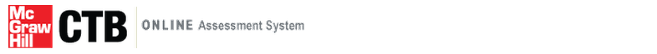
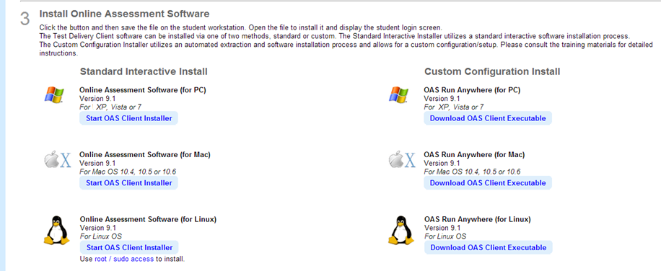
Looking Ahead
Download the Test Delivery Client Software
Direct download for site readiness
For the Standard Install
WINDOWS XP, Vista, Windows 7 | https://oas.ctb.com/downloadfiles/OAS.exe
MAC 10.5.4, 10.6 Intel, 10.7 | https://oas.ctb.com/downloadfiles/OAS.zip
LINUX Fedora 11, OpenSuse 11.1, Ubuntu 9.04 | https://oas.ctb.com/downloadfiles/OAS.bin
In March, these links will be available through the DEMO Online Assessment System
Slide 21

Slide 22
TDC Step 3 – New 2012 TDC installer
Test Delivery Client Setup
Standard Installer Method
1. Download the Standard TDC Client installer version.
2. Double click the TDC installer and choose to run/save the installation.**
3. When the installation has finished, students will use the Test Delivery Client shortcut present on the desktop to launch the application.
4. Configure the Proxy. Properties file if requiring proxy authentication.
5. Access the objectbank folder and install (cache) the testing content.
6. This workstation is now ready for online testing.
**It is not necessary to enter District and School ID #s during install. It is ok to skip this step.
Slide 22
Notes:
The steps to install the Test Delivery Client on the PC are: Access the software installation link. This link will be provided later in February. Choose to Run or Save. Clicking Run will begin the installation process. Follow the steps on the screens that display to install the software. Next, for sites that use proxy server authentication, locate the proxy.properties file and update.
Finally, access the testing content zip file from the link provided (or through the Test Administration System after it becomes available), unzip and place all files into the objectbank folder.
Speaker say: Content can be downloaded for practice testing before April 4, but you will need to download the final content packages prior to the test administration.
The student will either click the TDC shortcut link or navigate to the Online Assessment application via the “start, programs” to run the test delivery client.

Slide 23
TDC Installer - MAC Considerations
Test Delivery Client Installation - MAC Considerations
Standard Installer Method – Mac
2) Configure proxy.properties file found in
Macintosh -HD/Applications/OnlineAssessment/etc folder
3) Confirm Web Browser ‐ Safari®. Safari required on workstations for testing.
4) Click on Online Assessment Shortcut. TDC login page should launch.
This workstation is now ready for online testing.
1) Install student test content into folder
Macintosh- HD/Applications/OnlineAssessment/data/objectbank
Slide 23
Notes:
The steps to install on a Mac follow a standard install process. Mac sites tend to vary on software installation methods as there are some more automated ways to push software to a Mac. If you are a Mac site and need assistance with installing software, please contact the CTB help desk. We have Mac experts on staff that, based on your particular needs, can support you through the installation process. Following the installation, you will need to install content to the objectbank folder. For sites that use proxy server authentication, you will need to access and update the proxy.properties files. Safari is also required on Macs for the student test software to run.

Slide 24
TDC Installer – Linux Considerations
Test Delivery Client Installation - Linux Considerations
Standard Installer Method – Linux
2) Configure proxy.properties file found in [Installation location]/local/Online Assessment/etc/ folder.
3) Click on Online Assessment Shortcut. TDC login page should launch.
(Linux‐provided Online Assessment icon on the desktop)
4) This workstation is now ready for online testing.
1) Install student test content into folder …usr/local/OnlineAssessment/data/objectbank
Slide 24
Notes:
We recommend that Linux sites also use the standard installer though you can use the custom installer if you prefer. If you are a Linux site and need assistance with installing software, please contact the CTB help desk for instruction. Following the installation, you will need to install content to the objectbank folder. For sites that use proxy server authentication, you will need to access and update the proxy.properties files.

Slide 25
Test Delivery Client Setup
In order for the TDC to work properly and deliver an assessment, the following conditions must be met on each workstation:
Appropriate versions of AIR (or Flash, on the Mac) and the Java Runtime Environment must be installed and runnable by the logged-in user during testing.
The Test Delivery Client must be installed, and the Test Delivery executable must be runnable by the logged-in user during testing.
This executable must not be prevented from executing other processes, specifically java.exe.
The java executable must not be prevented from executing other processes.
The java executable must be able to make HTTP/HTTPS connections on ports 80/443 to *.ctb.com addresses.
The java executable must be able to bind and listen on TCP port 12345. The java component uses this port to receive requests from the Flash UI component.
The logged-in user during testing must have write access to [TDC installation location] and subfolders.
Slide 25
Notes:
There are some key considerations when installing the Test Delivery Client. Installation of the client may require administrative privileges.
** Speaker – review each of the items above.

Slide 26
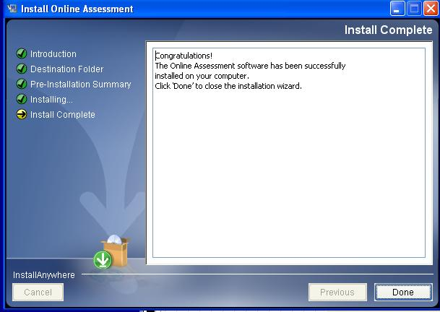
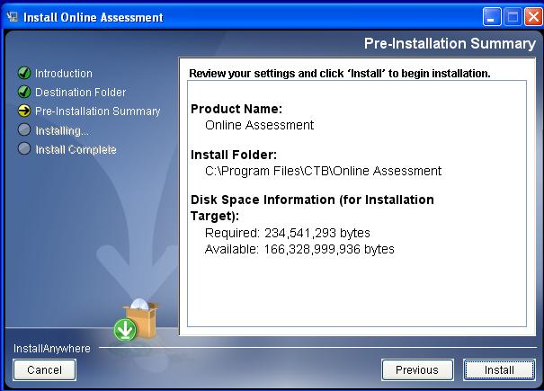
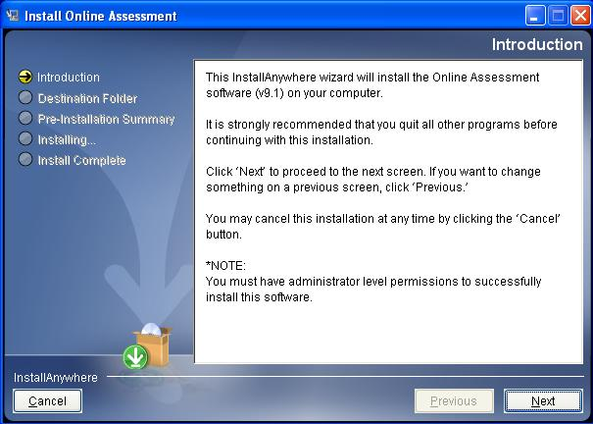
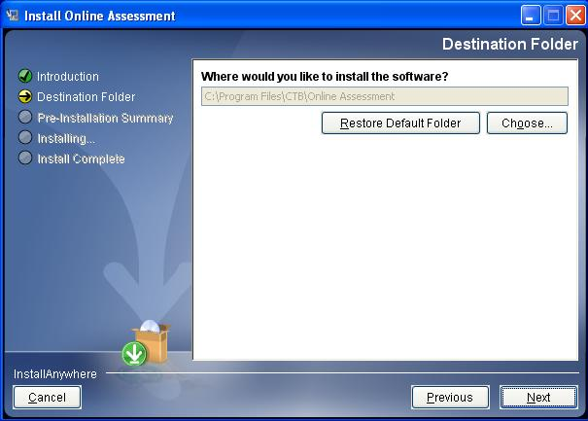
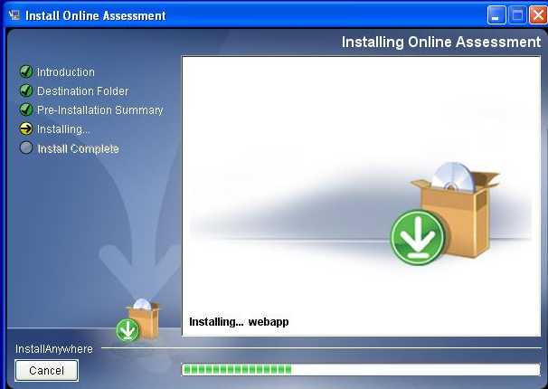
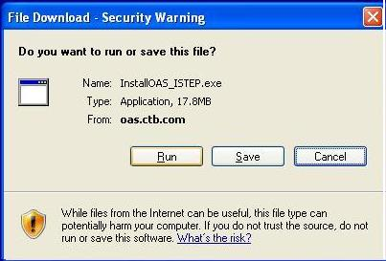
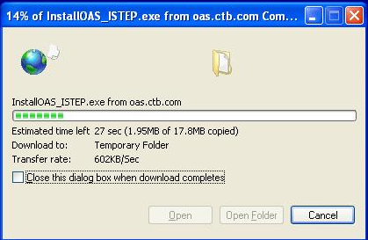
TDC Step 3 – Access 2011 TDC installer
Test Delivery Client Setup
(Click for animation)
Standard Installer - Access the TDC Installer and Install
Standard Installer – Download executable and run installer on each machine
Choose Operating System Platform
WINDOWS XP, Vista, Windows 7 | https://oas.ctb.com/downloadfiles/InstallOAS.exe
MAC 10.5.4, 10.6 Intel, 10.7 | https://oas.ctb.com/downloadfiles/InstallOAS.zip
LINUX Fedora 11, OpenSuse 11.1, Ubuntu 9.04 | https://oas.ctb.com/downloadfiles/InstallOAS.bin
1. Click the appropriate link above
3. Follow Installation Steps
2. Choose to Run the File
Slide 26
Notes:
The steps to install the Test Delivery Client on the PC are: Access the software installation link. These will be sent out in a memo to District Test Coordinators later this month.
Choose to Run or Save. Clicking Run will begin the installation process. Follow the steps on the screens that display to install the software.

Slide 27
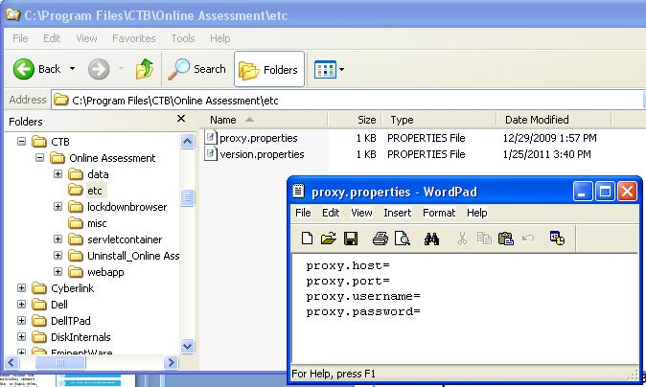
TDC Step 3 – Set Proxy Credentials
Test Delivery Client Setup Proxy
Standard Installer – Set Proxy Credentials if Needed
Enter Proxy Information if Required at Site
1. Open “etc” folder
2. Open “proxy.properties” file in text editor.
3. Enter proxy info (if needed) and save.
Slide 27
Notes:
Script:
If you choose the Standard installation method, the process to set the proxy properties file is shown. For those sites that have a proxy that requires authentication, navigate to the CTB Online assessment folder structure and locate the proxy.properties files. Open the file in a text editor, make the necessary changes, save and close. If you have automated network tools for deploying a file, it may be easier/faster to prepare the file and push out to the workstations from the server.

Slide 28
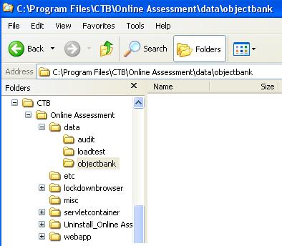
TDC Step 4 – Install content
Test Delivery Client Setup Content
Standard Installer - Access the Content and Install
Access the Content on OAS. Install on each workstation into objectbank folder
1. Open “objectbank” folder
2. Add test content files into “objectbank” folder
Slide 28
Notes:
Script:
After you have installed the client, navigate to the CTB Online assessment folder structure and locate the objectbank folder. Unzip and add content to the objectbank folder. . If you have automated network tools for deploying files, this may be easier/faster to push out to the workstations from the server. After installing the software, setting the proxy properties if required, and installing the content, this workstation is now ready for online testing.

Slide 29
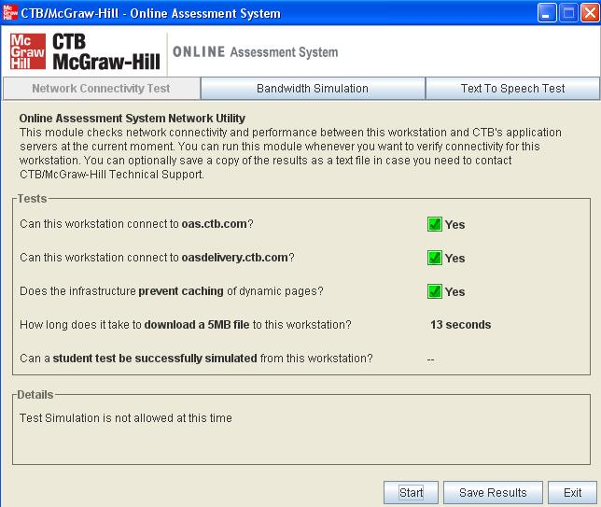
TDC Step 5 – Confirm Readiness
Test Delivery Client Setup Verify
Standard Installer – Verify setup on a few workstations
Confirm application installation and connectivity by using the TDC network utility.
  From the online application, launch the Network Utility.
  On the First Tab (Network Connectivity Test), click Start.
  Questions 1, 2 and 3 should return “Yes” which indicates that the application has been correctly installed.
  This does not confirm content installation.
From the “Network Connectivity Test” tab, click “Start”. The first three questions should result with “Yes” which confirms that the application has been correctly installed.
Slide 29
Notes:
If you use the standard installation method for the Test Delivery Client, you can partially confirm the workstation set up by running the network utility. When you run the network utility, you should receive 3 yes answers. Please ignore the load test simulation section. The load test is not currently active. *This option is not available in the custom installation process.

Slide 30
TDC Step 5 – Confirm Ready – 2nd method
Test Delivery Client Setup Verify
Standard Installer – Verify Setup on a few workstations
Launch Test Delivery Client software
Login using a fake login from the (OAS) training site (March 25)
If the application launches and login completes, then the application and content have been setup correctly.
Slide 30
Notes:
Bullet Points:
Verify workstations by logging into the client. You can use one or two of the EOI demo-training logins from the demo site.
If you can get to the TDC welcome page, the machine has been correctly configured.
Sample a few workstations to verify the setup.
This method works with both the standard and custom installer versions.
Script
The best method to verify workstation setup is to use a few of demo-training logins and try a few machines. This method works regardless of which version of the installer was used. If you login and the Welcome screen appears, the workstation has been properly configured.

Slide 31
Positive Testing Experience
For a Positive Testing Experience…
Anti-virus software full scans scheduled after testing hours
All other applications closed on testing machines during the test
Screen savers/power management set to a longer timeout
Restrict intensive bandwidth use during testing (VoIP, Payroll, Drop box)
Text To Speech –Volume and MP3
For a Positive Testing Experience…
Restore software (Deep Freeze) configured to retain test data after reboot
Laptop protocol – Use AC power, wired access, wireless check
Prioritize/Allow *.ctb.com
Ports Opened as described
Allow IPs (If IPs are used at site)
Blue = required
Orange = suggestions
Slide 31
Notes:
Bullet Points:
Items in orange are requirements
Items in blue are suggestions
Script
For a positive testing experience, please take few moments to review these additional elements. The items in the orange boxes are required. The items in the blue boxes are suggestions or considerations to keep in mind during testing time.

Slide 32
Next Steps/Takeaways
Next Steps / Takeaways
Test Delivery Client - available March 18
Key – Install TDC and Content as soon as available. Contact CTB Support if needed
CTB Staff resources are available to support installation and troubleshooting.
Verify workstation readiness prior to the test window.
Plan to attend Test Administration System Webinar
Slide 32
Notes:
Script
There are several takeaways from today’s session:
The link to the Final Test Delivery Client will be available by April 1. Watch for an email to confirm when the application is ready.
Regarding the test delivery client, consider the pros/cons for each installation method and choose the option that works better for your site. A troubleshooting guide and testing steps will also be available soon on the CTB Web Portal. Staff resources are available to support you through the process. We recommend to install the test delivery client as soon as you can after it is available – and contact the CTB support team if you run into any issues.

Slide 33
Checkpoint 3 Review
Looking Ahead
Looking Ahead
Test Administration Training
Install Test Delivery Client (Mar 25)
Final Workstation Check
DEMO System Access
Test Assignments and Practice Tests
Final Content for Installation (Apr 4)
LIVE System Access
Slide 33
Notes:
Script
Looking ahead to upcoming activities, we will conduct several test administration system training sessions in preparation for the upcoming test administrations.

Slide 34
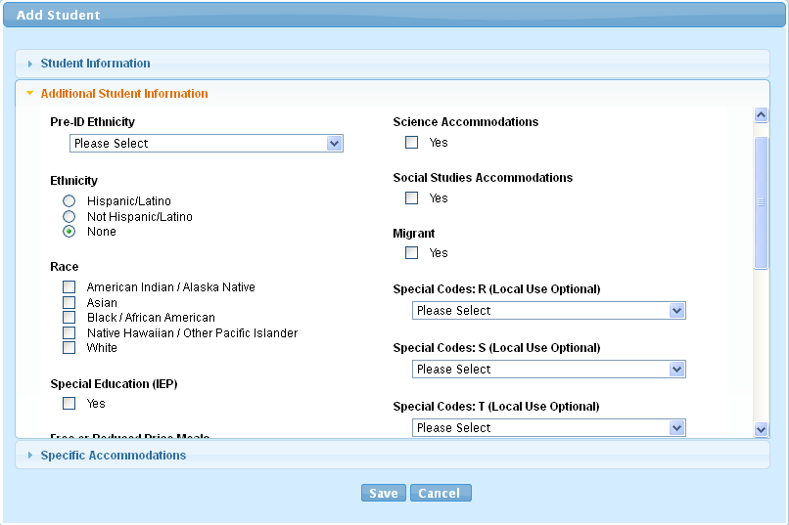
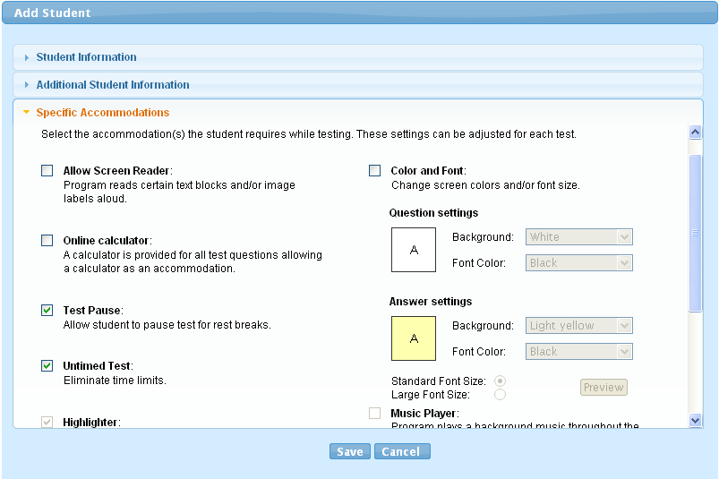
Looking Ahead C3 Slide 2
Looking Ahead
Test Administration Site (TAS)
Designed for usability and flow
Focus on minimal clicks
Consistent behavior and controls
  Manage Student and User Profiles
  Manage Test Sessions
  Create classes
Slide 34
Notes:
Script
Here are a few screen shots from the Test Administration System. These are related to the Students and student profile. As we mentioned, we will cover these updates more in depth during the test administration training.

Slide 35
Need Help
Support Resources
Need Help?
Support Options and Resources
Slide 35
Notes:
Bullet Points:
Covered a lot of information
Resources are available if you need them.
Script
We have covered a lot of information today. If you find you need assistance with navigating or finding information, there are several resources available to you.

Slide 36
Support Resources
Support Resources
Administration Policies and Procedures Assistance
DC Office of State Superintendent Office
Office of Accountability and Assessments
http://www.osse.dc.gov
DC CAS Customer Support (CTB)
CTB DC CAS Help Desk
DC-CAS_helpdesk@ctb.com
http://www.ctb.com/dc-cas
Phone: 800-994-8579, Fax: 866-282-2251
Hours of Operation: 8:30 a.m. – 5:00 p.m. Eastern Time
Slide 36
Notes:
Bullet Points:
Refer policy questions to the State Superintendent Office (OSSE)
Refer technology related question to the CTB support team.
Script
For policy related questions, please contact the . For technical support needs, please contact the CTB DC CAS Help Desk either via email or phone.

Slide 37
Thank You
Questions? Thank you for joining!
Thank You
Questions
Slide 37
Notes:
Thank you for joining today. We are now ready for the Question and Answer period. We will take Chat Window questions first, followed by Phone questions. Questions asked will be formatted into an FAQ with answers and posted to the CTB web portal.
DO NOT SAY – this is for the speaker to understand.
Policy Questions are for OSSE
Other questions – If the speaker can answer, then answer. If not, refer the question to program team on the call. If no one can answer, take the question and contact that person after the session.

Slide 38
Appendix Agenda
Appendix
Workstation Minimum Requirements Documentation
These documents can be found on www.ctb.com/dc-cas “Tech and Test Coordinator” buttons.
Support Documentation
These documents can be found on the CTB DC Web Portal at www.ctb.com/dc-cas “Tech and Test Coordinator” buttons.
Slide 38
Notes:
Appendix

