Slide 1
2012 DC CAS Kickoff
Tamara Reavis
Director Standards, Assessment, and Accountability

Slide 2
Agenda
Common Core Transition
Background
Reading
Math
Composition
DC CAS Health
PARCC Updates
ESEA Waiver Application

Slide 3
What are Common Core State Standards?
Content standards developed by a group of states
Development coordinated by National Governors Association and Council of Chief State School Officers
In collaboration with teachers, school administrators, and experts
States voluntarily choose to adopt
46 states, 1 territory, and D.C. have adopted the CCSS
More information available at www.corestandards.org

Slide 4
DC CAS Transition to Date
June 1, 2011 – Released final DC to Common Core Crosswalk.
June 15, 2011 –Blueprint for revised 2012 DC CAS assessment.
Summer 2011 –Staff professional development and conduct outreach to community.
Fall 2011-Support LEA implementation.

Slide 5
English Language Arts

Slide 6
Key Points in ELA
Reading
Staircase of increasing complexity
Diverse array of genres
Critical types of content for all students
Writing
Logical arguments based on substantive claims
Research is emphasized
Speaking and Listening
Present complex information
Academic discussions
Language
Grow vocabulary
Prepare students for real life experiences
Extends across reading, writing, speaking and listening

Slide 7
Common Core Changes
CCSS versus DC standards
English Language Arts
More complex text
Writing to a source
Shift to informational text
Use of evidence in writing
Skills are scaffolded from one year to the next
Literacy standards for History/Social Studies, Science and Technical Subjects

Slide 8
2012 DC CAS Reading
DC CAS Reading and Writing will be aligned to Common Core
Grade 3 Sample Blueprint
 | 2011 | 2012
Reading Informational Text | 33% | 43%
Reading Literary Text | 48% | 44%
Vocabulary Acquisition and Use | 19% | 13%

Slide 9
Mathematics

Slide 10
Mathematics Structure
Standards for Mathematical Practice
Eight Core practices that underpin a successful mastery of the mathematical process
Describes how proficient students approach math
Standards for Mathematical Content
Specifies what students should know and be able to do
Example Tasks
Exemplifies the range and variety of tasks demanded by the standards

Slide 11
Key Points in Mathematics
Kindergarten – Grade 5
Establishes foundation of using and understanding whole numbers, fractions, and decimals
Grades 6-8
Preparation for geometry, algebra, ratio and proportional reasoning, and probability and statistics
High School
Emphasis on applying math to solve problems arising in every day life, society, and the workplace
Traditional or integrated approach

Slide 12
Common Core Changes
CCSS versus DC standards
Math
Focus on greater conceptual understanding and demonstration of mastery at each grade
More depth than breadth
Understanding application
Inquiry
Math practices
Why not how

Slide 13
Sample Math Blueprint
Grade 3
 | 2011 | 2012
Number Sense and Operations | 32% | 12%
Priority |  | 18%
Patterns, Relations, and Algebra | 18% | 17%
Geometry | 13% | 12%
Measurement | 13% | 3%
Priority |  | 17%
Data Analysis, Statistics, and Probability | 23% | 22%
30%
20%

Slide 14
DC CAS Math
2012
DC CAS Math will focus on essential skills students need to be successful with the Common Core Standards.
2013
Math will also be fully aligned with Common Core

Slide 15
Composition

Slide 16
Key Points in Writing
Text Types and Purposes
Production and Distribution of Writing
Research to Build and Present Knowledge
Range of Writing

Slide 17
Common Core Changes
CCSS versus DC standards
Text-based prompts
No narrative responses

Slide 18
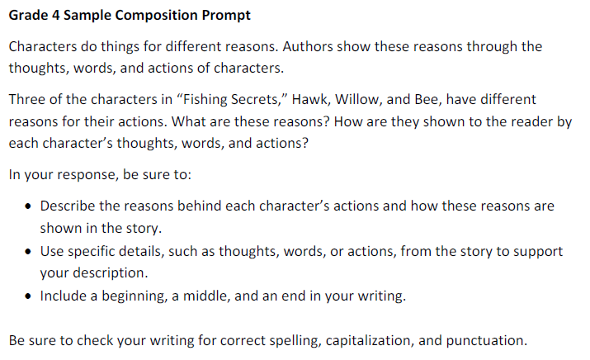

Slide 19
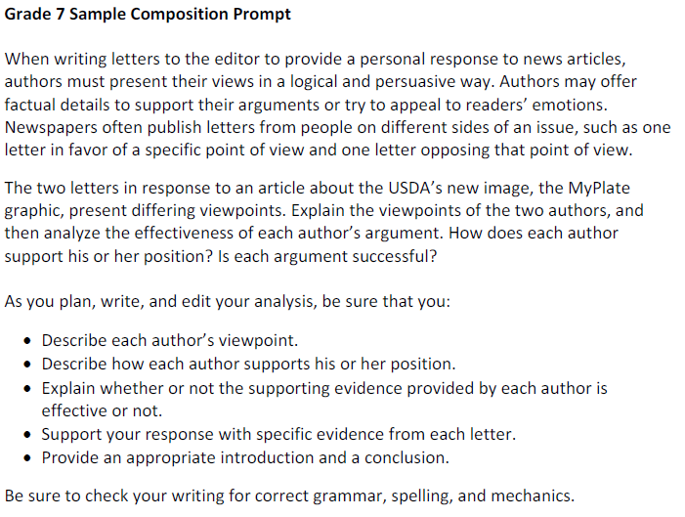

Slide 20
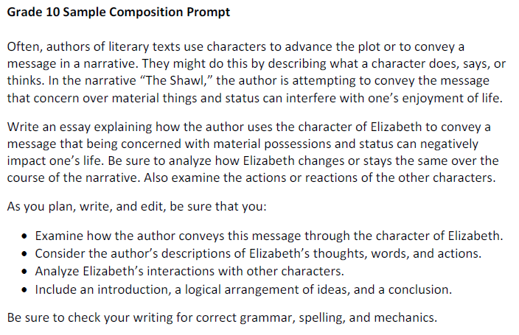

Slide 21
DC CAS Health

Slide 22
DC CAS – 2nd and 9th Grade
Grade 2
Reading and Math
Grade 9
Reading
Developed by DCPS, the DC CAS vendor, and OSSE to support the IMPACT teacher evaluation system.
Optional for charters

Slide 23
PARCC
2014 – PARCC will be administered.
Involved in all decision-making.
Goal is to create multiple opportunities to gauge student learning.
DC will achieve economy of scale in implementation and assessment costs.

Slide 24
PARCC Assessment Design Updates
Conditional on approval from the U.S. DOE
Two Optional Assessments
Diagnostic Assessment
Early indicator of student knowledge
Mid-year Assessment
Performance-based with an emphasis on hard-to-measure standards
Two Required Assessments
Performance-Based Assessment
Extended tasks and applications of concepts and skills
End of Year Assessment
Innovative, computer-based items

Slide 25
Additional PARCC Updates
Content Frameworks
Available at www.parcconline.org/classroom
Item Development
Two universities are currently developing innovative item types
Educator Cadres
K-12 educators needed to develop expertise on the CCSS and PARCC

Slide 26
ESEA Waiver
DC submitted an intent to apply
What stays the same
AYP Reporting
What changes
New achievable but ambitious annual measurable objectives (AMO)
Incorporating growth
Consequences of not meeting AYP
Differentiated accountability system

Slide 27
Community Outreach
Focus Groups
Will be held in December
Public Comment Period
Application posted for 30 days on OSSE website

Slide 28
We look forward to continued engagement and collaboration.
For additional information, please contact:
Tamara Reavis
Director of Standards, Assessment, and Accountability
tamara.reavis@dc.gov
202-654-6100
http://www.parcconline.org/

