Slide 1
Healthy Tots Wellness Continuation Grant
Division of Health and Wellness
FY24 Quarterly Meeting #1
March 28th, 2024
Notes:
Good morning and welcome to our to Healthy Tots Wellness Grant post award meeting for FY24. Today on the call with me is my colleague Sheena who is part of the HTA team and who you may have met at previous meetings and site visits.

Slide 2
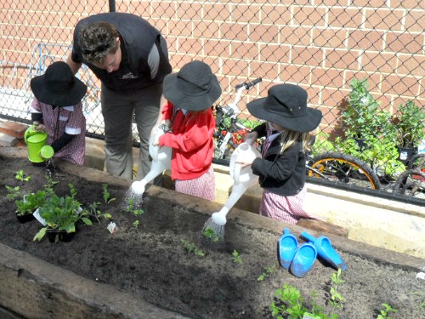
Introduction/New Staff
Ice Breaker
Spotlight: OSSE Wellness Guidelines for Child Care Facilities
Where to access to Guidelines
Future Healthy Tots Wellness Grant + new Guidelines
Nemours Grant + new guidelines
Reporting Documents
Q&A
Resources
Closing
Notes:
Today we are going to have the opportunity to introduce ourselves, give abrief FY24 overview, discuss duplicate sites, the reporting tools, closeout and reimbursement requests and end with a q&a.

Slide 3
Introductions
Notes:
Let’s make sure everyones cameras are on so we can introduce we other. I know we may have a new person or two on the call today. Ill go first.

Slide 4
Ice breaker
Notes:
Next lets do a quick ice breaker

Slide 5
How do you prepare for spring?
What is your favorite spring planning activity?
Notes:
Communicates core values and principles regarding healthy habits to childcare providers, to current and potential families and to the community.
Supports childcare providers and families act as role models for children by practicing healthy habits themselves.
Sets a standard that is clear and consistent
Helps guide those teaching children about the importance of these healthy habits.

Slide 6
Spotlight
Notes:
Next lets do a quick ice breaker

Slide 7
The Healthy Tots Program Presents
OSSE Wellness Guidelines for Child Care Facilities
ALIGNED WITH the Whole School, Whole Community,
Whole Child (WSCC) Model
- A Culture of Wellness Approach -
Notes:
Hello, I am Sheena King, Healthy Tots Program Specialist for the Health and Wellness Division. I am excited to present the OSSE Wellness Guidelines for Child Care Facilities, Aligned with the Whole School, Whole Community, Whole Child Model, A Culture of Wellness Approach.

Slide 8
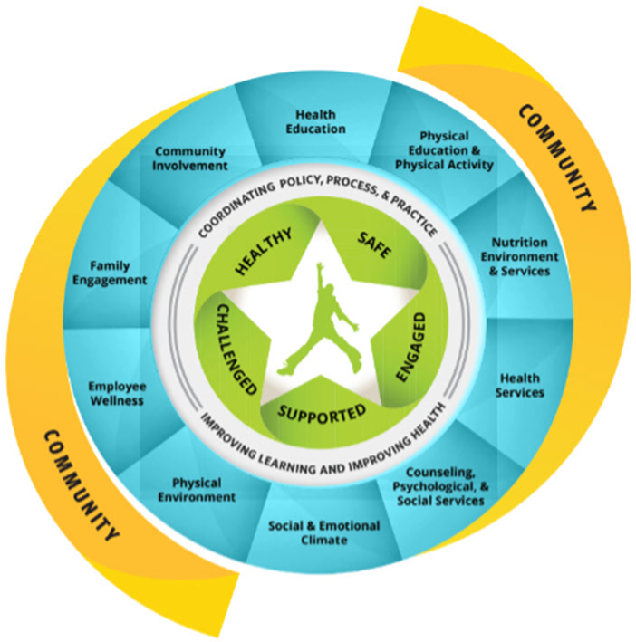
What are the OSSE Wellness Guidelines for Early Learning Facilities?
Provides early learning facilities with a road map on how to maintain a consistently supportive wellness environment for children aged 0-5.
Benefits to early leaning communities:
Communicates core values and principles regarding healthy habits to childcare providers, to current and potential families and to the community.
Supports childcare providers and families act as role models for children by practicing healthy habits themselves.
Sets a standard that is clear and consistent
Helps guide those teaching children about the importance of these healthy habits.
Notes:
The Wellness Guidelines are a collection of specific actions that can help early learning facilities develop and maintain a Culture of Wellness for early childhood education by integrating key components of wellness into their education programming and facility operations. The Wellness Guidelines are based on guidance and best practices from the nation’s leading health and early learning organizations.
The wellness guidelines addresses eight topic areas.
-Employee Wellness
-Family Engagement
-Social Emotional Health
-Teaching Healthy Habits and Self-Care Practices
-Nutrition Services
-Physical Activity
-Physical Environment and Environmental Sustainability
-Community Service
The OSSE Wellness Guidelines are WSCC aligned. The Center of Disease Control and Prevention Whole School, Whole Community, Whole Child model is a collaborative ap From birth through adolescence, the health and wellness of children and the environments they develop and learn in have been proven to impact their lifelong health and educational achievement.

Slide 9
What is the Culture of Wellness in Early Childhood Education (ECE)?
A Culture of Wellness in ECE describes an environment that is actively and strategically designed to:
facilitate connections and strong relationships between child care staff, children, and family caregivers;
promote physical and mental health, wellness, and safety through all aspects of operations (such as policies, expectations and practices);
foster a safe, healthy, engaging and supportive work environment; and
align with research-based practice guidelines.
Notes:
The Health and Wellness Division and Division of Early Learning worked together to create a definition for the Culture of Wellness in early childhood education. We felt it was important to determine and define what the culture of wellness would look like for early childcare facilities in Washington, DC.
A Culture of Wellness in early childhood education describes an environment that is actively and strategically designed to facilitate connections and strong relationships between child care staff, children, and family caregivers; promote physical and mental health, wellness, and safety through all aspects of operations; foster a safe, healthy, engaging and supportive work environment; and align with research-based practice guidelines.
The wellness guidelines helps us achieve this definition.

Slide 10
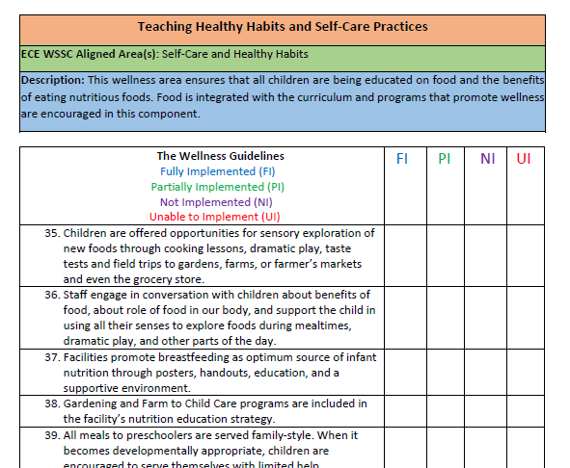
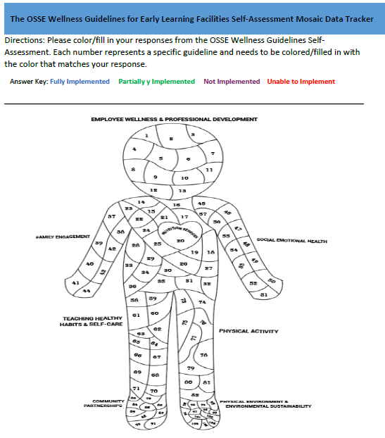
Completing the OSSE Wellness Guidelines for Child Care Facilities
Step 2. Complete the Mosaic Data Tracker
Step 3. It’s Time to Plan and Implement
Step 1. Complete the Self Assessment
Date to Complete | Wellness Guidelines Topic: Employee Wellness Wellness Guideline: Leadership provides staff recognition and team building activities to staff that fosters a safe and fun working environment. Action Steps: Describe how you will accomplish the activity, ensuring that steps are specific, measurable, achievable, and realistic | Person Responsible | Status M: Met IP: In Progress NM: Not Met NA: Not Applicable
1/1/2025 | 1. Leadership incorporates quarterly meetings to include staff recognition. | Director | IP
 | 2. Leadership will plan for annual retreats for team building. |  | M
 | 3. Create a climate and culture team. |  | IP
Let’s Take a Look at the New Wellness Guidelines!
The OSSE Wellness Guidelines for Child Care Facilities Aligned With the Whole School, Whole Community, Whole Child (WSSC) Model A Culture of Wellness
Notes:
Here we have three steps into completing the wellness guidelines. We suggest that this is completed annually.
First, you would complete the self-assessment tool. The idea of the wellness guidelines is to be informative not punitive. We really want what is best for our community!
Next, we have the Mosaic Data Tracker. This is a fun way to compile and see data. Everyone will have different variations of our Healthy Tots Wellness Bear! Our goal is for all of Washington, DC early learning facilities participate and strive for the Healthy Tots Blue Bear!
Lastly, we have a implementation tool for early learning facilities to map out their individual wellness journey.
The Healthy Tots team was awarded $10,000 from CDC/Nemours Children's Foundation to support creating an online tool for the wellness guidelines. With this funding we hope to continue working with Division of Early Learning, so that our early learning facilities could be recognized for implementing the wellness guidelines on the My Child Care DC website. We hope to add a Healthy Tots Blue Bear Badge for facilities that are implementing the wellness guidelines.
Our plan is to use our new online tool for informative data that can be helpful in creating and providing targeted technical assistance to early learning facilities.
Please feel free to check out our new wellness guidelines on our website. The link will be provided.
Thank you for listening.

Slide 11
Any questions, comments and/or concerns?
Please contact: HTA Program Specialist Sheena.King@dc.gov

Slide 12
Future Healthy Tots Wellness Grant + new Guidelines

Slide 13
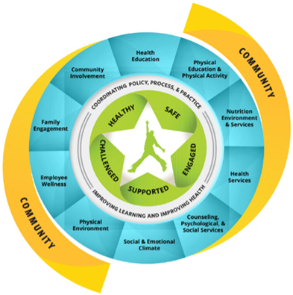
Future Healthy Tots Wellness Grant + new Guidelines
The first edition of OSSE’s wellness guidelines was a part of the Healthy Tots Wellness Grant’s RFA in FY2018/19 and FY20/21
Plan is incorporate the new guidelines in the RFA for FY2025/26
Each of the grant’s four program areas aligns with the guideline’s eight topic areas in addition to being WSCC aligned
The Educator Wellness Blueprint will also be added

Slide 14
Nemours Grant + new guidelines
Notes:
Next we will touch on reporting documentation.

Slide 15
Nemours Grant + new guidelines
Purpose: CDC/Nemours Children's $10,000 sustainability grant to improve healthy eating and physical activity initiatives in ECE settings
Goal: Create digital ECE Wellness Guideline assessment and evaluation tool to measure status of ECE site's indicator status across eight topic areas
Work Plan: HTA team to lead effort in coordinating digital development/launch of tool, test/promotion of tool with sponsors, communication strategy with OSSE and creation of reward/annual report card
Next Steps: Plan to use new data tool that can be helpful in providing targeted technical assistance to ECE sites and eliciting future funding/collaborative funding proposals for Healthy Tots /CACFP work
Healthy Tots: New guidelines app will be live by FY25. Plan is to have all CACFP sites complete tool.

Slide 16
Reporting Documentation
Notes:
Next we will touch on reporting documentation.

Slide 17
Important Dates to Remember
Action Item | Due Date
Q1 Metric Tool (October 1, 2023 – December 31, 2023) | January 30, 2024
Site visit confirmation | January 30, 2024
Signed MOU by each center | February 9, 2024
Site Visit 1 Scheduled | March 15, 2024
Q2 Metric Tool (Jan. 1 – Mar. 31) | April 15, 2024
Year 2 Mid-project report | May 30, 2024
Year 2 project expense reports | May 30, 2024
Site Visit 2 Scheduled | July 15, 2024
Q3 Metric Tool (April 1 – June 30 | July 15, 2024
End of year 2 project report | September 30, 2024
Q4 Metric Tool (July 1-Sept. 30) | September 30, 2024
End of year 2 invoices and expenses records due for July 1-September 30 | October 15, 2024
Notes:
This is the same calendar looks very similar to FY23 but the due dates start next month in January. First up is the signed MOUs and then confirming site visits. We will have a mid year project and check-in and then all of the reporting documentation will be due at the end of September. The mid- year report will entail providing a brief written summary of your current work for the first half of the year and the sustainability tool. All invoices and expenses are due in mid October. We will also be scheduling quarterly meetings to check-in on our progress through this fiscal year. This was the format used in the first two grant cycles and since we have a full year ahead of us we have more time to check-in and discuss any barriers and tactics you are using in your grant work. Also, in prior grant cycle, we held a symposium and I expect we will do something similar next October but in a virtual format.

Slide 18
Reimbursement Requests
Reminder from OSSE Grants Office:
OSSE grantees must adhere to their Grant Award Notification (GAN) and submit at least one reimbursement request per quarter in which it expended funds.
The reimbursement must include all funds expended, but not yet claimed for reimbursement.
HTA team will send out notices if you are out of compliance

Slide 19
Q&A
Notes:
Next we have time for QnA. You may have questions about EGMS, funding or any other requirement.

Slide 20
Resources
Notes:
I’ve also linked here the resources from our September meeting.

Slide 21
Guidance Resources
OSSE WEBSITE: FY2023 Informational Materials | osse (dc.gov)
LEGISLATION: Healthy Tots Act Part 1 (pages 45-49) Healthy Tots Act Part 2 (HTA CACFP Participation Waiver) (pages 98-99)
GUIDANCE: OSSE: A Step by Step Guide for Implementing Wellness Guidelines in Child Development Facilities
Notes:
Healthy Tots legislation and guidance.

Slide 22
What informs our work?
OSSE STRATEGIC PLAN 2023-2025: OSSE’s strategic plan
WSCC MODEL: What is WSCC?
OSSE WELLNESS GUIDELINES FOR CHILD CARE FACILITIES: The Guidelines
EDUCATOR WELLNESS: One-pager, Educator wellness Blueprint (updated)
Notes:
And here are links to the three items we previously discussed that drive our work at OSSE. Our strategic plan, WSCC model and educator wellness blueprint. I know fFeshfarm recently released their new strategic plan, so if other grantees have similar plans that have created for future work and sustainability, please share them with OSSE.
Also, new since the September meeting, is the finalized educator wellness materials so if you are interested in reading those click on the last two links.
Lastly, we are currently working on a project around finalizing and releasing our DC wellness guidelines for early learner so expect to receive more communication from Suzanne, Sheena and myself on those. The guidelines currently and with updates continue to focus core values and principles that drive our grant work.

Slide 23
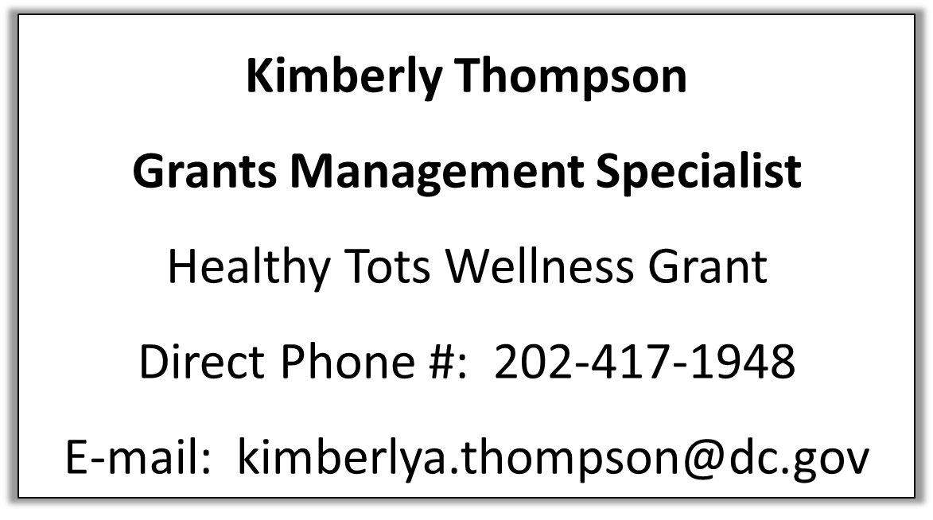
Healthy Tots Wellness Grant Point of Contact
Contact for questions about the grant including requirements, schedule, reporting, etc.
Notes:
If you have any questions about requirements or scheduling reporting here is my contact information.

Slide 24
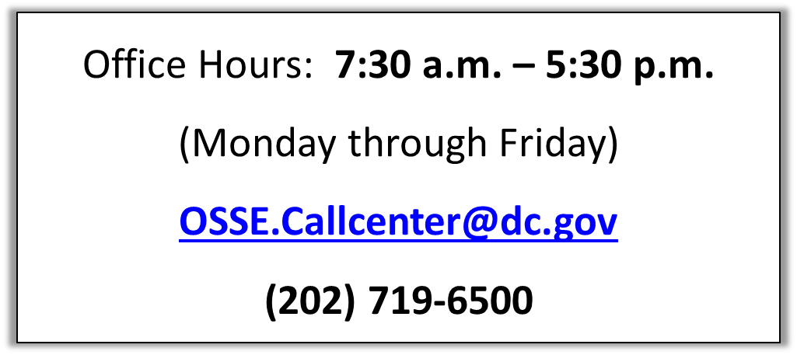
EGMS Technical Support
Please contact the OSSE Customer Service team if you experience technical issues and/or have any questions regarding EGMS as follows:

