Slide 1
School Test Coordinator Training
Office of the State Superintendent of Education
Assessment Team

Slide 2
Agenda
Introduction
Test Security Policies and Procedures
Test Administration Resources Scavenger Hunt
Before Testing
During Testing
After Testing
DC Science differences, tips, tricks, Q&A

Slide 3
Materials for this training
All materials and resources for this training are posted at http://osse.dc.gov/page/test-coordinators-training
All test security forms and guidelines are posted at http://osse.dc.gov/service/test-security-and-incident-forms

Slide 4
Introduction

Slide 5
Districtwide Assessments: Test Integrity Training 2016
February 2016

Slide 6
Important Dates
Task | Date
Test Integrity Coordinator / Test Monitor Training | 2/11, 2/16, 2/17, 3/3
School Test Plan due date | 15 school days prior to first day of window
PARCC Test Windows | Paper based: 3/28-4/29 Computer Based 1: 3/28-5/6 Computer Based 2: 4/4-5/13 Computer Based 3: 4/11-5/20
NGSS Science Test Window | 5/2-6/3
Affidavit submission due date | 15 Days After Administration

Slide 7
Testing Integrity
OSSE’s goal is for schools and LEAs to deliver a uniform and equitable statewide assessment program. For assessments to yield fair and accurate results the assessments must be administered in consistent and standardized conditions; the best way to ensure that occurs is to ensure educators understand and recognize acceptable and unacceptable assessment practice.

Slide 8
Statewide Assessments 2016
PARCC
DC Science
DC Science Alt
NCSC/MSAA Alt
OSSE uses the term “statewide.” DC Official Code and the Testing Integrity Act and Amendment use the term “Districtwide.” These two terms are equivalent.

Slide 9
OSSE Testing Responsibilities
Establish policy, regulations, and guidelines to ensure statewide assessments are administered with fidelity
Train and support LEAs and schools in administering the statewide assessment
Review and approve School Test Plans
Monitor statewide assessments
Conduct test integrity review

Slide 10
LEA Testing Responsibilities
For all schools/campuses under the LEA’s purview:
Filing school test plans with OSSE
Designate authorized personnel
Ensure authorized personnel are trained
Distribute testing integrity and security notification statement
Monitor statewide assessments
Report and investigate any breaches of test security
Collect and submit to OSSE testing integrity affidavits

Slide 11
School Testing Responsibilities
Create and submit school test security plan to LEA
Protect security of secure materials
Administer statewide assessment
Maintain test security file
Ensure integrity of testing environment
Report any breaches of test security
Sign and submit test security affidavits to LEA

Slide 12
Testing Integrity Documents
Laws, Requirements and Compliance:
Testing Integrity Act of 2013
Testing Integrity Act Amendment (2015)
OSSE Test Integrity Guidelines
Vendor Test Directions
Resources & Forms

Slide 13
Testing Integrity Act of 2013
Defines terms & roles
Test integrity coordinator; test monitor; authorized personnel
LEA & school requirements & OSSE requirements
Test security plans; reporting and investigations; affidavits; anti-retaliation
OSSE requirements
Training and standards; test plan review; monitoring and investigations
Prohibitions, sanctions & appeals
Actions that provide students inappropriate advantage on assessment; sanctions at LEA, school, and individual levels; LEAs, schools, and individuals may appeal sanctions to DME
Notes:
Include link

Slide 14
Testing Integrity Act Amendment
Further defines Districtwide assessments as those used for accountability
Shifts test plan creation and submission from LEA to school level responsibility
Shifts test plan submission from 90 days to 15 days prior to assessment
Requires OSSE to approve test plan 5 days prior to assessment
Allows use of approved electronics for testing
Requires OSSE to provide training and guidance 45 days prior to testing
Shifts NDA from signed agreement to distributed notification statement
Notes:
Include link

Slide 15
Test Security Guidelines
Explanation and additional details of Act and Amendment
OSSE role and responsibilities
LEA roles and responsibilities
School roles and responsibilities
Test environment
Roles, materials, exceptions
Monitoring and investigations
Notes:
Include link

Slide 16
Test Vendor Instructions
PARCC test manuals
NCSC/MSAA test manuals
DC science test manual
DC science alt test manual

Slide 17
Key Assessment Roles
Authorized personnel
Test integrity coordinator
Test monitor
Test administrator
Other roles:
Test proctor
Special education coordinator/Alternate assessment coordinator
Technology coordinator

Slide 18
Authorized Personnel
Any individual who has access to statewide assessment materials or are directly involved in the administration of a statewide assessment.
Requirements
Complete testing integrity training developed by OSSE
Receive test integrity and security notification statement
Report breaches of test security
Cooperate in testing integrity and security investigations
Refrain from prohibited activities
Read all applicable directions and guidance

Slide 19
Test Integrity Coordinator
The individual designated by the LEA to be responsible for testing integrity and security for the LEA and all of the schools/campuses under its purview during the statewide assessment.
Requirements
Designate and support test monitors
Attend testing security and integrity training
Submit school test plans for each school/campus under the LEA’s purview
Support test monitors
Monitor test administration at schools
Report any breach of testing security or deviation from test plan
Investigate, document and report to OSSE any breach or deviation
Sign, collect (10 days post test) and submit (15 days post test) testing integrity affidavit

Slide 20
Test Monitor
Individual designated by test integrity coordinator to be responsible for testing integrity and security for school/campus site.
Requirements
Create and submit school test plan to test integrity coordinator
Conduct test administration training for all authorized personnel at school site
Create and disseminate school test plan
Oversee security of all secured materials while in school
Support authorized personnel administering the test
Sign and submit affidavits to test integrity coordinator post-testing

Slide 21
Test Administrator
Individuals identified by the test monitor to be responsible for administering the assessment to students.
Requirements
Conduct the testing sessions as outlined in the appropriate test administrator manuals
Establish the testing climate within the test location
Coordinate the distribution and return of testing materials to and from students
Ensure that students who require accommodations receive the appropriate accommodations in TA’s testing group
Account for and maintain the security of all test materials under TA’s purview

Slide 22
Other Roles
Test Proctor
Assist test administrator with test administration and classroom management, work under their supervision
May administer accommodations
May be a volunteer
Special Education Coordinator and/or Alternate Assessment Coordinator
Assists the Test Monitor in identifying and documenting all testing accommodations needed for students
Trains test administrators to administer accommodations
Monitors testing for the correct and secure implementation of accommodations
Coordinates alternate assessments (if applicable to school)
Technology Coordinator
Assists the Test Monitor in preparing administrator and student devices for secure testing according to vendor directions
Troubleshoots any technology problems that may arise

Slide 23
Key Before Testing Tasks
OSSE | LEA | School
Issue and train testing security standards Issue testing security and integrity notification statement to LEAs Review school test plans | Collect and submit school testing plans to OSSE Distribute testing security and integrity notification | Establish and submit to LEA the school testing plan Receive test materials Inventory test materials Distribute test materials
 | LEA and/or School
 | Attend training Conduct test administration training Prepare technology to create secure environment Notify students and families of testing

Slide 24
Test security and integrity notification statement
http://osse.dc.gov/service/test-security-and-incident-forms

Slide 25
School Test Plan
Every school must submit a school test plan to LEA
Every LEA must submit school test plans for all schools/campuses under the LEA’s purview to OSSE at least 15 days prior to first day of assessment window
There is no specific format or template required by OSSE for most elements, but plans must contain the following information:
School information
Staff roster
Test dates
Test calendar
School policies and procedures for:
Material security
Reporting irregularities and incidents
Investigating irregularities
Prohibited actions
Provision of accommodations
Assurances that DC and OSSE requirements will be met
OSSE is providing a template in Excel
This year, schools are required to follow OSSE instructions for documenting/naming test sessions and test administrators in Pearson Access Next. See instructions here.
LEAs may require additional elements
Test plans must be submitted via the OSSE Support Tool
Notes:
Provide/insert school test plan

Slide 26
Local Test Administration Training
Train all authorized personnel at LEA/school in state, LEA and school policy and procedures
Distribute Testing Integrity and Security Notification Statement to all authorized personnel
Include the following topics:
Review of School Test Plan
Review of Test Security Guidelines
Review of Test Administration Procedures
Review of vendor-supplied testing manual(s)
Notes:
More in depth this afternoon

Slide 27
Notify Students and Families
Students | Families
Prepare students to participate in the PARCC, NCSC, and NGSS Science Explain purpose and dates of testing Encourage positive attitudes about testing Ensure accommodations are addressed | School/LEA must provide families with a letter regarding the dates and purpose of the statewide assessments Copies of letters sent home must be kept on file for the test monitor’s review A template with English and other translated versions of the letter are available on the OSSE website (http://osse.dc.gov/publication/guide-new-parcc-assessment-parents) for school use
Notes:
Double check link

Slide 28
Key During Testing Tasks
OSSE | LEA | School
Support test integrity coordinators and test monitors Monitor assessment administration at school sides | Support test monitors Monitor assessment administration at school sites | Maintain school security file Follow school test plan Administer assessment Document handling of secure materials on chain of custody form Follow the test directions
 | LEA and/or School
 | Actively monitor and manage test environment Report irregularities, incidents and/or breaches of security

Slide 29
Reporting
Document minor deviations from testing plan in School Security File
Submit incident reports via:
OSSE website
OSSE Support Tool (as attachment)
Forms here
Notes:
Include incident report form

Slide 30
Maintaining a Security File
School security file must contain:
School test plan(s)
Documentation of any changes to or deviations from school test plan(s), including records of make-up test groups
Copies of all incident forms
Documentation of all irregularities
Documentation of recommendations for invalidated student scores
Chain-of-custody documentation: receipt and return of secure test materials
Test administration concerns/notes
Missing secure materials (i.e., test materials initially received by the Test Administrator but not returned)
Be kept on file for four years

Slide 31
Administration Monitoring
The Test Site Observation Report
Provides guidelines for setting up a positive and uniform testing environment
Used by OSSE monitors to evaluate adherence to Districtwide assessment administration guidelines
To be posted here: http://osse.dc.gov/service/test-security-and-incident-forms
Notes:
Provide/insert monitoring template

Slide 32
Key Post Testing Tasks
OSSE | LEA | School
Collect affidavits Verify data | Sign affidavits Collect and submit affidavits (from test monitors and test integrity coordinators) to OSSE within 15 days of the end of testing File and execute LEA plan of action in response to any significant incidents deemed by OSSE as needing follow up response | Package and return or dispose of secure test materials as per vendor instructions Document any missing materials and remaining incidents Sign and submit affidavits (from test monitors only) to test integrity coordinator within 10 days of end of testing
 | LEA and/or School
 | Document any remaining incidents

Slide 33
Affidavits
http://osse.dc.gov/service/test-security-and-incident-forms

Slide 34
Hot Topics
Test environment and materials
Exceptional circumstances
Nonpublic placements
Electronics
Accommodations
Violations & sanctions

Slide 35
Testing Environment & Materials
Wall displays with tested content or test taking strategies must be removed/covered
Students may have activities unrelated to tested content after testing materials have been collected
Students may not have non-vendor provided support materials (dictionaries, thesauruses, reference guides, formulas and conversion tables) unless specified in student’s IEP, 504 or EL plan

Slide 36
Exceptional Circumstances
Absences/Makeups
Include in calendar
Homebound students
Test monitor work with test integrity coordinator; notify OSSE
Testing at alternative sites
Test monitor work with test integrity coordinator and OSSE
Homeschool students
Must notify school by 3/1
Significant medical emergencies
May apply for Medical Exemption with support from physician
Other Emergencies
Student safety first, then document and submit to OSSE

Slide 37
Non-public placements
LEAs must ensure that all eligible students enrolled at their LEA, including students in non-public settings participate in statewide assessments. Non-publics are considered a school/campus under the purview of the LEA.
Non-public requirements:
Compliance with Testing Integrity Act of 2013, Amendment of 2015, Test Security Guidelines and vendor manuals
Creation and submission to LEA of enrollment school test plan for students at that site

Slide 38
Electronics
Cell phones may not be used in the testing environment by students or test administrators
During the administration of paper based tests, no cell phones may be in the testing environment at any point during testing.
During the administration of computer-based tests, school test monitors and school technology coordinators may use cell phones for technical support
Grade-level appropriate calculators will be available through the test platform on calculator sections of mathematics units for computer based tests.
Students may use hand-held, grade appropriate calculators on calculator sections of assessments. No calculators are allowed on non-calculator sections, except when specified by a student’s IEP.

Slide 39
Accommodations
It is important that accommodations and accessibility features used on assessments are also used in instruction
Any unique/non-standard accommodations not included in the manuals for an assessment must be approved by OSSE prior to their use on statewide tests
Students need to be familiar and comfortable with all necessary accommodation(s) BEFORE the assessment – practice tests and tutorials are a resource.
An emergency accommodations form will be available online (PARCC and OSSE website) for temporary accommodations in the event of student injury (e.g. a scribe for a student with a broken wrist)
Guidelines to selecting, implementing and evaluating the use of accommodations for students with disabilities and English language learners
http://osse.dc.gov/service/accommodations

Slide 40
TI Act Violations
Photocopying, reproducing, disclosing secure test items or materials
Reviewing, reading, looking at test items or student responses unless specifically permitted
Assisting students with answers to test questions (verbal/nonverbal cues)
Altering student responses
Altering test procedures in formal instructions
Allowing students to use notes, references or other aids unless specifically allowed

Slide 41
TI Act Violations
Having in one’s personal possession secure test materials except during scheduled testing time
Allowing students to view or practice secure test items before or after scheduled testing time
Making or having answer keys to unreleased test items or forms
Leaving secure test materials in a non-secure location or unattended by authorized personnel
Using unapproved electronics during the assessment

Slide 42
Sanctions for Violations
If an LEA, school, and/or individual knowingly and willingly violates the Testing Integrity Act, they may incur the following sanctions:
LEA/School:
Payment of expenses incurred as a result of the violation;
Administrative fine; and/or
Invalidation of test scores
Individual:
Denial, suspension, revocation or cancellation of, or restrictions on issuance or renewal of OSSE-issued license for a minimum of one year;
Payment of expenses incurred as a result of the violation; and/or
Administrative fine
Notes:
Knowingly and willfully violating matters. Notify OSSE early on questionable issues to avoid problems

Slide 43
Questions

Slide 44
Test Administration Resources Scavenger Hunt

Slide 45
Test Administration Resources Scavenger Hunt
Directions: Follow the directions on the handout to access all the key sites and resources you will need to complete the rest of today’s training. Keep these tabs open in your computer to access later this afternoon, and bookmark them. You will have 20 minutes to complete this activity. If you get stuck, work with a neighbor!
http://osse.dc.gov/sites/default/files/dc/sites/osse/page_content/attachments/Test%20coordinator%20Training%20Scavenger%20Hunt%20Activity.docx

Slide 46
Before Testing

Slide 47
Before Testing Introduction
We will not cover every task that needs to happen before testing, but we will cover the key points where we saw difficulties last year. Refer to the PARCC Test Coordinator manual for more detailed step-by-step checklists. LEAs may have additional requirements and may have a more specific checklist for their schools.
This section of the training will cover:
Student registration
Pearson Access Next user setup and permissions
Accommodations and the Personal Needs Profile (PNP)
Scheduling and timing
Training test administrators
Pearson Access Next creating test sessions
Infrastructure trials
Final preparation

Slide 48
For More Information
Find all materials from today at http://osse.dc.gov/page/test-coordinators-training
PARCC.Pearson.com is the central site for practice tests, manuals, links to guidance documents, technology information and more.
Training modules are available at https://parcc.tms.pearson.com/ for all student registration tasks
PARCC Support Center can help you via phone or live chat support if you encounter issues:
Monday-Friday, 6:30 a.m. – 7:30 p.m.
1-888-493-9888
parcc@support.pearson.com

Slide 49
Student Registration

Slide 50
PARCC/DC Science Student Registration
Initial registration for PARCC at dc.pearsonaccessnext.com is complete for DC students
DC Science registration will occur later this spring
It is the responsibility of schools and LEAs to make sure student registrations are complete and up to date before the time of the test including:
Adding students who enter your school
Making sure all students are registered for the correct tests
Double-checking student data for correctness

Slide 51
Add A New Student
On dc.pearsonaccessnext.com (follow along in the training site, https://trng.pearsonaccessnext.com):
From Setup > Students, open the task list and select Create / Edit Students, Registration, and Manage Student Tests and click Start.
Select Create Students.
Enter the organization where the student will be testing.
Enter the student’s state student identified (USI).
Enter the student’s last name.
Enter the student’s first name.
Enter the student’s birthdate.
Enter the student’s sex.
Click Create.

Slide 52
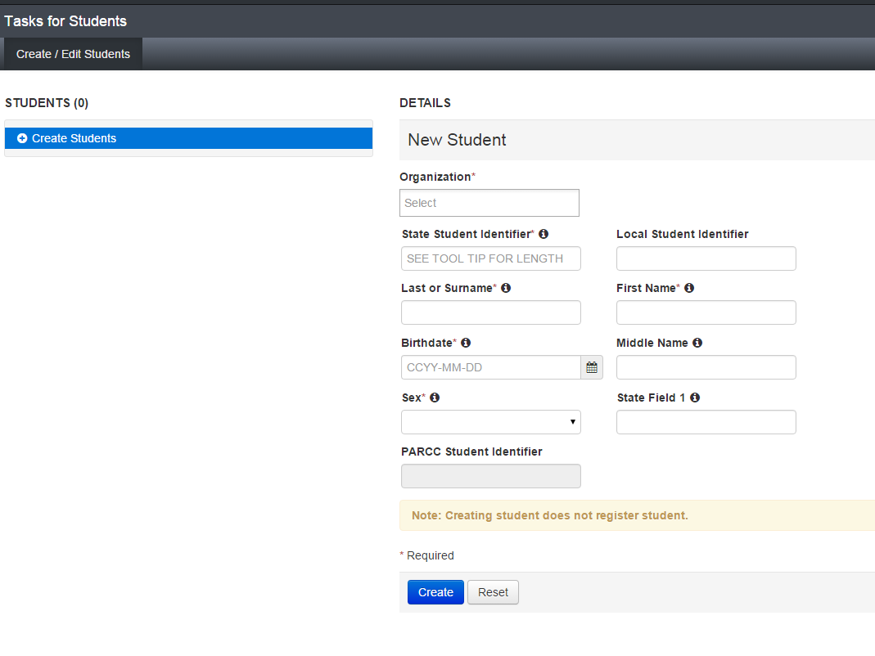
Create/Edit Students Screen

Slide 53
Register a Student for a Test
After the student is created, you still must register a student for their tests, using the “Register Students” and “Manage Student Tests” tasks.
Under Register Students:
Select the student(s) to be registered and mark Registered.
Enter or update the students required demographic information.
The fields that are not required may be entered now or at a later date. If these fields remain blank, some may cause a critical warning. These will not prevent students from testing. Ignore the gifted/talented field or mark “No.”
Click Save.
Under Manage Student Tests
Find the test you wish to assign under Student Tests or click Create Student Tests .
Select the student from the drop down menu.
Select the test you are assigning to the student.
Select the organization where the student will be testing.
Select the Test Format.
Select “No” from the drop down under retest (unless retesting).
Enter in any Personal Needs Profile (PNP) Information (next topic).
Click Create/Save.

Slide 54
Register Students Screen

Slide 55
Manage Student Tests Screen

Slide 56
Select a Student to Edit
From Setup > Students search for a student using their name or USI.
Check the box next to the student(s) you want to edit
Check the tasks you want to access for those students
Click the blue Start button

Slide 57
Selecting a Student to Edit

Slide 58
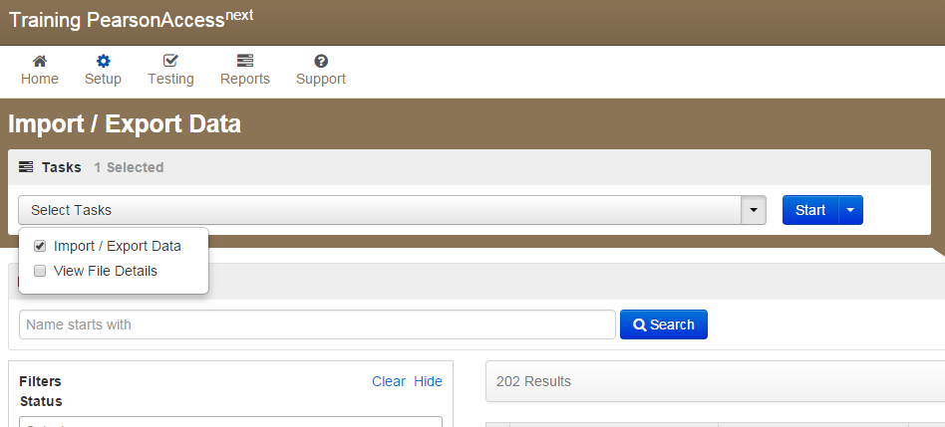
Import/Export to View/Edit Many Registrations
From Setup > Import/Export Data, select Import/Export Data from the task list and hit start.

Slide 59
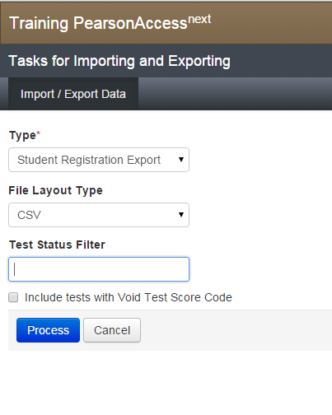
Import/Export to View/Edit Many Registrations
Select student registration export, CSV file format, and no test status filters, click process

Slide 60
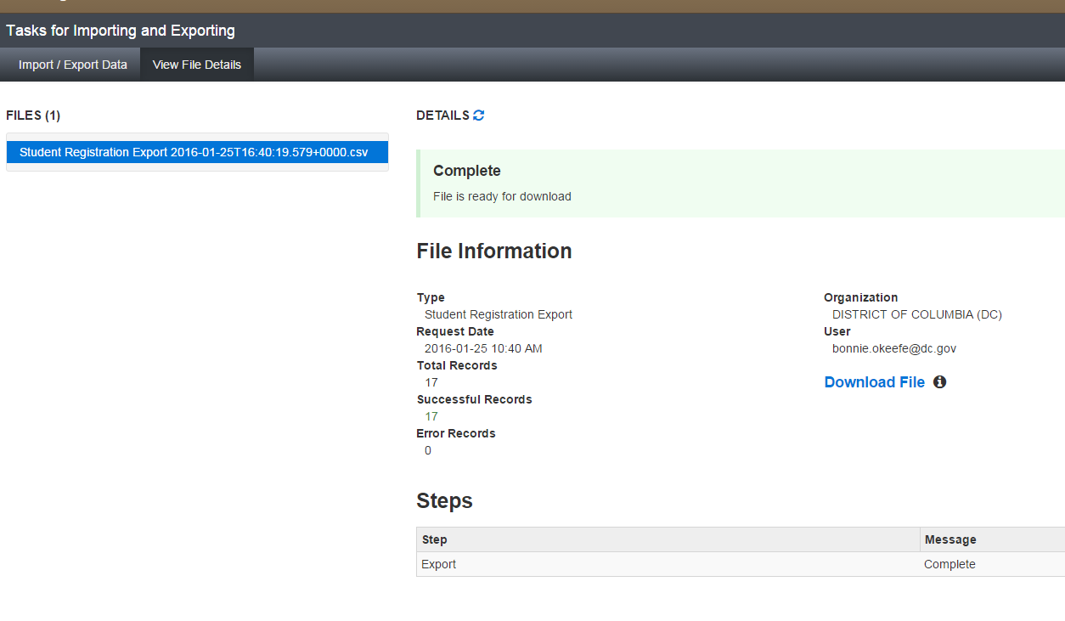
Import/Export to View/Edit Many Registrations
Your file may take several minutes to process. Click the blue refresh symbol to test progress, and when the file is ready a blue download button will appear. You may use this same process to import an updated file using “student registration import”. A file format guide is available under the support tab.
If there are errors, Pearson Access Next will deliver an error report, and show you records in error

Slide 61
SR/PNP Requirements for Sessions, Test Administrator Fields
This year, instead of a separate roster submission with the school plan, OSSE requires schools use the following naming conventions to identify test sessions and test administrators in the SR/PNP:
Uploading the session name in column AR using the SR/PNP will automatically create a populate a test session.
LEAs may have additional requirements/guidance for their schools for using non-required fields in the SR/PNP.
All test administrators will be entered in the Student Registration/Personal Needs Profile (SR/PNP) file in Pearson Access Next (PA Next). Please ensure that the following information is uploaded in PA Next for every student using naming conventions to code for each field:
SR/PNP Field | SR/PNP Column ID | Naming Convention | Sample Code
Test Administrator | AR | Lastname.Firstname | Doe.Jane
Session Name | AP | SUBJECT.grade.TAinitials.regular(R)/makeup(M) | ELA.03.JD.R

Slide 62
Common Errors Importing Data Files
When exporting a file from Pearson Access Next to edit and upload (e.g. student registration file), Excel commonly will mess up formatting in 4 key fields, which will cause errors when uploading:
LEA ID must be 4 digits long
School ID must be 4 digits long
Student birthdate must be in yyyy-mm-dd format
Grade must be 2 digits long
Before you save your edits (as .csv) and upload, reformat these fields. Select the column in Excel, right click, choose “Format Cells…”, choose the custom category and enter the following text depending of the field you are reformatting:
LEA ID: 0000
School ID: 0000
Birthdate: yyyy-mm-dd
Grade: 00
File templates and guidance can be found in the Pearson Access Next support tab, or Pearson customer support should be able to help you on the phone or chat functions if you have any difficulties

Slide 63
Pearson Access Next User Accounts

Slide 64
Creating/Managing User Accounts
Any authorized personnel in your school who need to use Pearson Access Next will need user accounts created for them
Each user account may have different permissions assigned based on role and needs
User accounts from last year are still in the system and may be reactivated as appropriate
LEA Test Coordinators: Make sure you reactivate/create accounts for all your non-public schools as well as your regular campuses
User accounts can be managed individually, or using the file import/export feature

Slide 65
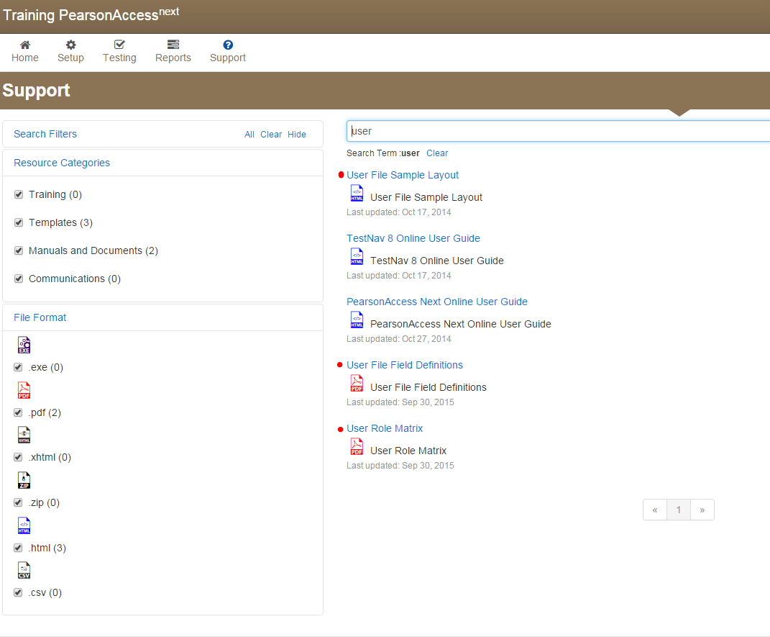
User Account Permissions
User account permissions are up to each LEA, but must maintain test security and provide the minimum access necessary according to role.
Highly recommended that Test Administrators only receive the Test Administrator role, with no add-on roles
To learn more about user account permissions, read the user account matrix and user account file field guide in support tab of Pearson Access Next.

Slide 66
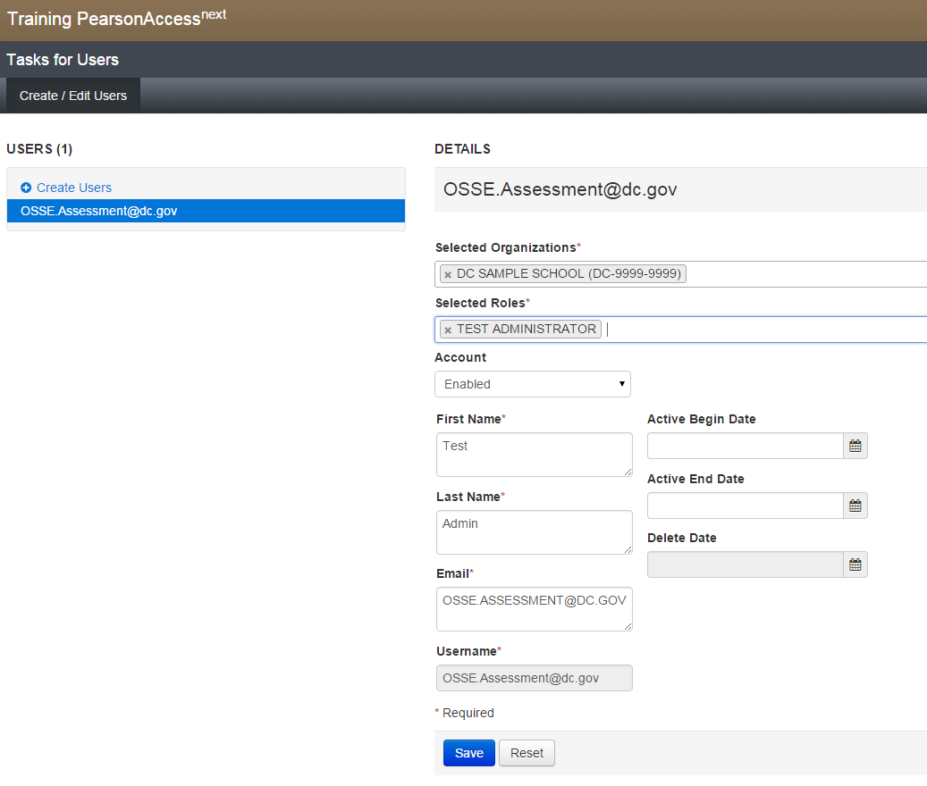
Create a New Account
Under Setup>Users under tasks choose “create/edit users”, click start. Insert information for each new user needed and click “save”. After you save, the user will automatically get an email to create their own password (just like you got to create your password).

Slide 67
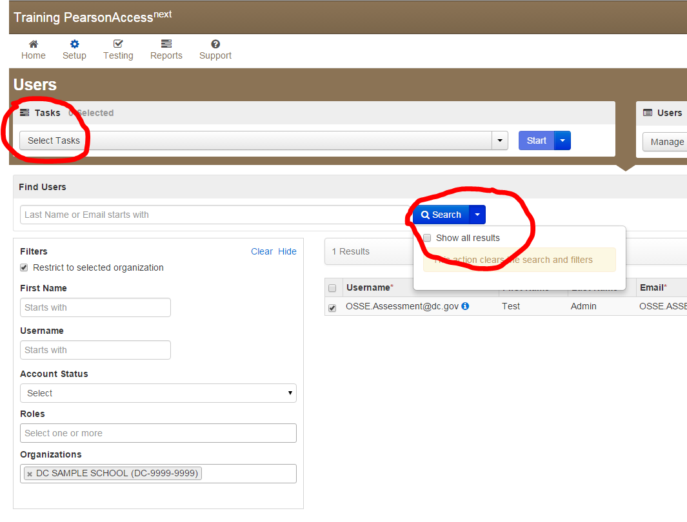
Reactivating an Old Account
Under Setup>Users click the blue down arrow next to the search button to see all the users in your school. Select users you want to edit/reactivate, and under tasks choose “create/edit users” and “reset passwords”

Slide 68
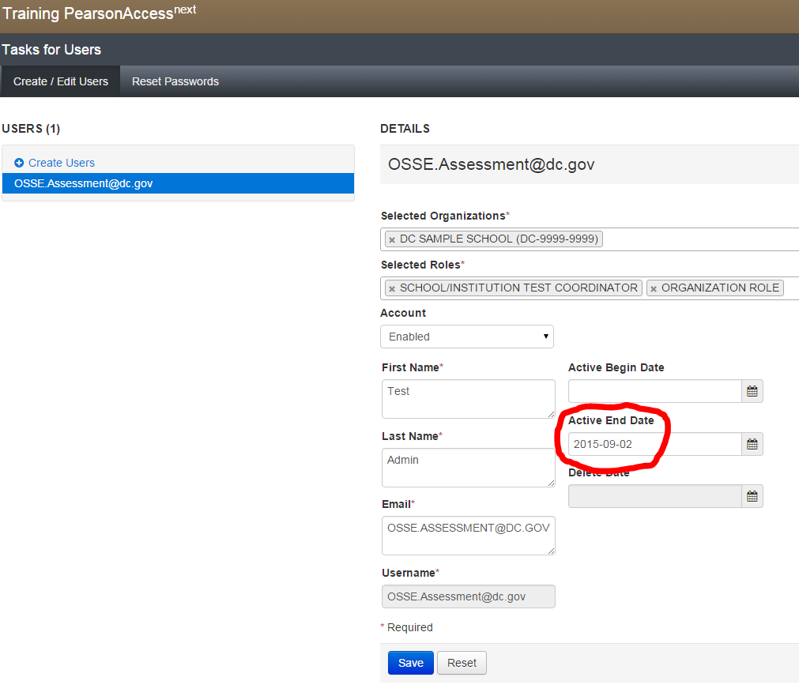
Reactivating an Old Account
In the create/edit users task, erase the active end date for your selected users, or replace with a date of your choosing. Edit permissions as needed, click save. In the reset password task, reset passwords to automatically send an email to the user.

Slide 69
Accommodations and the Personal Needs Profile (PNP)

Slide 70
Accommodations for Special Populations
Four distinct groups of students may receive accommodations on statewide assessments.
Students with IEPs
Students with Section 504 plans
Students who are English learners
English learners with disabilities who have an IEP or 504 plan (eligible for both sets of accommodations)
Notes:
PARCC manual p.14
SWD includes 504 plans
Four distinct groups of students may receive accommodations on PARCC assessments:
Students with disabilities who have an Individualized Education Program (IEP);
Students with a Section 504 plan who have a physical or mental impairment that substantially limits one or more major life activities, have a record of such an impairment, or are regarded as having such an impairment, but who do not qualify for special education services;
Students who are English learners; and
Students who are English learners and with disabilities who have an IEP or 504 plan. These students are eligible for both accommodations for students with disabilities and English learners.

Slide 71
The PARCC Accessibility System
The PARCC assessment platform includes several accessibility features built into the system that all students can access at any time.
Accessibility Features available to all students (built into design)
Additional accessibility features are available to any student, but must be specifically selected in student registration for planning purposes.
Accessibility Features identified in advance (includes Administrative Considerations)
Certain accommodations are available only to students with disabilities (IEP or 504) and others for English learners (ELL) with ELL plans.
Accommodations must be documented in the IEP/504/ELL plan, and also in the student’s PNP.
Accommodations
ELL
IEP/ 504

Slide 72
The PARCC Accessibility System
Examples of each type of feature:
Pop-up glossary
External spell check
Enlarged font
Repetition of directions
Accessibility Features available to all students (built into test)
Text-to-Speech for Math Assessment
Color contrast
Frequent breaks (admin consideration)
Small group testing (admin consideration)
Accessibility Features identified in advance (includes Administrative Considerations)
Extended Time
Human signer for test directions
Calculation device
Braille Test Booklet
Accommodations
ELL
IEP/ 504
Word-to-word dictionary
Translation of math to Spanish

Slide 73
Accommodations Webinar Series
Part I: January 27, 2016
Assessment accommodations for students with disabilities
Part II: February 22, 2016, 3:00-4:30 p.m.
Assessment accommodations for English language learners
Part III: February 29, 2016, 1:00-2:30 p.m.
Student registration, Personal Needs Profile, and implementation of accommodations

Slide 74
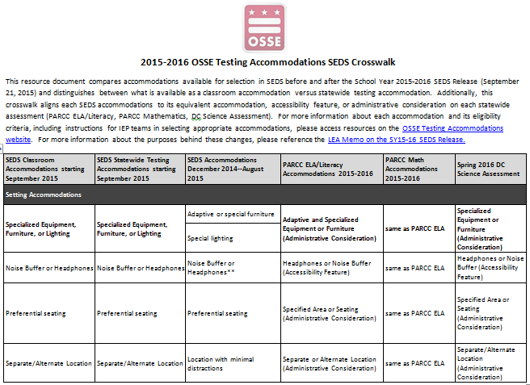
SEDS/PARCC/DC Science Crosswalk
Use the crosswalk guidance document to compare science accommodations with PARCC.
Available on the OSSE Accommodations Site
http://osse.dc.gov/service/testing-accommodations.
Notes:
Testing Window: May 2 – June 3, 2016
Tested Grades: 5th Grade, 8th Grade, and High School Biology
Test Administration Platform: Online using TestNav8 (same platform as PARCC)

Slide 75
PARCC Accommodations Resources
PARCC.Pearson.com
Accommodations practice tutorials, http://parcc.pearson.com/tutorial/
Accessibility Features and Accommodations (AF&A) manual and implementation guidance: http://avocet.pearson.com/PARCC/Home
Training modules: https://parcc.tms.pearson.com/
DC.Pearsonaccessnext.com

Slide 76
Student Registration and PNP
The PARCC personal needs profile (PNP) records the accessibility features and accommodations for every student and “turns on” computer-based accommodations.
New this year: In 2015 there were separate PNP and student registration (SR) files for the PBA and the EOY. In 2016, there is one combined file and one combined assessment design. This is called the SR/PNP.
SR/PNP is managed at dc.pearsonaccessnext.com.

Slide 77
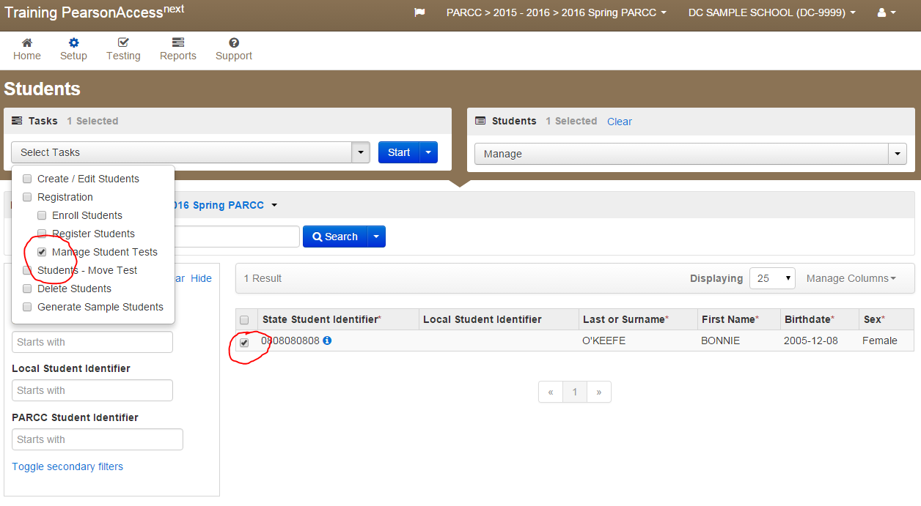
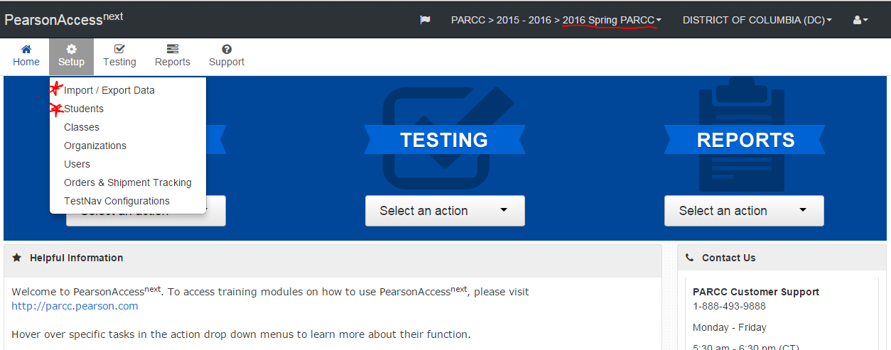
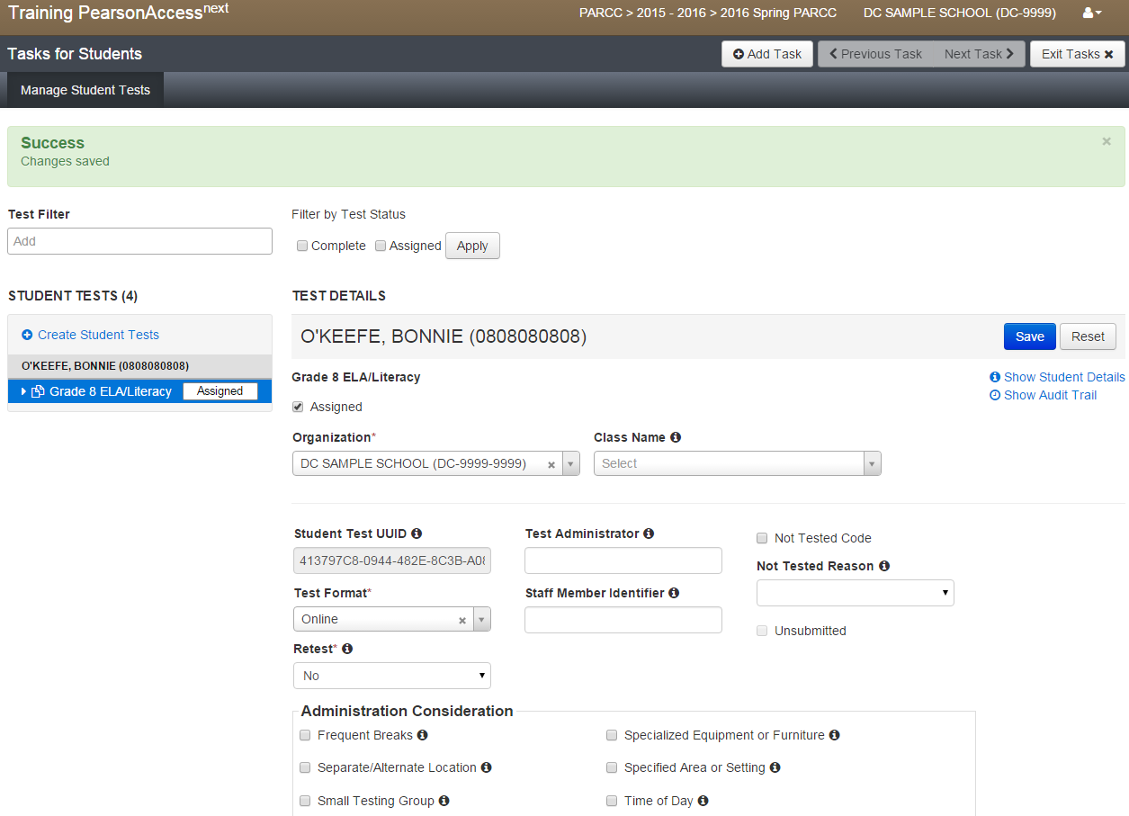
Student Registration and PNP Demo
DC.PearsonAccessNext.com

Slide 78
Accommodations Items to Remember:
Documenting accommodations in Pearson Access Next is required, even if the accommodation isn’t linked to the computer
Computer accommodations must be entered for students prior to proctor caching the test
ELA Read-Aloud and ELA Text-to-Speech are allowable accommodations, but are only appropriate for a very small number of students. Highly recommended to consult the worksheet here: http://avocet.pearson.com/PARCC/Home#10621

Slide 79
Unique Accommodations
Q: What if Mark’s team decides he needs an accommodation that is not listed in SEDS?
A: The IEP team should document it on the IEP in the “Unique Accommodations” box. Also, the LEA must submit a Unique Accommodations Request to OSSE for approval.
Form is found here: http://osse.dc.gov/service/testing-accommodations
“Unique/Non-Standard Accommodation” replaced “Other” in SEDS.

Slide 80
Scheduling & Timing

Slide 81
The Puzzle of Scheduling
Time
Space & Equipment
People
Accommodations

Slide 82
Time: Test Windows
Select PARCC Test Window
Computer
Option 1: 3/28/16 – 4/29/16
Option 2: 4/6/16 – 5/13/16
Option 3: 4/11/16 – 5/20/16
Paper
3/28/16 – 4/29/16
Select DC Science Test Window
Computer Only
5/2/16 – 6/3/16

Slide 83
Time: ELA Test Units
Varying unit times increase the complexity of scheduling

Slide 84
Time: Math Test Units
Varying unit times increase the complexity of scheduling

Slide 85
Space & Equipment
Primary Considerations
Rooms
Devices
Bandwidth & Access Points
Test Security
Other Considerations
Non-Testing Students
Bell Schedule
Student Movement
Meals, Specials, and More

Slide 86
People: Students & Staff
Primary Considerations (how many, who, where?)
Student Counts
Grade
Classroom
Testing Groups
Staff Counts
Staff for Testing Grades
Additional Staff Needed for Test Administration
Other Considerations
Authorized Personnel
Non-Testing Students
Early Finishers
School Administrators/Internal Monitors

Slide 87
Accommodations
Complex Puzzle

Slide 88
Accommodations
Primary Considerations
Student Counts
Individual Accommodations
Is this accommodation human or computer administered?
Clustering Compatible Accommodations
Staffing
Other Considerations
Time-based Accommodations
Space & Staffing
IEPs, 504 Plans, ELL Plans, and Summaries
Test Administrators & Proctors
External Monitors

Slide 89
Think, Pair, Share
Experienced Test Coordinators
What worked best in scheduling testing last year?
What is one challenge you faced in scheduling testing last year?
What is one thing you learned while testing was already in progress that you wish you knew before making the schedule?
First-Time Test Coordinators
What is one strategy you think you may use to complete this year’s schedule?
What is your biggest fear in creating a test schedule?

Slide 90
Training Authorized Personnel

Slide 91
Training Authorized Personnel
Who requires training?
Test Administrators
Test Proctors
Authorized Personnel
What should the training include?
See OSSE Sample Test Security Training for Schools
How should training be documented?
The following may be placed in the school’s Test Security File (optional):
Training Materials
Sign-In Sheets
Statewide Testing Integrity and Security Notification Statement Distribution Roster (signature not required)

Slide 92
Sample Test Security Training
http://osse.dc.gov/page/test-coordinators-training

Slide 93
Creating/Editing Test Sessions

Slide 94
Pearson Access Next Test Sessions
Test sessions are groups of students within Pearson Access Next. Before students take the test, they must be placed in a test session for each test (math, ELA). Test sessions should match testing groups
Test session and Test Administrator naming requirements for test security: See school plan guidance
If you upload students with their test session name populated in the SR/PNP, the system will auto-create test sessions
Find more detailed information on test sessions in the parcc.pearson.com training modules

Slide 95
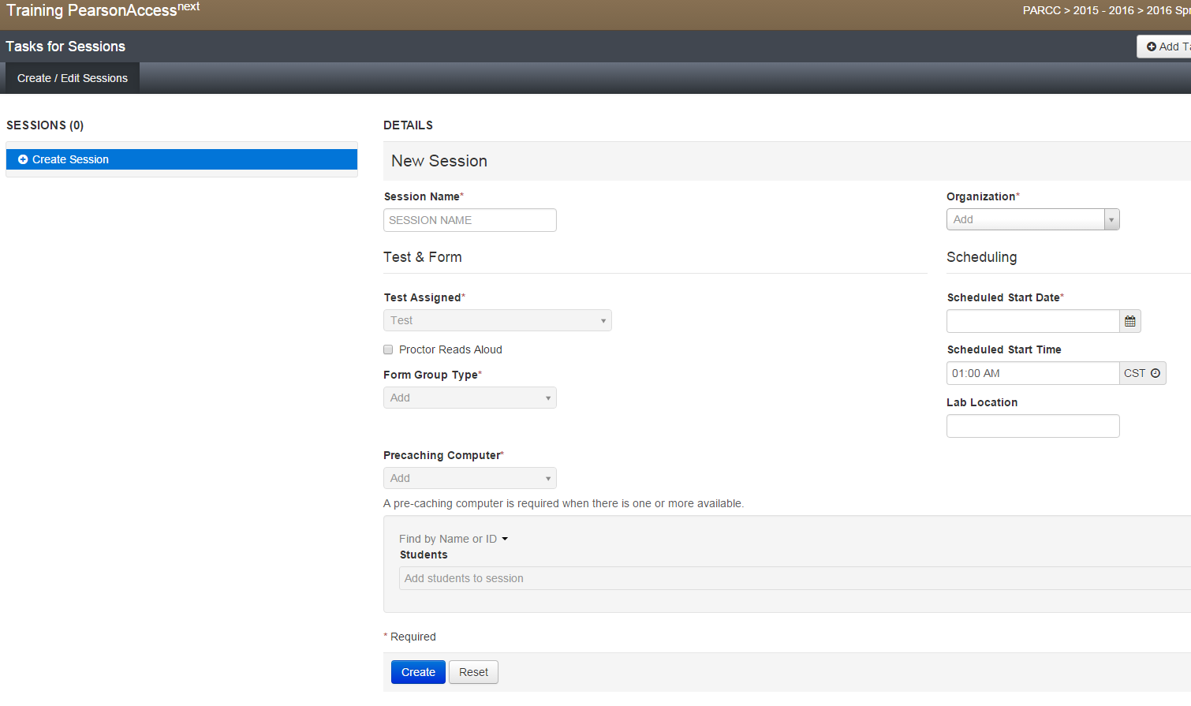
Create/Edit a Test Session
Go to Testing > Sessions. Search for and select the session you want to edit, or go straight to the task list to make a new session.
Open the task list and select Create / Edit Sessions, click Start.
Enter the required details for this test session.
If your Technology Coordinator configured at least one proctor caching computer, you must use that proctor caching computer in order to submit this form or setup Custom TestNav Settings.
Note: you can add students individually by name or in bulk using the Class option. To add students by Class, select Find by Class and choose the class containing the sample students you would like to add to the session. If you are creating a read aloud session, only students receiving read aloud can be in a read aloud test session.
You may use the Student Registration/Personal Needs Profile (SR/PNP) Import process to auto-create your sessions and classes.
After a session is created, a Password box becomes available. This box contains the password that will be included in the student testing ticket and which all students will use to log in to the test (along with their unique User ID).

Slide 96
Infrastructure Trials

Slide 97
Why Do An Infrastructure Trial?
Infrastructure trials are highly recommended, especially for schools new to computer testing, or using new testing devices this year
Infrastructure trials are a dress rehearsal of the test logistically and technologically
You can involve students and teachers, to prepare for the live testing experience
A great chance to pressure-test internal communications systems and work out any technology setup issues
Detailed guide available here: http://avocet.pearson.com/PARCC/Home#10590 and in training module format

Slide 98
New Infrastructure Trial Features
Multiple unit setup mimics transition between units in live testing
Unit 1: Tutorial for grade level
Unit 2: Practice test content (formerly PBA)
Unit 3: Practice test content (formerly EOY)
PNP in the infrastructure trial can now be used to assign accommodated practice tests/tutorials during the infrastructure trial

Slide 99
Final steps before testing

Slide 100
Before Testing, Don’t Forget…
Check that all test registrations and PNP information is complete and correct before proctor caching
Setup computers and proctor cache (will be covered in technology coordinators webinar)
Gather any ancillary materials for distribution (e.g. blank paper, pencils, headphones). Required and optional materials lists available in manuals.
Print and secure student testing tickets
Order any additional paper materials at least 5 business days before they are needed
Meet with students, notify parents of testing

Slide 101
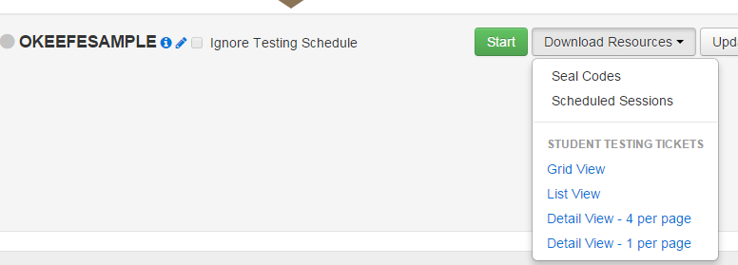
Print Student Testing Tickets
Under Testing > Students in Sessions choose session(s) you want from the list on the left side of the screen
Under the “Download Resources” dropdown, choose the view you want for tickets to download.

Slide 102
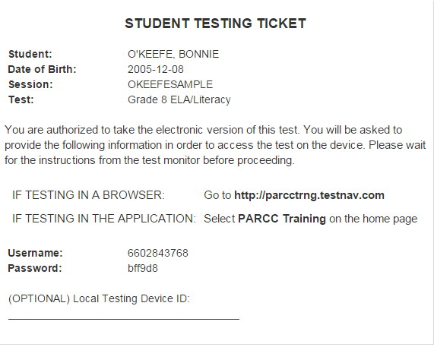
Student Test Ticket Sample

Slide 103
During Testing

Slide 104
During Testing Introduction
During testing, it is particularly important to follow your school test security plan to the letter and refer to the PARCC test coordinator and test administrator manual for procedures, scripts, etc.
This section of the training will cover:
Day of testing best practices
Pearson Access Next administering test sessions
ELA/Literacy field testing
Administering accommodations
Student logout procedures
Make-up testing
Troubleshooting and getting help

Slide 105
Day of testing: Best practices

Slide 106
Day of Testing: Culture & Organization
Recommendations
Test Schedule
Printed and available
Whole school knows test schedule and locations
Plan for communicating changes daily
Materials Check-Out/Check-In System is Efficient
Signage and Customized Materials to Minimize Confusion
Label test locations
“Testing in Progress” signs
Room-specific accommodations summaries
Plan for Student Needs
Mints/snacks/meals
Bathroom

Slide 107
Day of Testing: Test Security
Recommendations
Culture of Monitoring
Empower test proctors
Real-time feedback to test administrators
Test Coordinator/Test Monitor
Visible during testing (in and out of rooms)
Assistance with monitoring and/or troubleshooting
Zoom-in and zoom-out
Irregularities
Document irregularities in School Security File
Use OSSE for reporting and technical assistance

Slide 108
Think, Pair, Share
Experienced Test Coordinators
What is one organizational system you used during testing that worked well?
First-Time Test Coordinators
What is one organizational system that you have used that you think could work well during testing?

Slide 109
Managing Computer Test Sessions during Testing

Slide 110
Starting a Test Using “Students in Sessions”
Under Testing > Students in Sessions choose session(s) from the list on the left side of the screen to view all students in the session and their tests, download test tickets, and conduct the test.
When you are ready to start the session, click the green start button and unlock the appropriate test unit.
New this year: Each unit of every test is set up separately, and can be locked/unlocked by a Test Administrator or Test Coordinator from the Student in Sessions screen. There is no longer a need for seal codes or the set section start function.
Lock/unlock can be done at the student level, or for the whole session at once. Only unlock units for students who are present.
New this year: The test form id will confirm easily if a student has the correct special test before they start (e.g. text to speech, Spanish)

Slide 111
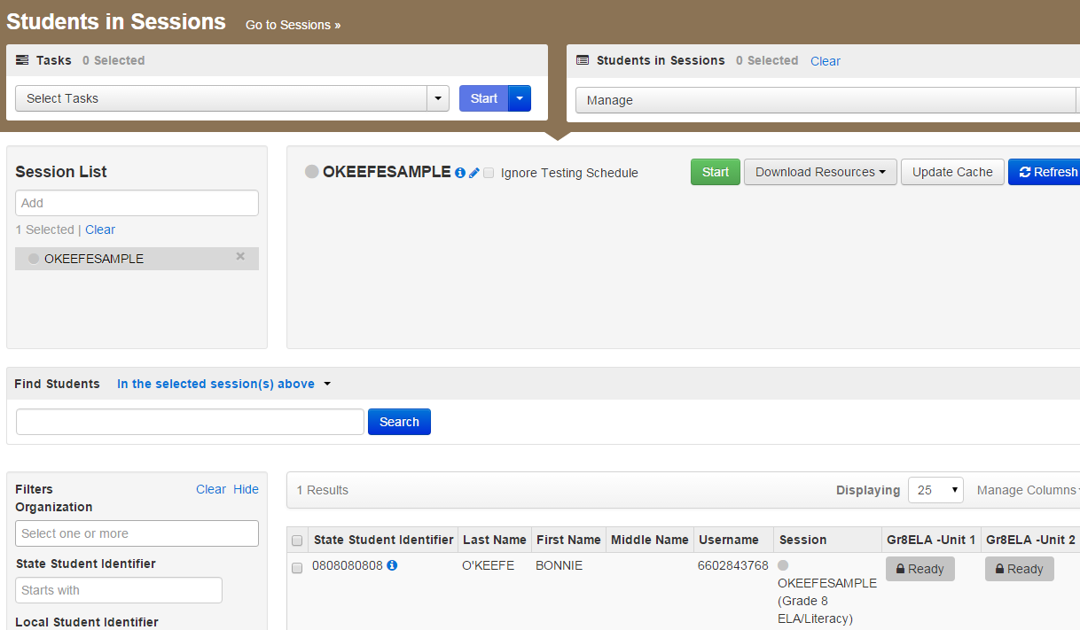
Students in Sessions

Slide 112
Monitoring Test Status
During the test, Pearson Access Next will display one of the following student test statuses on the Students in Session screen for all test units in whatever session you have selected:
Each unit will have a lock or unlock icon next to it:
Status | Description
Ready | The student has not yet started the test.
Active | The student has logged in and started the test. If the student exits the test improperly and the status remains set at Active, the student cannot resume testing unless the status is changed to Resumed or Resumed Upload by a Test Administrator.
Exited | The student has exited TestNav but has not submitted test responses. The student cannot resume testing unless the status is changed to Resumed or Resumed Upload.
Resumed or Resumed Uploaded | The student has been authorized to resume the test, but has not yet logged in.
Completed | The test has been submitted by the student through TestNav and the data has been processed. The test can only be re-opened by OSSE.
Marked Complete | The student has exited TestNav and will not resume the same test, or has never logged in to a test, but the test session needs to be stopped. The test can only be re-opened by OSSE.

Slide 113
Common Error: Units vs. Sections
Common error last year
Math tests in 7th grade and high school have calculator and non-calculator sections within Unit 1.
When students come to the end of the non-calculator section, they should check their work, and move on to the calculator section independently. The sections are not timed, and the Test Administrator does not have to intervene except to give them calculators if using handheld. Directions on the screen and test directions will explain this.
Be sure your test administrators in these grades understand the section distinction. There were many administrative errors last year on this topic.

Slide 114
ELA Field Testing GradeS 4 and 7

Slide 115
Field Testing for Grades 4 and 7 ELA
All DC students in grades 4 and 7 will take an additional unit of the ELA assessment to accommodate field test items.
Participation is required, and will help ensure high-quality tests. In future years, different grades will be selected for field test participation.
In these grades, tests will include Unit 3a and 3b. These Units will appear as Unit 3 in PA Next, but are separately timed and should be administered in separate sittings.
Grade 4: Unit 3a = 90 mins, Unit 3b = 90 mins
Grade 7: Unit 3a = 90 mins, Unit 3b = 110 mins
Be sure your test administrators in these grades are prepared by reading the field testing appendix to the Test Administrator Manuals.

Slide 116
Administering Accommodations

Slide 117
Day of Testing Accommodations
On the day of testing, your students and their test administrators should all know and be comfortable with the accommodations and accessibility features they will receive or administer
Prepare all special materials (assistive tech, extra calculators, headphones, special test booklets) ahead of time
Pay special monitoring attention to students with accommodations at the beginning of the test, to ensure they are receiving all their correct accommodations

Slide 118
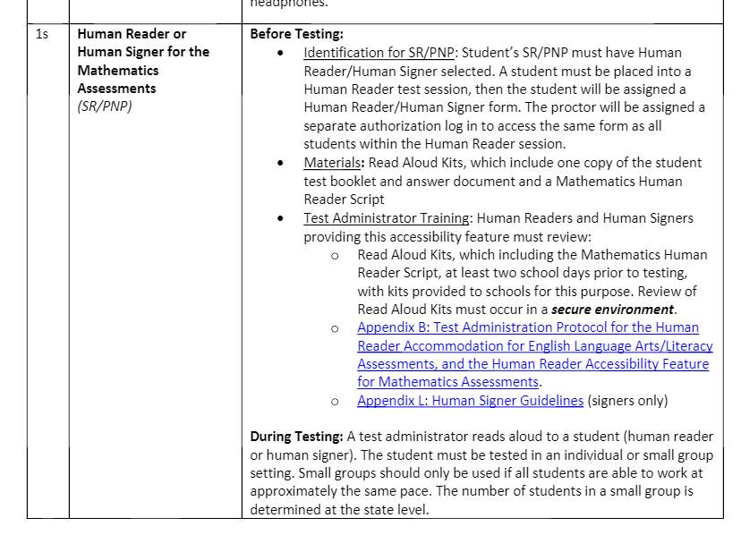
Accommodations Implementation Guidance
Access the PARCC Accommodations Manual here for step-by-step implementation guidance for each accommodation or accessibility feature
New format focused on before/during/after testing implementation
Example:

Slide 119
Fix a PNP Error During Testing
What to do when an accommodated test form (e.g. test to speech, Spanish math test) is incorrect for a student during testing
This is a high-impact error, because it could cause a student to lose their work or be invalidated if not caught early.
The best thing is to avoid the problem by finalizing all PNP data before proctor caching or starting any test sessions
Full step-by-step guidance here

Slide 120
Fix a PNP Error During Testing
If the test session has been started and the test form has been assigned incorrectly, you will need to delete that test registration and start from scratch:
Submit a test security incident form and void request to OSSE if the student has opened the test
Mark the test complete in the students in sessions screen
Go back to the “Manage Student Tests” menu and assign a whole new test in that subject to the student, enter the correct PNP information, place that test in a test session, verify form assignment, print new test ticket information, start new test.

Slide 121
Student logout procedures

Slide 122
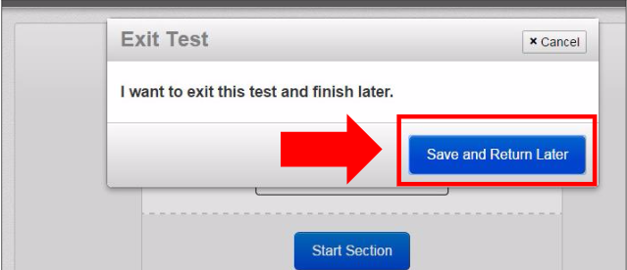
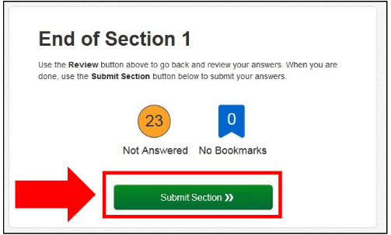
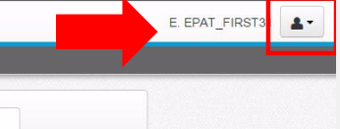
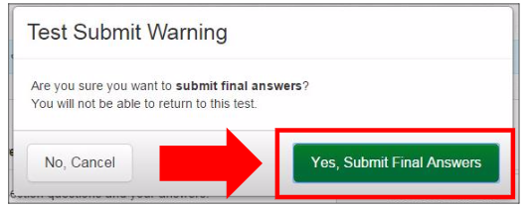
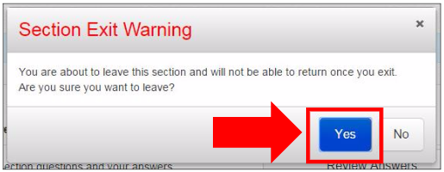
Student Logout Procedures
Guidance here
May be shared with students during testing or referenced by Test Administrators

Slide 123
Make-up test administration

Slide 124
Make-Up Test Scheduling
Considerations
Test Window
Accommodations (especially time-based ones)
Student Fatigue
Chronic Absenteeism
Time, Space and Equipment
Staffing
Whole School Schedules and Student Movement
Test Security
Recordkeeping on Changes to the School Test Plan

Slide 125
Make-Up Test Sessions in Pearson Access Next
Students may take units out of order to continue testing with their group, make sure you unlock the correct units for each student
You may administer makeup sessions to mixed grades of students, pay special attention to test time and directions
Step by Step Guidance Available Here
Option 1: Leave the student in their original session. During the makeup test period, a Test Administrator may unlock the session they missed. During the makeup session, a Test Administrator may be managing students in multiple sessions at once, and you will document your makeup session group in your school’s test security file if needed for future reference.
Option 2: Move all students in a grade who need makeup tests into a new session with .makeup at the end of the session name. Students will need new testing tickets printed for this session.

Slide 126
Who to Call, How to Get Help

Slide 127
Who to Call, How to Get Help
PARCC.Pearson.com is the central site for practice tests, manuals, training modules, links to guidance documents, technology information and more.
Technology error codes and troubleshooting
New this year: PARCC Support Center is run by a new contractor, in response to feedback from last year. They can help you via phone, email or live chat support if you encounter issues with Pearson Access Next or Test Nav 8, and they can answer basic test administration questions:
Monday-Friday, 6:30 a.m. – 7:30 p.m.
1-888-493-9888
parcc@support.pearson.com
OSSE Support during testing:
Contact us for support/guidance on test administration policy, questions on crafting your test plan, accommodations, and real-time “what should I do now?”, or to escalate/flag a technical issue you have reported to Pearson.
General questions, osse.assessment@dc.gov
This year, there will be a new OSSE phone number to call during testing, TBA.
We will use the OSSE Support Tool (OST) to track issues during testing and correspond with LEAs securely, routing schools through LEAs. Do not send any student information via email. New LEA users will have training opportunities prior to testing.

Slide 128
After Testing

Slide 129
After Testing
Stop sessions
All tests must be in complete or marked complete status
Collect and shred student testing tickets and used scrap paper
For paper-based tests, ensure student information is complete on all tests, follow instructions in manuals on shipping back scorable (answer booklets) and non-scorable (test booklets) materials.
Braille and large print booklets must be transcribed
Closeout any incident documentation
Data cleanup and verification
Complete and send affidavits to OSSE, archive records

Slide 130
DC Science, Tips and Tricks, Q&A

Slide 131
What’s New: Science 2016
Features / Technology:
The Student Registration and Personal Needs Profile files will be combined into a single file (SR/PNP) for registration. Verification and additional fields will be setup for science.
A paper form as an accommodation will be available for each grade. Student responses must be transcribed into the online platform.
An audio form will be available as an accommodation. Headphones will be required for this accommodation only.
The Google Chrome browser is no longer supported, but the TestNav desktop app and other supported browsers (e.g., IE, Firefox) may be used. Chromebooks are still supported devices.

Slide 132
What’s New: Science 2016
Test Design:
Two parts to a test per grade
Each part is timed for one hour
Four different forms per grade
Flexibility to test each part on separate days
Seal Codes required

Slide 133
Science Test Design
What is the difference between Parts and Units?
2 Parts = 1
Complete Science test
PARCC “Units” may be locked and unlocked
separately
Notes:
Science will be divided into two parts, but the administrative activities will take place on the entire test:
For example, if a students test is marked complete – they no longer have the ability to take any other part of the test, even if they didn’t complet
PARCC each unit is treated separately

Slide 134
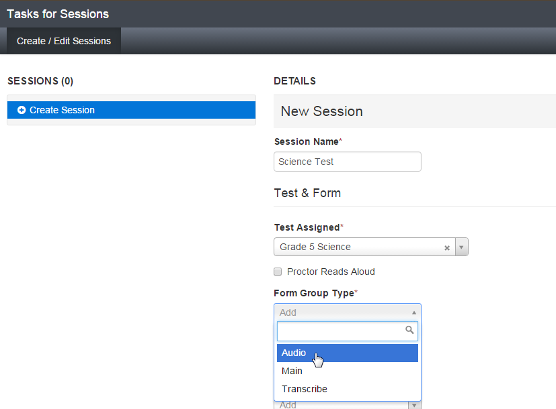
Assign Audio Form
Setup at the time Test Sessions are created. After selecting Audio, all students placed into the session will access the audio version of the test.

Slide 135
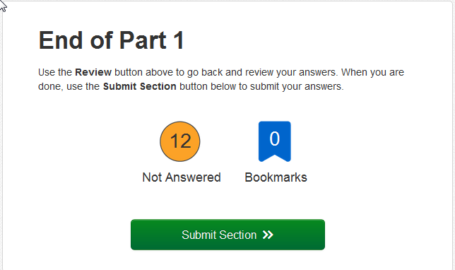
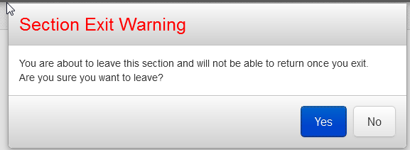
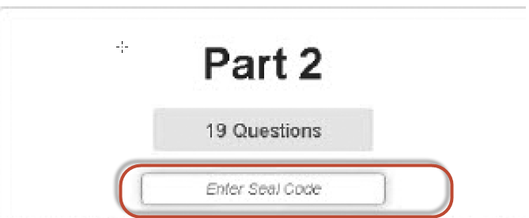
Security Seal Codes
Seal codes will only be used to access Part 2 of the science test.

Slide 136
Science: Important Dates
Test Administration Webinar: Apr. 4, 2016
Paper Test Order Window: Apr. 6 – 20, 2016
Student Registration Opens: Apr. 18, 2016
Testing Window: May 2, 2016 – Jun 3, 2016

Slide 137
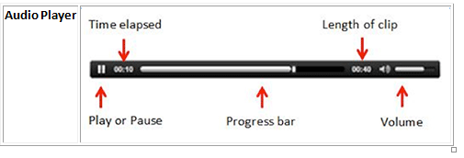
Audio vs. Text to Speech

Slide 138
Next Steps
Watch/register for accommodations webinar series.
Feb. 22, 3-4:30 p.m. Part II (ELLs)
Feb. 29, 1-2:30 p.m. Part III (Implementation/PNP)
LEAs: Remind NPP test coordinators to register for the NPP test coordinator training on March 3, 1-4 p.m.
Deadline for submitting school test plans: 15 days prior to testing
Mark your calendars for open office hours
Science test administration webinar, April 4
TBA:
Webinar for technology coordinators, early March

Slide 139
OSSE Contacts
All materials will be posted on http://osse.dc.gov/page/test-coordinators-training
Direct questions to OSSE.Assessment@dc.gov or to the assessment team:
All assessments: Jessica.Enos@dc.gov
Accommodations, special populations: LaNysha.Adams@dc.gov
DC Science: Swea.Hart@dc.gov
Test Security: Tonya.Mead@dc.gov
PARCC tech, policy, admin: Bonnie.OKeefe@dc.gov
Test development and design: Nikki.Stewart@dc.gov
Or attend our office hours

