Slide 1
Sample Test Security Training
February 11; 2016
Office of the State Superintendent of Education
Assessment Team

Slide 2
Introduction
This is a sample test security training slide deck for schools to use in their trainings of school staff to administer secure statewide assessments. All slides highlighted in blue should be customized by schools.

Slide 3
Sign-In Sheet
Note from OSSE: Authorized personnel no longer sign a non-disclosure agreement as confirmation that they have been through test security training. It is recommended that a sign-in sheet is used to record training attendees and placed in the school’s test security file.

Slide 4
Sample Agenda
Agenda
Role of the School Test Monitor
Role of the Test Administrator and Test Proctor
Responsibilities of All Authorized Personnel
Testing Calendar
School Plan for Test Security
Reporting Incidents
Statewide Testing Integrity and Security Notification Statement

Slide 5
School Test Monitor
Major duties include…
Creating and implementing school test security plan
Creating testing calendar
Training authorized personnel
Troubleshooting during testing (e.g.; emergencies; changes to the schedule; make-up tests)
Serving as liaison to the LEA Test Integrity Coordinator
The school test monitor is defined in section 101 and section 201 of the Testing Integrity Act as an individual who is designated by the LEA test integrity coordinator to be responsible for testing integrity and security at a school or campus site. There must be one test monitor for each school or campus under the LEA’s control; including nonpublic placements. The school test monitor is responsible for creating and implementing all aspects of the school test security plan before; during; and after the statewide assessment at the school or campus site. This individual coordinates security; maintains data integrity within their school or campus and trains and supports all authorized personnel at that site. The test monitor must be an employee of the LEA who can successfully fulfill these functions.

Slide 6
Test Administrator
Major duties include…
Preparing the test environment (e.g.; removing non-permissible bulletins and wall displays)
Distributing; monitoring and collecting testing materials
Ensuring students do not have non-permissible materials
Reading test directions aloud
Responding to student needs during testing
Reporting irregularities and test security violations
Serving as liaison to the School Test Monitor
The test administrators are professional employees of the LEA or a school and designated as authorized personnel under the Testing Integrity Act of 2013. The test administrator is responsible for administering the statewide assessment to students; must comply with all the responsibilities and prohibitions of authorized personnel; and must perform all duties assigned by the school test monitor. Test administrators may administer the test to their own students if another individual; also authorized personnel; who is not the teacher of record for the testing group; is also present for the test administration. If the test administrator is not the teacher of record for the testing group; additional authorized personnel are not required. The exception is alternate assessments; an assessment of students with significant cognitive disabilities; which may require administration by a teacher with whom the student is familiar.

Slide 7
Test Proctor
Major duties include…
Assisting the Test Administrator to distribute; monitor and collect testing materials
Ensuring students do not have non-permissible materials
Observing the room during testing
Reporting irregularities and test security violations
Assisting in emergencies
Serving as liaison to the School Test Monitor when the Test Administrator cannot leave the testing room
Proctors may assist test administrators with classroom management during testing; distribute and collect test materials; or administer accommodations as directed by the school test monitor and test administrator. As such; test proctors are considered by OSSE to be authorized personnel and must comply with all the responsibilities and prohibitions of authorized personnel. Test proctors need not be professional employees of the LEA or school; and may be volunteers; contractors; or aides. They must receive training in test security and test administration procedures from the school test monitor; and work at all times under the direct supervision of a test administrator or school test monitor. Parent volunteers serving as proctors may not proctor the assessment of their own child.

Slide 8
Responsibilities of All Authorized Personnel
Fulfill duties as assigned by the School Test Monitor
Review the school’s testing calendar and plan for test security
Review the Statewide Testing Integrity and Security Notification Statement
Ensure the security of testing materials
Prohibit any form of cheating
Report test security incidents and testing irregularities
Ensure a secure and successful administration of the statewide assessment

Slide 9
Testing Calendar
Insert slides and/or use handouts to familiarize trainees with the school’s testing calendar.

Slide 10
School Plan for Test Security
Insert slides and/or use handouts to familiarize trainees with the school’s plan for test security. This should include details on the following:
Preparing the test environment and prohibited materials (e.g.; non-permissible bulletin and wall displays)
Procedures for the secure maintenance; dissemination; collection and storage of Districtwide assessment materials before; during and after administering a test
Actions prohibited by authorized personnel; including cellphone policy
Prohibited materials by assessment (i.e.; ELA; Math; and Science)
Calculator policy
Procedures for the provision of appropriate and necessary accommodations on statewide testing for students with disabilities and English language learners; per their IEP; 504 plans; and/or ELL plans
Procedures for weather; natural disaster; fire alarm or school-wide emergency
Materials permitted after testing
Procedures for students; authorized personnel and any other individuals to report irregularities in testing administration or testing security

Slide 11
Other Test Administration Content
School staff may also need additional training specific to their roles in testing and your school’s testing policies and processes. For example:
Test administrators: Training on Pearson Access Next functions; troubleshooting and getting help during testing; review of test administrator manual and scripts; login/logout procedures for students; implementation of any accommodations they may need to provide; school communications plan during testing.
Test proctors: Training on how to assist with classroom management; helping students login/logout; any accommodations they may need to provide.
Other staff: For staff not directly involved in testing, how to observe secure procedures and create a school-wide environment for a smooth testing experience (e.g. how student schedules may change; how/if to enter a room while testing is in progress; maintaining quiet in testing hallways).

Slide 12
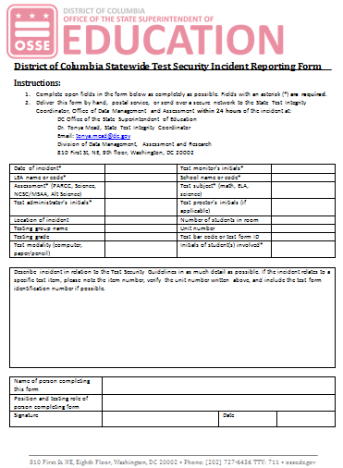
Reporting Incidents
http://osse.dc.gov/service/test-security-and-incident-forms
Per the Testing Integrity Act of 2013 as amended in 2015 (D.C. Law 20-27; D.C. Official Code $ 38-771.01 et seq.); all authorized personnel; defined as an individual who has access to statewide assessment materials or is directly involved in the administration of a statewide assessment; shall Immediately report any breach of testing security to the test monitor; test integrity coordinator; or OSSE.

Slide 13
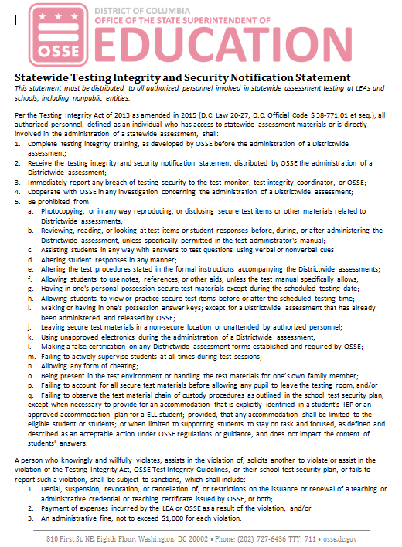
Statewide Testing Integrity and Security Notification Statement
http://osse.dc.gov/service/test-security-and-incident-forms
The LEA or school must do the following: distribute the testing integrity and security notification statement (without the signature requirement) as developed by OSSE to all authorized personnel of the LEA and schools subject to its control informing them of the consequences for knowingly and willingly violating law; regulation or school test security plan; and ensure all authorized personnel of the LEA and schools subject to its control receive a testing integrity and security notification statement developed by OSSE.

Slide 14
Sample Exit Quiz
Exit Quiz
What is the role of the Test Administrator? Test Proctor? School Test Monitor?
What are the responsibilities of Authorized Personnel?
What are prohibited activities and materials during administration of the statewide assessment?
What are key elements of the school’s plan for test security?
What do I do in an emergency?
How do I report test security incidents? Do I need to tell the School Test Monitor? The Principal?
What are the sanctions for violating test security?

