Slide 1
Healthy Tots Wellness Grant
Division of Health and Wellness
Post Award Grantee Orientation
June 1st, 2023
Notes:
Good morning and welcome to the Healthy Tots Wellness Grant Post Award Grantee Orientation.
I'm Kimberly Thompson, a Grants Management Specialist at OSSE who serves at the grants manager for the Healthy Tots Wellness Grant. I am joined on the call with Suzanne Henley who is the Program Manager at OSSE for Out of School Time and Early Childhood Programs.
You've been invited to this call because you have been awarded one of three HTWGs for fiscal year 23. Congratulations to all of the grantees on you hard work putting together the grant submissions and choosing better the early childhood and staff community in DC.

Slide 2
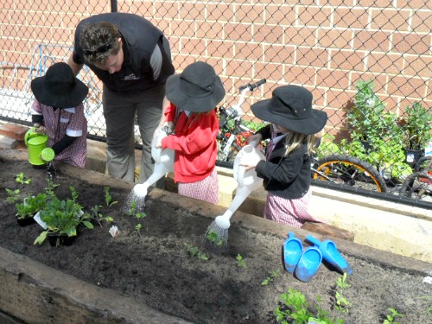
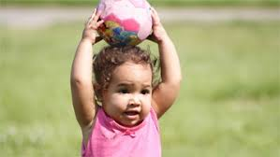
Icebreaker
Grantee Information
Program Area Activities
Q&A
Program Area Metrics
Metric and Sustainability Tool
Q&A
Reporting and Site Visits
Tracking Expenses & Submitting Reimbursement Requests
Reapplication Process
Important Dates to Remember
Q&A
Notes:
Today we will start with an ice breaker and go through all of the agenda topics you see here on the list. There will be three different question breaks so please hold your questions until these specific times. You are also able to drop questions in the chat. We may be able to answer some of these questions in the chat feature or we can response during the question breaks.
I little housekeeping, everyone will be muted for most of the presentation so lets get started with the ice breaker.

Slide 3
Icebreaker
Notes:
Let's start with an ice breaker.

Slide 4
A little about you….
Your name
The organization you are representing
Where do you consider “home”?
Thinking back to your childhood, what did you want to be when you “grew up”?
Notes:
Let's share a little bit about ourselves to get to know all the new faces on the call today.
Share you name, organizing, where you consider home and what did you want to be when you grew up? And then pass to another person.
I'll go first, I'm Kimberly Thompson with OSSE. I call Capitol Hill, DC but I am originally from Fort Worth, Texas. I wanted to be an architect growing up. Now I'll pass it to ….

Slide 5
Grantee Information
Notes:
Thank you everyone for sharing. I hope everyone learned something new about another this morning.
Let's jump into the grantee information.

Slide 6
City Blossoms
Program Name: Early Growers
“…Propose to implement the Healthy Tots program at 17 early childhood centers and engage 445 early childhood educators to directly impact 1,307 children. City Blossoms staff will partner with educators and early childhood centers to design age-appropriate gardens and bilingual nature-based programming where young children make their first connections to fresh food and outdoor education.
Notes:
Our first grantee is City Blossoms, they are a two time previous grantee that plan to continue their work with their Early Growers program under the Outdoor Learning/Environmental Education. They plan to design age appropriate gardens and implement bilingual nature-based programming where young children make their first connections to fresh food and outdoor education.

Slide 7
FRESHFARM Markets
Program Name: Freshfarm to Childcare
“…will recruit 15 ECEs to participate in its updated and full spectrum farm-to-childcare program, renamed 'Freshfarm to Childcare,' which includes local procurement, professional development, and family engagement services.
FRESHFARM will sort ECEs into beginner, intermediate, and advanced cohorts. FRESHFARM will build a technical assistance (TA) curriculum that includes workshops, office hours, and one-on-one technical assistance; group TA sessions will be open to all ECEs in the District. Grantee will also pair each of the 15 selected sites with a Community Food Educator who will support them with custom, weekly local food procurement, cooking, family engagement, and claiming Local5 reimbursements ….”
Notes:
Next we have Freshfarm, who is another two time grantee who was awarded the HTWG under Community Food Works before their merger. They plan to work with 15 ECEs under their farm to childcare program Freshfarm to Childcare and focus on local procurement, staff development and family engagement. They will sort their ECEs in three tiered group and offer various types of TA and pair them with a community food educator.

Slide 8
Kids Comprehensive Services
Program Name: Staff Wellness
“….Program is to build capacity within early childhood facilities to support the well-being of early childhood professionals. The following goals have been identified: (1) Provide an individualized staff wellness plan based on the needs and strengths of the staff and center; (2) Review the facility's practices and policies to inform the plan for implementation of the staff wellness plan and (3) Implement an evidence-based staff wellness program that provides the strategies to create a workplace that supports and sustains a culture of wellness. ….”
Notes:
Our newest grantee is Kids Comprehensive services – which is a first time grantee. They will work in the staff wellness program area and support the well being for early childhood staff through staff wellness plans and update facility's practices and policies. They will also work to create a workplace that supports a culture of wellness.

Slide 9
Grantee Breakdown
Farm to Childcare and Local Food Procurement
FRESHFARM Markets
Staff Wellness Culture and Program
Kid's Comprehensive Services
Outdoor Learning/Environmental Education
City Blossoms
Notes:
As you can see here, we have a mix of three different program areas of the HTWG.

Slide 10
Duplicate Program Sites
Multiple program area can be implemented at a site.
The HTA team will notify you if another program area is operating at your selected sites for awareness.
Grantees have 30 days from grant award or by July 1st to secure partnership with the required amount of early learning facilities sites per program area
Farm to Childcare & Local Food Procurement (minimum of 15 sites)
Outdoor Learning/Environmental Education (minimum of 7 sites)
Staff Wellness Culture and Program (minimum of 7 sites)
All intent/commitment agreements must be submitted to Kimberly Thompson at kimberlya.thompson@dc.gov by July 1
Notes:
Keeping that in mind, multiple program area can be implemented at a site. So as you are collecting site forms and MOUs, OSSE will notify you if another grantee is operating at your site.
Grantees will have 30 days from grant award to secure their required number of partnerships with early learning sites. The number varies per program area; 15 for farm to child care and 7 for outdoor learning and staff wellness.
All completed paperwork can be emailed directly to me, You can submit on a rolling basis or all at once.

Slide 11
Program Area
Grant Activities
Notes:
Next up we are going to review grant areas of each program area being awarded.

Slide 12
Physical Activity/Education Checklist
Increase the number of facilities implementing high-quality physical activity and education programming.
Train early childhood educators on physical activity delivery methods that support staff in leading and encouraging gross motor play.
Provide technical assistance associated with implementing and leading consistent physical activity program(s) that include structured teacher-led activities and unstructured play
Support the full implementation of an existing physical activity policy, as needed, or support the completion of a physical activity policy.
Incorporate opportunities for adult (staff) physical activity and education into to the programming to encourage experiential learning and support the staff’s capacity to act as role models in this program area.

Slide 13
Physical Activity Grant Activities
Conduct a pre and post assessment of 1) the facilities’ physical activity programming to assess its adherence to Caring for Our Children’s physical activity guidelines and 2) opportunities for the staff to participate in physical activity throughout the day. The results of the pre-assessment should inform the grantees’ plan for each facility.
Implement an evidence-based or evidence-informed physical activity intervention that aligns with Care for Our Children’s physical activity guidelines - 3.1.3.1: Active Opportunities for Physical Activity, 3.1.3.4: Caregivers’/Teachers’ Encouragement of Physical Activity, and 9.2.3.1: Policies and Practices that Promote Physical Activity.
Provide technical assistance to child development facilities at least four times per month during the grant period to help them successfully implement the physical activity program. Teachers must gain the competence to lead and support physical activity independently. If the grantee determines that a different technical assistance schedule is more appropriate to achieve this activity this must be described and explained in the application.

Slide 14
Physical Activity Grant Activities
5. Provide assistance to the facility in determining, sourcing and purchasing materials to implement structured physical activity and education programming, as needed.
6. Work with a minimum of seven early learning facilities during the grant period.

Slide 15
Farm to Childcare Checklist
Increase the number of child development facilities that are serving locally grown and locally processed and unprocessed foods at least once per week and claiming the Local5 reimbursement.
Connect facilities to locally grown, and locally processed and unprocessed foods from growers engaged in sustainable agriculture practices. Grantees can also help to connect facilities with producers or distributors that take local produce and minimally process them (cut up, freeze, canned, turn into baby food, etc.).
Assist facilities in serving seasonal, locally grown and/or locally processed and unprocessed foods into their menu at least once a week.
Incorporate opportunities for staff to purchase accessibly priced locally grown foods as part of the facility’s local food program.
Notes:
Each program area has a checklist and set of activities.
For farm to schools, this area focuses on serving local and unprocessed foods at least once a week while claiming the Local5 reimbursement under CACFP.
Theres also a focus on sustainable agriculture practices, serving seasonal and incorporating opportunities for staff to purcase local foods.

Slide 16
Farm to Childcare Activities
Conduct a pre and post assessment of 1) the facilities’ local food procurement practices/knowledges, service of local foods and claiming of the Local5 reimbursement; and 2) the staff’s knowledge of locally grown foods’ benefits and where to purchase these foods. The results of the pre-assessment should inform the grantees’ plan for each facility.
Provide technical assistance to child development facilities at least four times per month during the grant period to help them successfully implement procurement methods that result in local foods being served in meals at least one time per week and claimed for Local5 reimbursement.
Provide technical assistance to support facilities in successfully incorporating local foods into children’s meals in a manner that promotes curiosity, exploration and consumption of new foods.
Assist facilities in determining, sourcing and purchasing local food.
As needed, provide resources, materials and equipment to support facilities to incorporate local foods into meals.
Notes:
Grantees can read through the full list but Highlights of farm to childcare activities include (1)conducting a pre and post assessment of local food procurement practices and knowledge, (2)providing technical assistance 4x per month during the grant cycle, ensure that local foods are served and claimed one time per week, (3) develop a realistic sustainability plan to support the facility in continuing and enhancing their programming after the grant ends and (4) Work with a minimum of 15 early learning facilities during the grant period.

Slide 17
Farm to Childcare Activities
6. Grantees will be required to work with each facility they serve to develop a realistic sustainability plan to support the facility in continuing and enhancing, if appropriate, the programming after the grant ends.
7. Work with a minimum of 15 early learning facilities during the grant period.

Slide 18
Outdoor Learning/Environmental Education Checklist
Increase the number of facilities implementing high quality outdoor learning through various methods such as gardening, developing natural play areas, and incorporating outdoor learning into existing curriculum.
Train early childhood educators on practices to foster an engaging and supportive outdoor learning/environmental education environment.
Provide technical assistance associated with implementing and leading outdoor learning/environmental education activities.
Support the implementation of an outdoor learning/environmental education program and/or incorporating such activities into existing programming.
Incorporate opportunities for staff to learn how to accessibly incorporate nature activities into their lives outside of work as a method to promote stress reduction and staff well-being.
Notes:
Next we have the outdoor learning checklist.
This area focuses Increasing the number of facilities implementing high quality outdoor learning through various methods such as gardening, developing natural play areas, and incorporating outdoor learning into existing curriculum.

Slide 19
Outdoor Learning/Environmental Education Activities
Conduct a pre and post assessment of the status of the facilities’ outdoor learning/environment education program. Successfully implement a gardening education/environmental sustainability program.
Implement an evidence-based or evidence-informed physical activity intervention that aligns with the Early Childhood Environmental Education Programs: Guidelines for Excellence | eePRO (naaee.org) guidelines within the capacity of the centers’ needs and readiness, including administration, staff and existing outdoor space.
Provide technical assistance to child development facilities at least four times per month during the grant period to help them successfully implement an outdoor learning/environmental education program. The grantee may begin the grant period by role modeling the delivery of the lessons to enrolled children; however, through training and technical assistance the teachers must gain the competence to lead and support outdoor learning/environmental education independently. If the grantee determines that a different technical assistance schedule is more appropriate to achieve this activity this must be described an explained in the application.
Notes:
Same with the other program area a pre and post assessment is completed along with routine TA.
A highlight here is that Early Childhood Environmental Education Programs: Guidelines for Excellence | eePRO (naaee.org) guidelines will be used to implement an outdoor learning/environmental education program

Slide 20
Outdoor Learning/Environmental Education Activities
6. Provide resources, materials and equipment for creating outdoor learning/nature-learning areas.
7. Grantees will be required to work with each facility they serve to develop a realistic sustainability plan to support the facility in continuing and enhancing, if appropriate, the programming after the grant ends.
8. Work with a minimum of seven early learning facilities during the grant period

Slide 21
Staff/Center Wellness Policy Checklist
Increase the number of facilities maintaining a culture that supports and encourages staff wellness.
Provide training concerning staff well- being.
Provide technical assistance associated with designing an educator well-being program.
Support the implementation of educator wellness program that fosters a working environment of mutual respect, trust and teamwork where staff feel empowered to make decisions and know that program leadership supports them.
Notes:
Lastly, we have the staff wellness required checklist and activities to Increase the number of facilities maintaining a culture that supports and encourages staff wellness.

Slide 22
Staff Wellness/Center Wellness Policy Grant Activities
Conduct a pre and post assessment of educator wellness to assess the staff strengths and needs. Conduct a pre and post environmental assessment to assess the wellness culture of the facility, including practices and policies. The results of the pre-assessment should inform the grantees’ plan for each facility.
Implement an evidence-based or evidence-informed staff wellness program that aligns with the themes addressed in the U.S. Department of Health and Human Services’ September 27, 2021 Supporting the Wellness of All Staff in the Head Start Workforce | ECLKC (hhs.gov) (Log Number ACF-IM-HS-21-05) according to the centers’ readiness and need as demonstrated in staff and environmental assessments.
Provide technical assistance to child development facilities at least four times per month during the grant period to help them successfully implement a staff wellness program. The grantee may begin the grant period by leading the implementation; however, through training and technical assistance the facility staff and leadership must gain the competence to lead and maintain the program independently.
Notes:
Similar to the other areas, Kids Comprehensive services will be required to complete a pre and post assessment of educator wellness at their sites and provide TA 4x a month. They will be tasked with using the Head Starts's Supporting the Wellness of All Staff in the Workforce to implement evidence based and informed staff wellness programs.

Slide 23
Staff Wellness/Center Wellness Policy Grant Activities
4. Provide resources, materials and equipment for operating am educator wellness program.
5. Grantees will be required to work with each facility they serve to develop a realistic sustainability plan to support the facility in continuing and enhancing, if appropriate, the programming after the grant ends.
6. Work with a minimum of seven early learning facilities during the grant period.

Slide 24
Question Break
Notes:
That was a lot of introductory information to get through so we now how our first question break. You can come off mute to ask a question or drop a question in the chat.

Slide 25
Program Area Metrics
Notes:
Thank you for the all the great questions. If you still have any outstanding questions that were not addressed we can connect via email to ensure you get a response.
The next section is going to review program area metrics, which are new to this grant cycle.

Slide 26
Farm to Childcare and Local Food Procurement Component Metrics
Emerging
Local foods are served 2 times per month and these meals are claimed under Local5.
Evolving
Local foods are served once a week and these meals are claimed under Local5.
Perfecting
Local foods are served three times a week and these meals are claimed under Local 5 .
Notes:
To start, each program area has a tiered system of metrics starting with an emerging stage then progressing towards evolving and the a perfecting status. Each progress indicator builds upon the previous one.
For example, for local food procurement, there's emerging, evolving and perfecting and the frequency that local foods is offer and claimed under Local5 at a EC site is increasing over the span of each week and then month.
You can see the progression of 2x per month, then once a week and then the end goal is 3x per week.

Slide 27
Staff Wellness Culture and Program Component Metrics
System: Facility has a program-wide culture that promotes children's and staff mental health, social and emotional well-being and overall health via actionable staff wellness steps and strategies based on identified needs of the facility.
To achieve this, programs can:
Emerging
Evolving
Complete staff well-being survey to assess staff strengths and needs via a survey of current and prospective staff.
Complete staff well-being survey to assess staff strengths and needs via a survey of current and prospective staff.
With staff input or feedback, develop a clear mission and goals for staff wellness with actionable steps and strategies. (For action steps see strategies #2 - #7 of Supporting the Wellness of All Staff in the Head Start Workforce | ECLKC (hhs.gov).)
Periodically assess strengths and needs of staff by gathering data directly from both current and prospective staff.
Implement identified policies, procedures, and strategies to support staff wellness that are informed by program data. Gather feedback from staff on wellness strategies to determine if refinements or improvements are needed.
With staff input or feedback, develop a clear mission and goals for staff wellness with actionable steps and strategies based on staff well-being survey results. (For action steps see strategies #2 - #7 of Supporting the Wellness of All Staff in the Head Start Workforce | ECLKC (hhs.gov).)
Perfecting
Complete staff well-being survey to assess staff strengths and needs via a survey of current and prospective staff.
Reference: Supporting the Wellness of All Staff in the Head Start Workforce | ECLKC (hhs.gov)
Notes:
Next we have the staff wellness and culture metrics and progress indicators. This program area is probably the most dense so I'll give a brief overview of all the information. Staff wellness has two sets of indicators; the one here is system work which will inform the culture work on the next slide.
To start with system work, Kids Comprehensive will work will sites to complete well being surveys and then move to solicit input and feedback to develop a clear mission and goal for staff wellness. Next they will work to implement new policies and procedures to support staff wellness informed by program data.

Slide 28
Staff Wellness Culture and Program Component Metrics
Culture: Facilities foster a working environment of mutual respect, trust, and teamwork where staff feel empowered to make decisions and know that program leadership are there to support them. To achieve this, programs can: For example:
Emerging
Health and fitness challenges
Celebrating staff’s personal and professional achievements
Evolving
Empower education staff to feel true ownership of the learning and developmental progress of children in their care by implementing one concrete action in one of the following areas:
Empower education staff to feel true ownership of the learning and developmental progress of children in their care by implementing two concrete actions in one of the following areas:
Support education staff to take risks, try innovative strategies, and treat mistakes as learning opportunities
Create frequent opportunities for education staff to take the lead on decisions.
Support education staff to take risks, try innovative strategies.
Use strategies such as reflective supervision, peer reflection groups, mentoring.
Create frequent opportunities for education staff to take the lead on decisions about education practices and implement strategies that work for their classroom or home-based setting.
Perfecting
Noticing and rewarding staff for their work (e.g., personal thank-you notes, shout outs)
Use strategies such as reflective supervision, peer reflection groups, mentoring, coaching, and mental health consultation to build a work climate of respect and trust.
Engage staff in team activities that foster a safe and fun work environment by implementing at least one concrete action in one of the following areas:
Reference: Supporting the Wellness of All Staff in the Head Start Workforce | ECLKC (hhs.gov)
Notes:
Once the system work is completed, then the focus is on creating a culture of staff wellness that focuses on mutual respect, trust and teamwork.
Here, site staff can start at the emerging level and hold health challenges like collecting walking 100 miles, celebrating personal achievements, rewarding other for their work with thank you notes.
The evolving level builds upon the emerging level and Empowers education staff to feel true ownership of the learning and developmental progress of children in their care by allowing staff to take lead on decisions about education practices and try innovative strategies. While also using strategies such as reflective supervision, peer reflection groups, mentoring, and mental health consultation to build a work climate of respect and trust.
Lastly, the perfecting status requires staff to implement two concrete actions in each of the list of indictors provided in the evolving section.
Another point to highlight in this program area is that each step builds on the previous one so th next step includes the previous status steps plus new ones.

Slide 29
Outdoor Learning/Environmental Education Component Metrics
Emerging
Some opportunity to experience the natural world or natural objects observed, either outdoors or indoors.
Evolving
Emerging standards in addition to:
Perfecting
Emerging and Evolving standards in addition to:
Some appropriate pictures, books, or toys that represent nature realistically are accessible.
Some outdoor experiences with nature observed, weather permitting.
Some easily experienced living plants or animals observed indoors.
Staff point out and talk about nature/science materials and/or experiences.
Some sand and/or water play accessible for children 24 months and older, indoors or outdoors.
Staff show interest in and concern for nature.
Staff draw children's attention to and appropriately talk about nature/science.
Staff draw children’s attention to and appropriately talk about nature/science.
Close supervision always provided when children play with sand/water.
Reference: Early Childhood Environmental Education Programs: Guidelines for Excellence can be found here: early_childhood_ee_guidelines.pdf (naaee.org)
Notes:
The last program area to review is Outdoor learning.
Here sites starting at the emerging level Some appropriate pictures, books, or toys that represent nature realistically like realistic toy animals, Some opportunity to experience the natural world or natural objects observed, either outdoors or indoors like a fish tank or plants indoors and Some supervision when children use nature/science materials, including sand/water.
The evolving indictors include some outdoor experiences with nature like having infants sit on blankets on grass or older toddlers explore flowers and trees. Staff also point out and talk about nature like discuss the weather.
The perfecting status is highlighted by staff Staff show interest in and concern for nature for example, responding to child's interest in picture or pet; helping child recycle material; helping child water plants; talking about birds infants sees outside a window. Staff also draw children’s attention to and appropriately talk about nature/science

Slide 30
Metrics and Sustainability Tool
Notes:
Now that we have review the progress indictors and metrics, lets dive in to the Metric and sustainability tool which will be required to completed quarterly and with you mid year and end of the year projects.

Slide 31
Overview of Metrics and Sustainability Tool
All grantees will be required to complete the HTA Metrics and Sustainability Tool each quarter to track progress in measurable goals, sustainability status, roadblocks and risks and mitigation strategies for each program area.
Each program area has a defined tiered status for goal attainment that includes Emerging, Evolving and Perfecting statuses.
The goal is for all sites to make improvements to meet assigned objectives.
Note that some sites may start or end on different statuses progress or quickly.
The Sustainability tool will track and compare the status of your sustainability plan from grant submission for each site. Tool will capture:
Edits to submission, risk of roadblocks and mitigation strategy
Status chart for all four quarters
The tool will be provided to all grantees via email and will be available on the OSSE website.
Notes:
To start:
All grantee will be required to complete this tool.
It will track progress in your specific program area through measurable goals, sustainability statuses, capture any roadblocks or risk to may encounter and any mitigation strategies you used to stay on track and move the needle in your work.
I just discussed the different defined tiered statuses for goal attainment - emerging, evolving and perfecting and the goal for each of the sites you are working with is to make improvements to meet the assigned objectives. Note that some sites may start of end on different statuses. Some sites may achieve the perfecting status more quickly than others.
Another part of the tool, will capture sustainability of your grant's work. It will track and compare the status of your sustainability plan from grant submission for each site. You will be asked to provide an update on the status for each site for all four quarters of the grant fiscal year.
This tool and along with a written version of the progress indictors- emerging, evolving and perfecting will be provided to all grantees with email and will be available online as well.

Slide 32
Metric tabs (instructions)
Tab # | Tab Name | Column Name | Directions
1-4 | Metric Farm to Childcare, Metric Staff Wellness, Metric Physical Activity, Metric Outdoor Education | Strategy | Be very specific and include sub-steps.
 |  | Who will do the work? | [For every task there needs to be a responsible party/parties. Who will ensure the work get finished?
 |  | Status | List the number of sites that meet the tiered statuses each quarter.
 |  | Totals | List the total number of sites reached for each tier and total number of children and/or staff reached.
 |  | Roadblocks and Risk | List roadblock and mitigation strategy. Select risk level from drop-down; low, moderate or high.
 |  | Notes: | Add comments about progress or success.
Notes:
Now let’s look at the metric tool. For this example, we will use the Farm to Childcare tab of tool but know that there is a specific tab for each of the four program areas. Each tab covers the same information listed here, the only difference is the progress indictaors of emerging, evolving and perfecting are different for each program area.
For the metric tab, grantees will provide information on strategies used to meet their objective, list relevant staff doing the work, list the number of EC sites under each tiered status of emerging, evolving, and perfecting, provide the total number of sites and children reached, list any roadblocks/risk or mitigation strategies used and provide any other key notes to consider.
Note that this information is pulled directly from the tool's instruction tab, which you will be able to refer to as you complete the tool through the grant cycle.

Slide 33
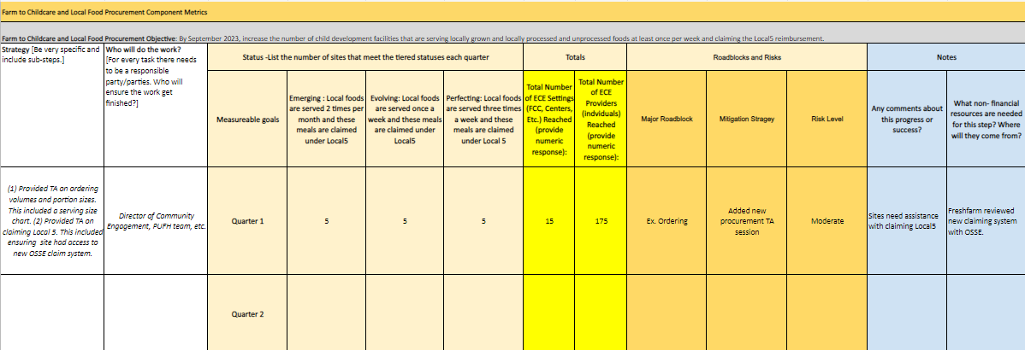
Metric tabs (instructions)
Completed example from Farm to Childcare and Local Food Procurement Component:
Notes:
Now that I've provided an overview of the metric tool and instructions for completing it, lets look at mock example of a completed one for Farm to Childcare and Local Food Procurement Component:
Under strategy the strategy column, specific steps and sub steps are provided. For example, (1) Provided TA on ordering volumes and portion sizes. This included a serving size chart. (2) Provided TA on claiming Local 5. This included ensuring site had access to new OSSE claim system.
Relevant staff doing the work includes: Director of Community Engagement, PUFH team, etc
And for the first quarter, theres 5 sites under each progress indicator status of emerging, evolving and perfecting for a total of 15 sites. 175 children were reached.
Ordering was listed a major roadblock. A new procurement TA sessions for sites was provided as a mitigation strategy. Ordering was listed a moderate risk level. Notes and comments provided included noting that sites needed assistance with claiming Local5 and the grantee reviewed the claiming with OSSE.

Slide 34
Sustainability status tabs (instructions)
Tab # | Tab Name | Column Name | Directions
6-9 | Sustainability Status Chart Q1-4 | # of Sites | Add additional sites to meet program area requirement or number of sites you have.
 |  | Sustainability Plan (At grant submission) | Write brief description of sustainability plan from grant submission.
 |  | This plan is ... (Use dropdown) | Use this dropdown to indicate any edits to the goal listed as compared to how the goals are written in the plan submitted.
 |  | Major Risk of Roadblock (List) | Add any major risk or roadblock that affected your sustainability plan timeline at grant submission. Ex. Delays in sustainability plan schedule have been a result of ...
 |  | Mitigation Strategy (List) | Add any mitigation strategy used address unforeseen risks or roadblocks.
Notes:
The next part of the Metric and Sustainability tool is the sustainability status chart which will be completed for each quarter. Grantees will respond to the same questions and prompts listed on this slide and continued on the next slide each quarter.
Each quarter, grantees will complete this information for each of their sites whether is the required 7 or 15 sites for program area.
Grantees will provide a brief description of sustainability plan from grant submission, indicate if the sustainability plan is the same or has been modified, Add any major risk or roadblock that affected your sustainability plan timeline at grant submission and Add any mitigation strategy used address unforeseen risks or roadblocks. Some columns prompts will require an open text response or have a drop down of option responses to choose from.

Slide 35
Sustainability status tabs (instructions cont)
Tab # | Tab Name | Column Name | Directions
6-9 | Sustainability Status Chart Q1-4 | Edit Date | Indicate the date the date the goal was updated.
 |  | Quarter 1-4 Status | Enter one of the four status options below from the drop-down: (1) On Track: Goal is on track to be achieved; (2) Not Started Yet: Activities toward this goal have not been started; (3) Off Track: Goal is off track of original timeline and (4) Completed.
 |  | Start | Enter the start date of sustainability plan.
 |  | End | Enter end date of sustainability plan.
Notes:
These are the last four columns and prompts to respond to in the sustainability status tab. Grantees will provide their edit date,
Enter one of the four status options below from the drop-down: (1) On Track: Goal is on track to be achieved; (2) Not Started Yet: Activities toward this goal have not been started; (3) Off Track: Goal is off track of original timeline and (4) Completed.
And enter the start and end date pf their sustainability plan.

Slide 36
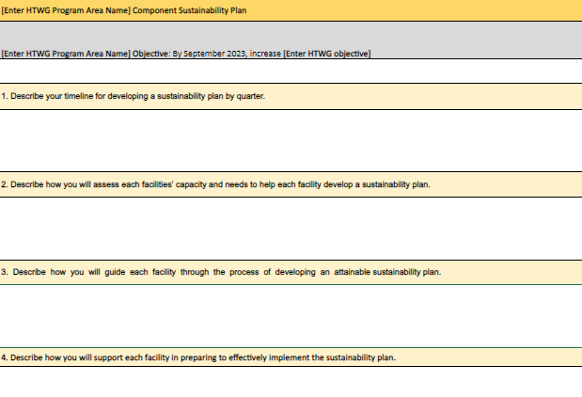
Sustainability Plan (instructions)
Notes:
Grantees will also be required to Answer these four questions for their sustainability plan. This activity will only be done once.
This template can be customized for each program area by including your grant's focus area's name.
Grantees will describe their timeline for developing a sustainability plan by quarter, (2) Describe how you will assess each facilities’ capacity and needs to help each facility develop a sustainability plan., (3) Describe how you will guide each facility through the process of developing an attainable sustainability plan and (4) Describe how you will support each facility in preparing to effectively implement the sustainability plan..

Slide 37
Sustainability tab (instructions)
Completed example:
Note: The drop down for second fillable column and the quarterly status columns.
Notes:
Now lets looks a completed sustainability status tab from the tool. Here you can see that 5 sites are listed as an example, you will need to add rows and list all your required site; 7 for outdoor learning and staff wellness and 15 for local foods. Once the tools is shared, let OSSE know if you need any assistance with editing the document.
For the list column grantees can add their sustainability plan from submission, use the drop down for the second column. For this example, new/not included was selected, staffing was listed as a risk of roadblock. Under mitigtaion straetgy, grantees can write In a strategy used then select whether their plan was edited. Here since the sustainability plan being used is different from submission then Y for yes is selected. Edit date is provided.
Then the status for each quarter is completed. This column has the option to ue the drop down tab for different statues. Lastly a start and end date is provided.

Slide 38
Question Break
Notes:
Let's take a pause now to digest all the new information and content I just covered.
Now is time for another question break.

Slide 39
Reporting and
Site Visits
Notes:
Thanks again for all the great questions.
Lets move into the reporting and site visit section and requirements.

Slide 40
Reporting Documentation
MOU with each site providing services
Time logs of Technical Assistance provided
Sign in sheets from training and events. Sign in sheets must include
Date and name of training of event
name and signature of each participant
Satisfaction Survey after each training/event
Short knowledge/behavior assessment after each training session, family engagement event, etc.
Financial records of all expenses (keep ALL receipts, invoices, etc)
Pictures, videos from trainings and activities (including media releases)
Quotes from teachers, parents, and other stakeholders about trainings and event
Quarterly report including OSSE metric and sustainability tool
Notes:
Listed here are the reporting document

Slide 41
Year 1 Reporting Requirements
You will need to submit signed copies of the MOU with each childcare facility you are working with
Copies of time logs, sign in sheets, assessments/survey results (raw data and summary) are due at the same time as the reports (1 set for mid project and 1 set for end of year 1 report)
HTA needs assessment and post assessment
Pictures, videos, quotes are submitted with the end of year 1 report
Financial records are due when you submit reimbursement requests
Per Quarter - grantees will be required to attend a meeting with OSSE
Opportunity to share their learnings, highlight successes, discuss and problem-solve challenges, collaborate with other grantees, and receive technical assistance from OSSE
OSSE will host a culminating meeting at the end of the award period to showcase the overall work and accomplishments of the grant
Grantees will be required to submit regular reports for OSSE to track the grantee’s performance
Submit a final report on the effectiveness of the grant activity
Notes:
Additional information on reporting requirements is provided as well.

Slide 42
Tracking Expenses &
Submitting Reimbursement Requests
Notes:
Expenses and reimbursement requests will be completed through EGMS. Since grantees have done this in the past we will hold a separate shorter check in about reimbursement requests.
Test environment: https://ossetest.mtwgms.org/WDCosseGMSWeb/GMSLogon.aspx
Login: OCIO-DA
PW: Test@1234
Click GMS Access Select
Select Sela PCS
Scroll down to Available and select Healthy Tots Wellness Grant

Slide 43
Reapplication Process Overview
Notes:
Now that weve covered what required for year one, lets discuss what required for reapplication.

Slide 44
What will be required for re-application?
Application will open late summer 2023
Intended award date October 1, 2023
Application Materials required (subject to change)
Detailed planning expenditures for FY2024
Budget justification narrative for FY2024
Program Timeline for FY2024
Program Participation Table for FY2024
Performance indicators (similar to worksheet)
Program sustainability plan
Interest of Services Forms for any additional centers
Notes:
Read slide information.

Slide 45
Important Dates
Notes:
Next lets review important key dates to remember.

Slide 46
Important Dates to Remember
Action Item | Due Date
Timeline and Performance Indicators | June 30, 2023
Signed MOU by each center | July 1, 2023
Site visit confirmation | June 16, 2023
Site Visit 1 Scheduled | June 30, 2023
Site Visit 2 Scheduled | Sept. 1, 2023
Year 1 Mid-project report | June 30, 2023
Year 1 project expense records | June 30, 2023
End of year 1 project report | September 30, 2023
End of year 1 invoices and expenses records due for July 1-September 30 | October 15, 2023
Notes:
Here's dates to add to your calendars.
Read the dates and action items
OSSE will work with grantees to schedule site visits.

Slide 47
Notes:
Now we have time for our last question break. You can come off mute to asks any questions on this last section.

Slide 48
Resources
OSSE WEBSITE: FY2023 Informational Materials | osse (dc.gov)
LEGISLATION: Healthy Tots Act Part 1 (pages 45-49) Healthy Tots Act Part 2 (HTA CACFP Participation Waiver) (pages 98-99)
GUIDANCE: OSSE: A Step by Step Guide for Implementing Wellness Guidelines in Child Development Facilities
Notes:
Thanks for all of the great questions. If we were not able to answer one of your questions we will reach out to you specifically or send out an email to all grantees.
Listed here are great resourcesfor implementing wellness in ECs and a link to the Healthy Tots legislation.

Slide 49
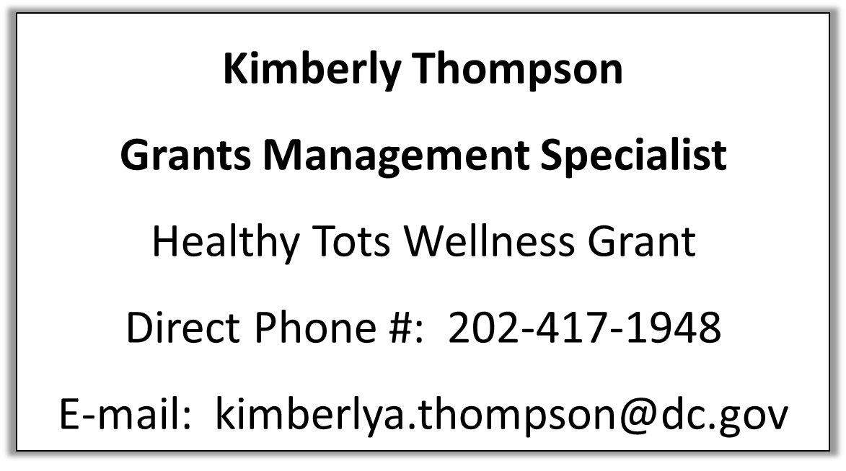
Healthy Tots Wellness Grant Point of Contact
Contact for questions about the grant including requirements, schedule, reporting, etc.
Notes:
If you have any questions about requirements or schedling reporting here is my contact information.

Slide 50
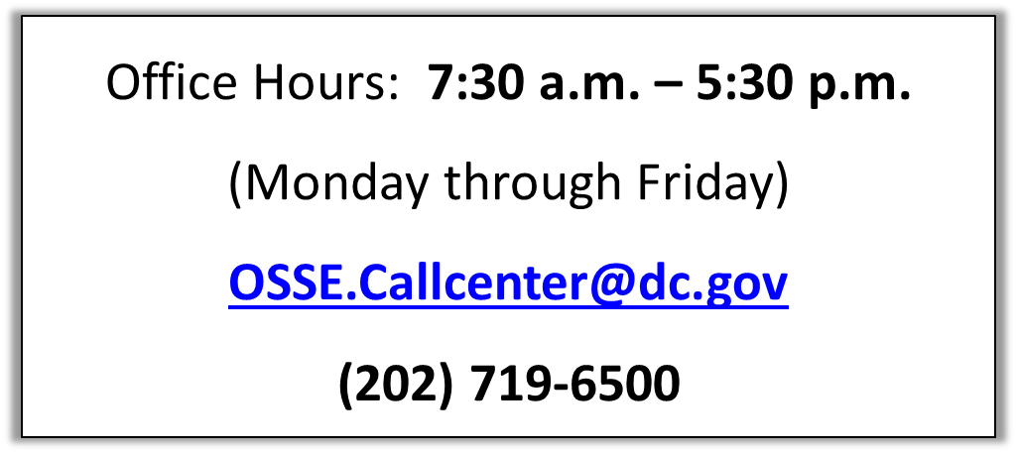
EGMS Technical Support
Please contact the OSSE Customer Service team if you experience technical issues and/or have any questions regarding EGMS as follows:
Notes:
Additionally, you may encounter Technical issues such as not being able to type or submit something in EGMS. The situations may involve contact EGMS or submitting a ticket to OSSEs call center.
Any other Questions should be directed to Suzanne or I .

Slide 51
Notes:
I just want to say thank you for attending the training today. I am so excited to have all three wonderful organizations as grantees and cant wait to get started on our work.
Suzanne – do you want to add anything else?

