Slide 1
Before we get started…
A copy of today’s webinar slides will be posted to http://osse.dc.gov/parcc/leas/2015-16resources.
During the webinar, participants are encouraged to ask questions by typing in the question box.
A follow-up email will be sent to all participants that will include the link to the recording and address any follow-up items.

Slide 2
OSSE Support Tool
New User Training for
LEA Assessment Coordinators
Division of Data, Assessment, and Research
March 2016

Slide 3
OSSE Support Tool for Assessment in 2016
This spring, OSSE’s assessment team will use the OSSE Support Tool (OST) to communicate securely with LEAs, receive documentation and track/respond to LEA questions during testing.
We are using the OST to collect documentation from LEAs securely, to flag issues on specific student tests in a secure venue and allow LEAs to track their open issues and responses from the OSSE in one place, so nothing gets lost in an email.
We will commit to answering questions as soon as possible, but we will prioritize questions from schools actively testing and potential test integrity concerns.

Slide 4
Who to Call During Testing
For Technology Questions on PARCC contact Pearson:
PARCC/Pearson Customer Support 1-888-493-9888
Monday - Friday, 6:30 am - 7:30 pm (EST)
Live chat available at dc.pearsonaccessnext.com
PARCC E-mail: parcc@support.pearson.com
For policy questions, general guidance, incident reporting and to escalate Pearson tickets contact OSSE assessment team via OSSE Support Tool (OST) or at 202-304-3269 PARCC resources: http://parcc.pearson.com/
OSSE resources: http://osse.dc.gov/parcc/leas/2015-16resources

Slide 5
Examples of OST Use During Assessments
Submissions requiring OSSE approval/confirmation of submissions:
Submit school security plans 15 calendar days prior to assessments
Submit test security incident reports, medical exemption requests, unique accommodations requests
Submit affidavits after testing
Technical assistance and customer service, response will be prioritized by urgency/severity:
Ask a policy/administration question about a specific assessment
Request that a test for a specific student be un-submitted or a test registration transferred between LEAs
Request technical assistance with Pearson Access Next tasks
Escalate a technical problem you have already reported to vendor customer support

Slide 6
OSSE Support Tool
Q: What is the purpose of the OST?
To provide a vehicle for LEAs to contact the state for support and technical assistance. During testing, it will be the best way to submit secure documentation on a variety of assessment issues. It has been used for SEDS questions and enrollment audit activities in the past.
Only the LEA Special Education Points of Contact (LEA SE POC), LEA Data Managers/Registrars, and LEA Assessment Coordinators should have access to the OST. Everyone with an LEA Coordinator level permission in Pearson Access Next was added as an OST user recently.
Q: Who should have access to the OST?
Q: How do I access the OST?
Login via https://octo.quickbase.com. New users should have recently received an invitation to join. If you are unable to login, email osse.assessment@dc.gov for assistance.

Slide 7
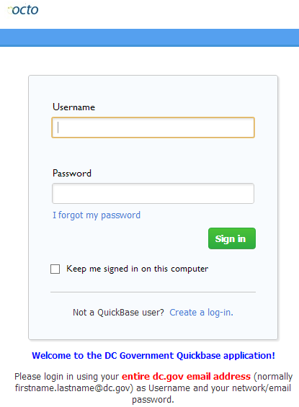
OSSE Support Tool
Access Requirements:
The OST can be accessed from:
https://octo.quickbase.com
A username and password is required to access the tool.
If you have used QuickBase in the past, use the same username and password. If this is your first time using QuickBase, click “Create a log-in”, complete the fields, and request access.
If you have not used Quickbase in the past, create a login. If you have difficulty logging in, email osse.assessment@dc.gov.

Slide 8
OSSE Support Tool
To send OSSE a question/issue/document, click on the “Add Request for Support” button.

Slide 9
OSSE Support Tool
Select the category that best describes your issue from the drop down box. A second drop-down box may appear asking for additional information.
The Assessments Issue Types

Slide 10
Summary of Assessment Topics in the OST
Assessments – Test Security Plan
Assessments – Medical Exemption Forms and Unique Accommodations
Assessments – Affidavits
Assessments – Incident Reports
Assessments – PARCC
Assessments – DC Science
Assessments – MSAA/DC Science Alt
Assessments – Other

Slide 11
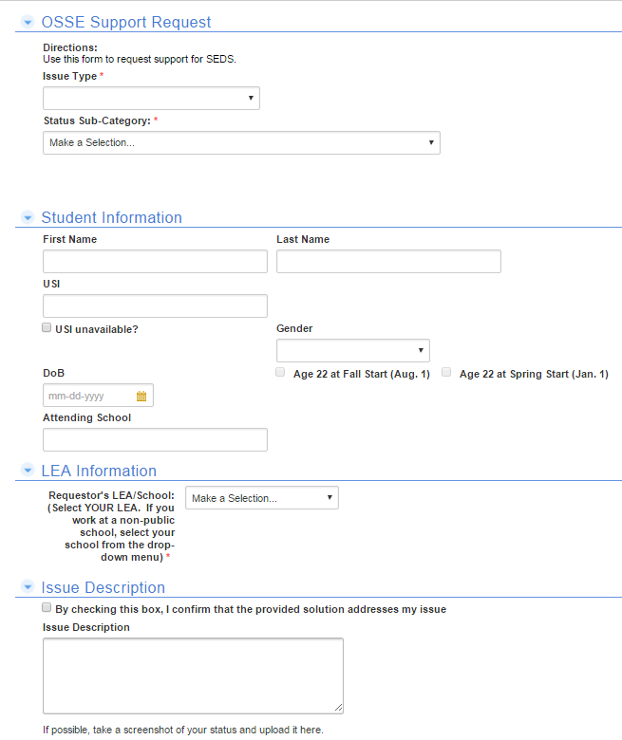
OSSE Support Tool
If your request involves a specific student, please complete the fields under ‘Student Information.’ If it involves multiple students, you can identify them later in “issues”.

Slide 12
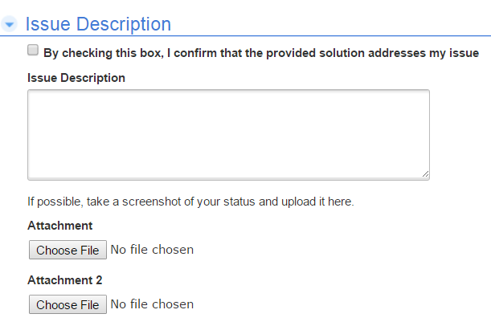
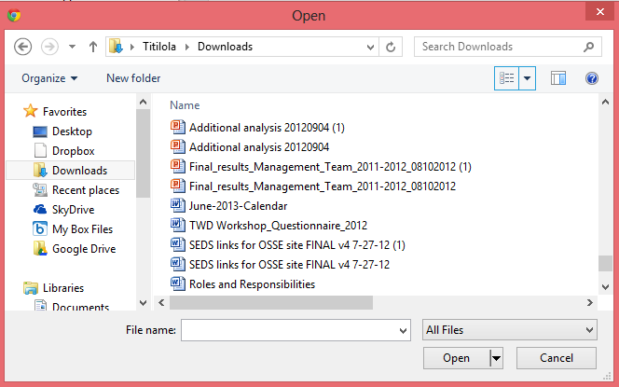
OSSE Support Tool
Enter a detailed description of the issue.
If necessary, a user may take a screenshot of the page in PearsonAccessNext where he/she is experiencing an issue to include in the Support Request. Never take a screenshot of test items.
To do this, click on , select the file/image from the user’s computer, and click “Open.”
The name of the file/image the user uploaded will appear.
Once the user has completed the request, click the button.
Click the button to return to the OST Homepage.

Slide 13
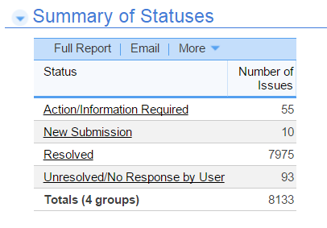
OSSE Support Tool
Once the user has successfully submitted a request for assistance, he/she should receive an email acknowledging receipt of the request.
An OSSE representative will review the request, then either ask the LEA for additional information or submit a resolution and await confirmation from the LEA.
When the status changes from “New Submission” to either “Action/Information Required” or “Resolved” the user will receive an email.

Slide 14
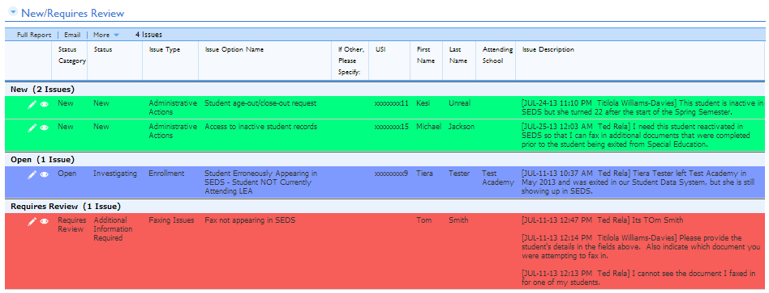
OSSE Support Tool
The “New/Requires Review” report displays requests that have been submitted at your LEA:
GREEN indicates that a request has been newly submitted and has not yet been reviewed by OSSE personnel.
RED indicates that a request has been reviewed by OSSE Personnel and requires additional information from the requestor.
GRAY Request has been closed due to no response from the requestor.

Slide 15
OSSE Support Tool
If a request is highlighted RED, the user must provide additional information.
To provide additional information, click on the edit icon ( ) next to the request.
In the “Issue Description” field, the original description submitted will appear in grey. Any additional questions entered by OSSE Personnel will also appear in grey.
Enter in any additional information that has been requested and provide more details regarding the issue. Click .

Slide 16
OSSE Support Tool
Once a request has been resolved, the request will appear under “Resolved Requests” and the resolution can be viewed under “Issue Description” where the resolution has been added.

Slide 17
OSSE Support Tool
Additional Documents for Support

Slide 18
Who to Call During Testing
For Technology Questions on PARCC contact Pearson:
PARCC/Pearson Customer Support 1-888-493-9888
Monday - Friday, 6:30 am - 7:30 pm (EST)
Live chat available at dc.pearsonaccessnext.com
PARCC E-mail: parcc@support.pearson.com
For policy questions, general guidance, incident reporting and to escalate Pearson tickets contact OSSE assessment team via OSSE Support Tool (OST) or at 202-304-3269 PARCC resources: http://parcc.pearson.com/
OSSE resources: http://osse.dc.gov/parcc/leas/2015-16resources

Slide 19
Questions?
Please submit a ticket through the OSSE Support Tool or email OSSE.Assessment@dc.gov.

